Slide 1
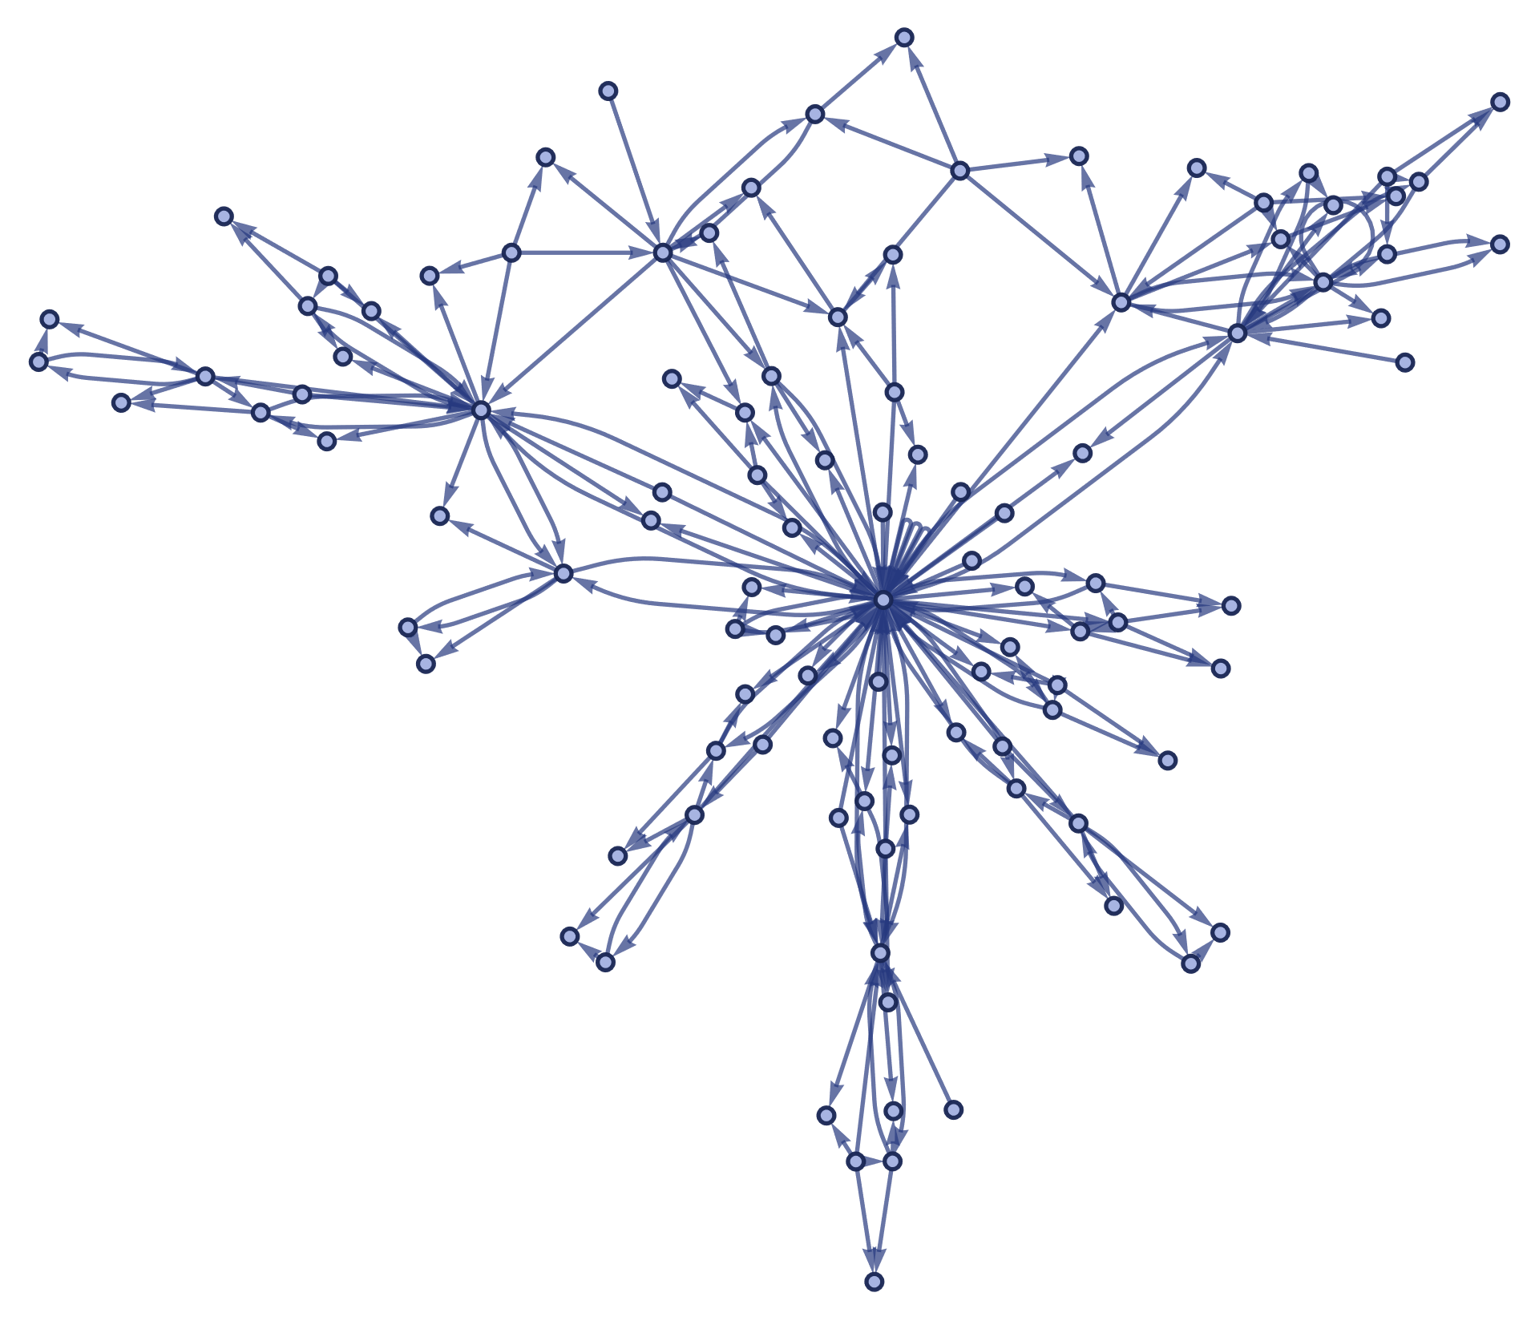
Graph Search Algorithms
Tang Anke

Slide 2
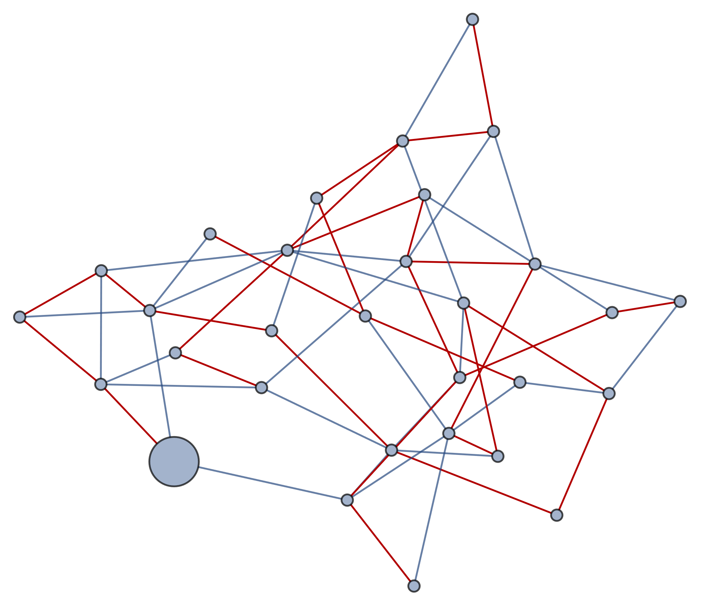
Depth First Search
Depth-first search (DFS) is an algorithm for traversing or searching tree or graph data structures. The algorithm starts at the root node (selecting some arbitrary node as the root node in the case of a graph) and explores as far as possible along each branch before backtracking.
A version of depth-first search was investigated in the 19th century by French mathematician Charles Pierre Trémaux as a strategy for solving mazes.

Slide 3
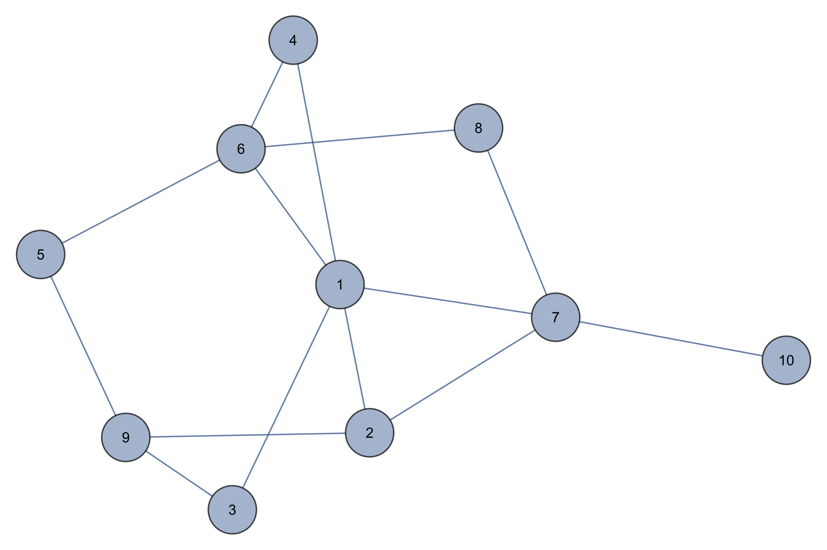
Depth First Search

Slide 4
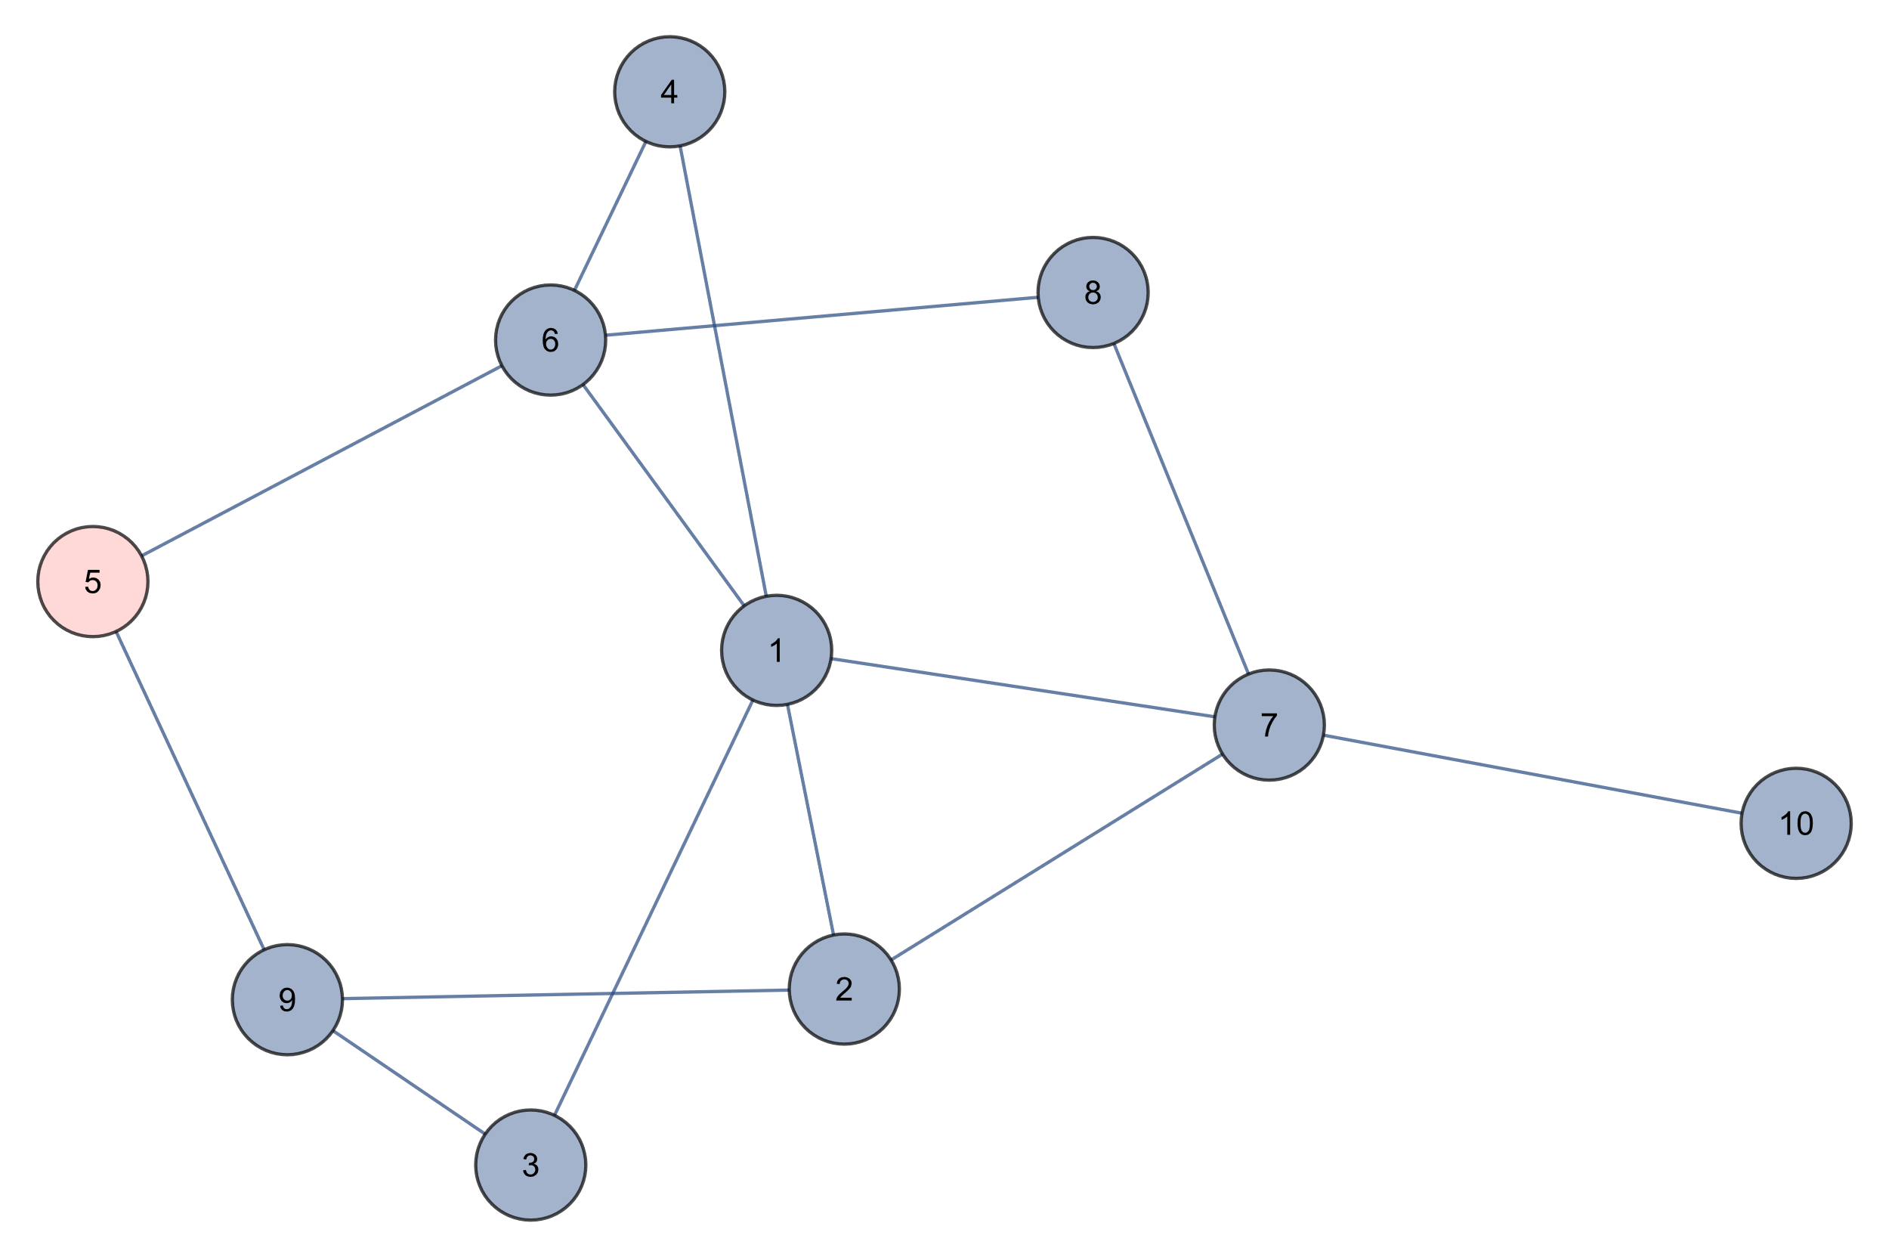
Depth First Search
5
STACK

Slide 5
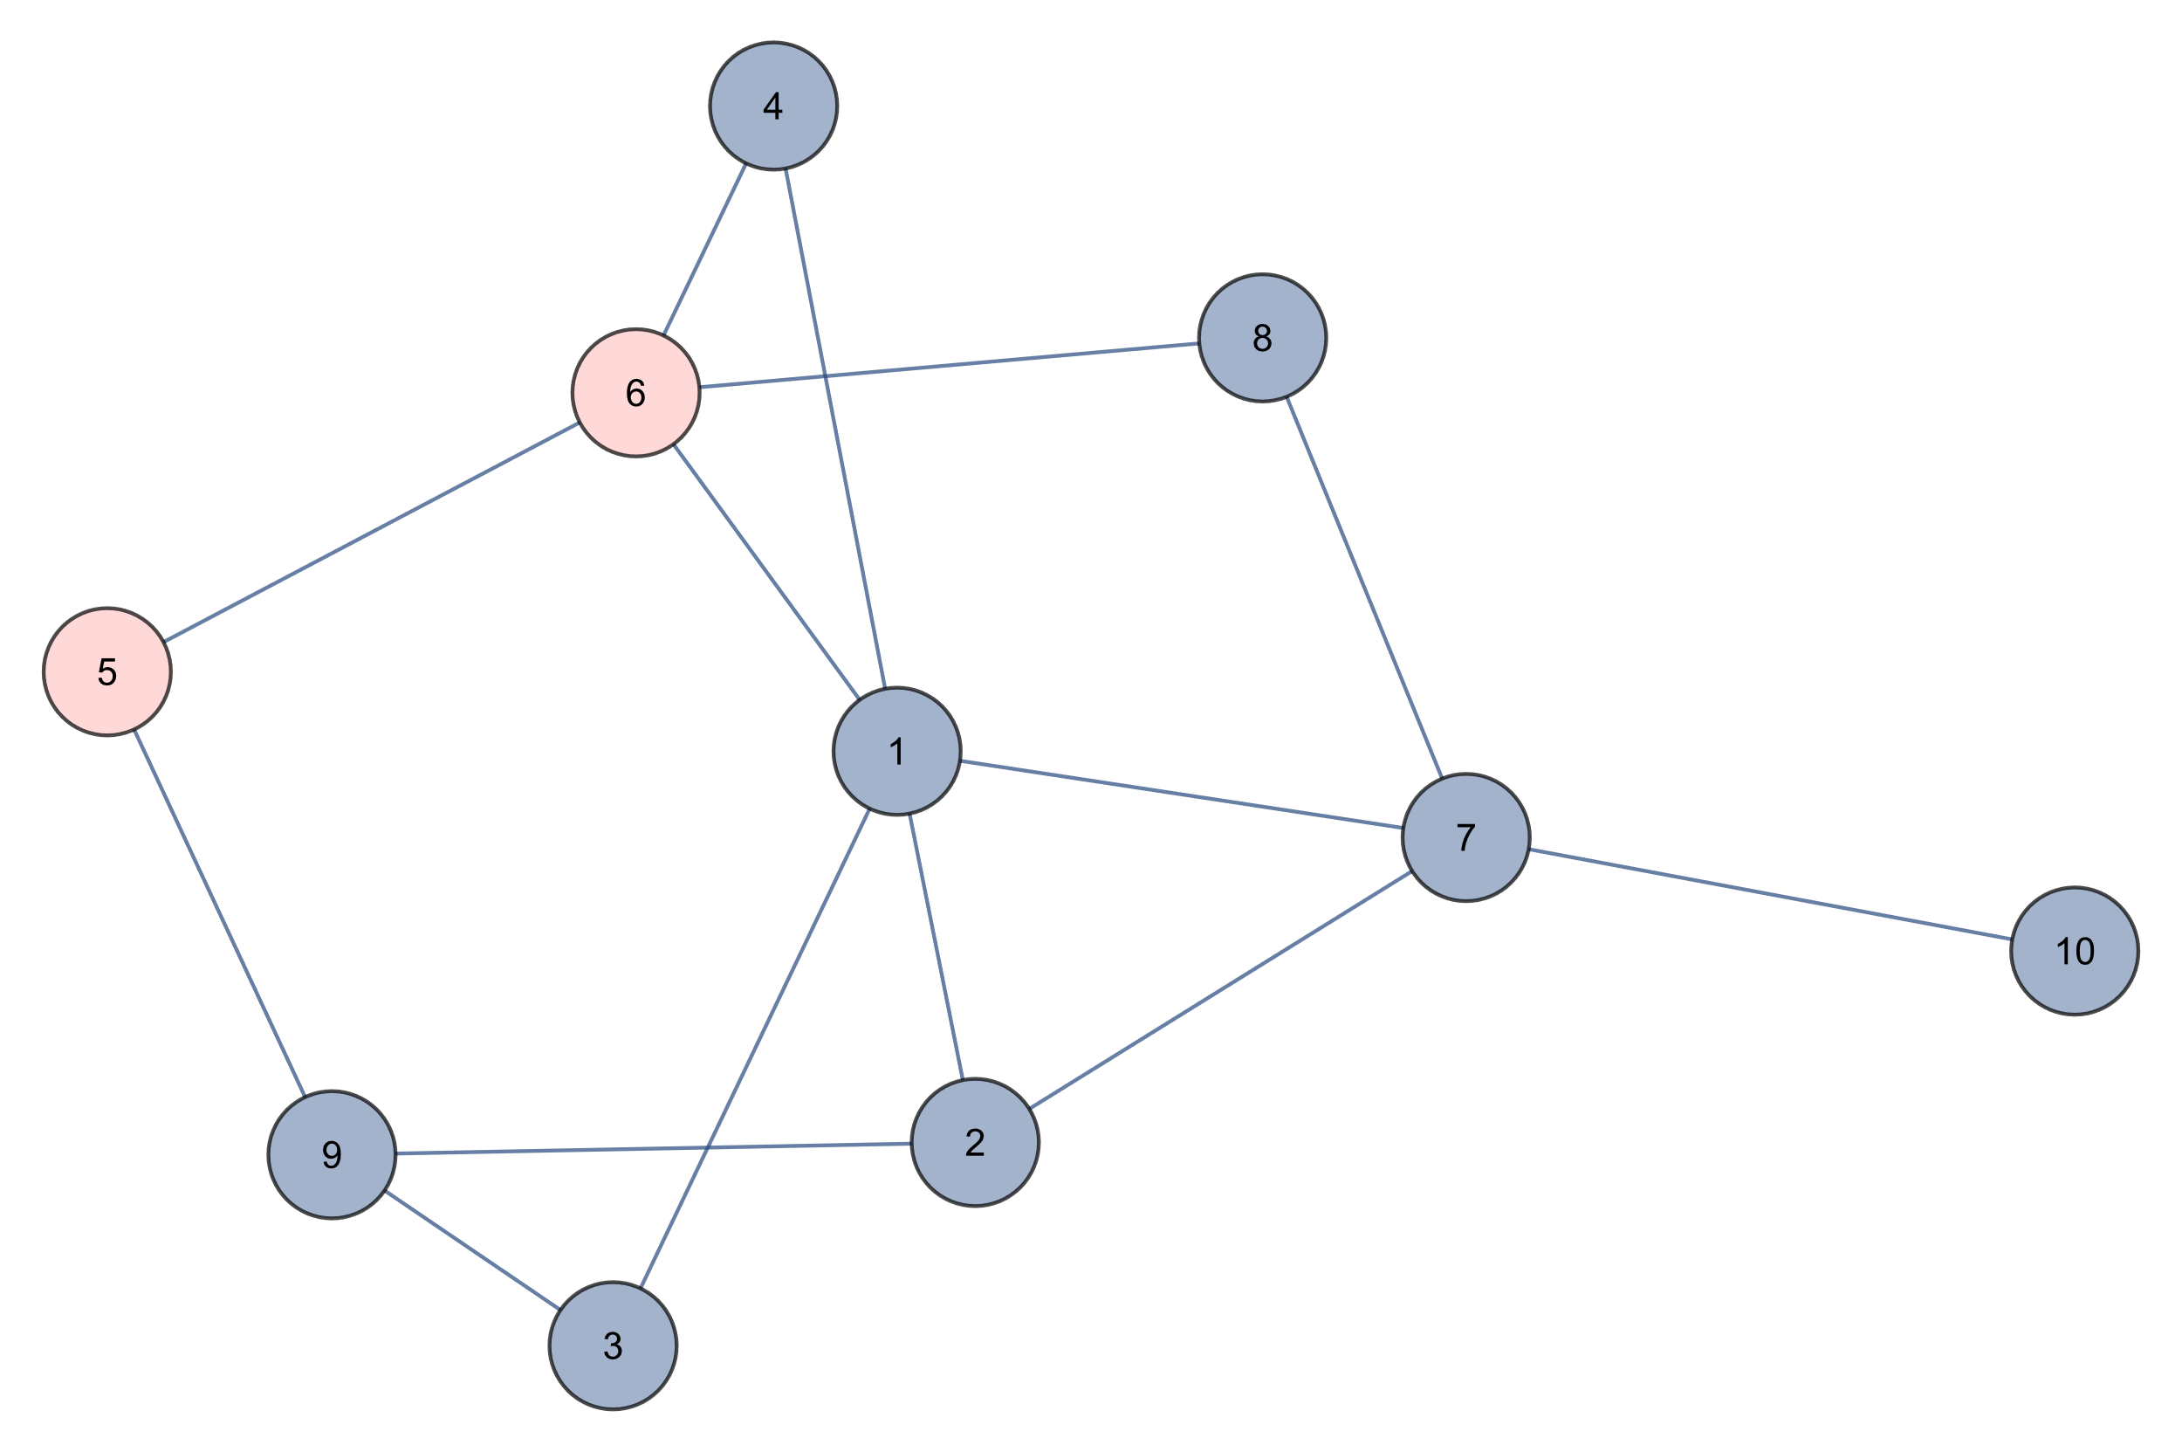
Depth First Search
5 6
STACK

Slide 6
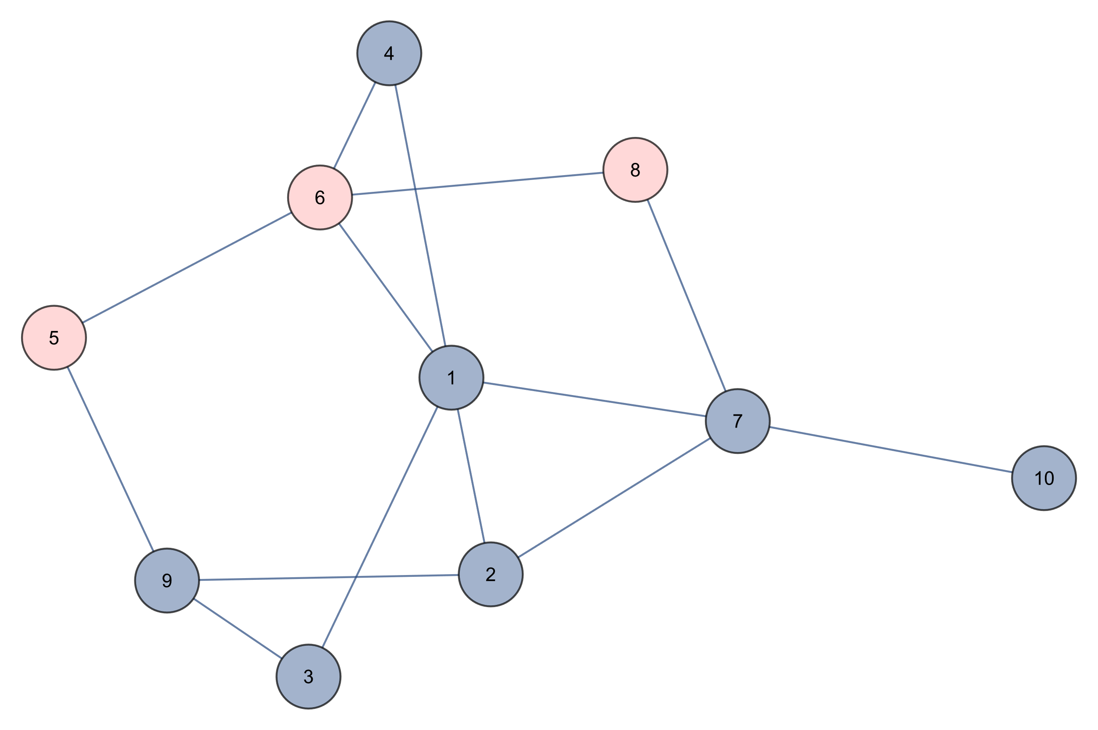
Depth First Search
5 6 8
STACK

Slide 7
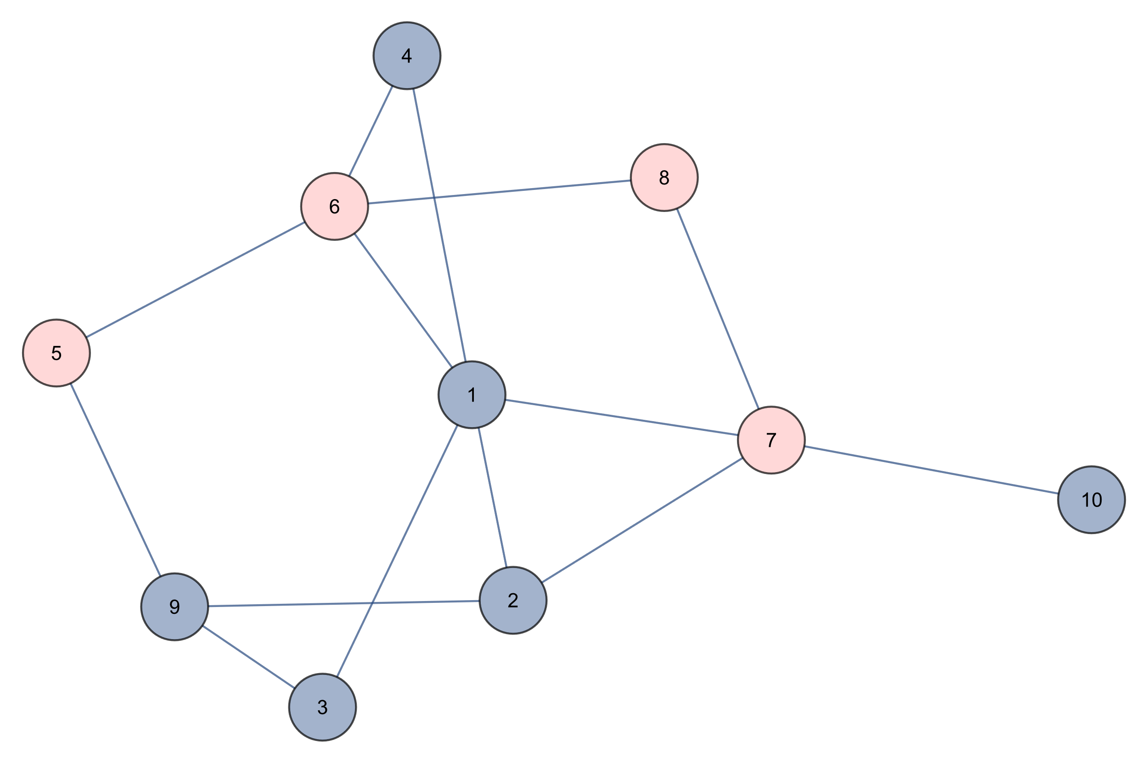
Depth First Search
5 6 8 7
STACK

Slide 8
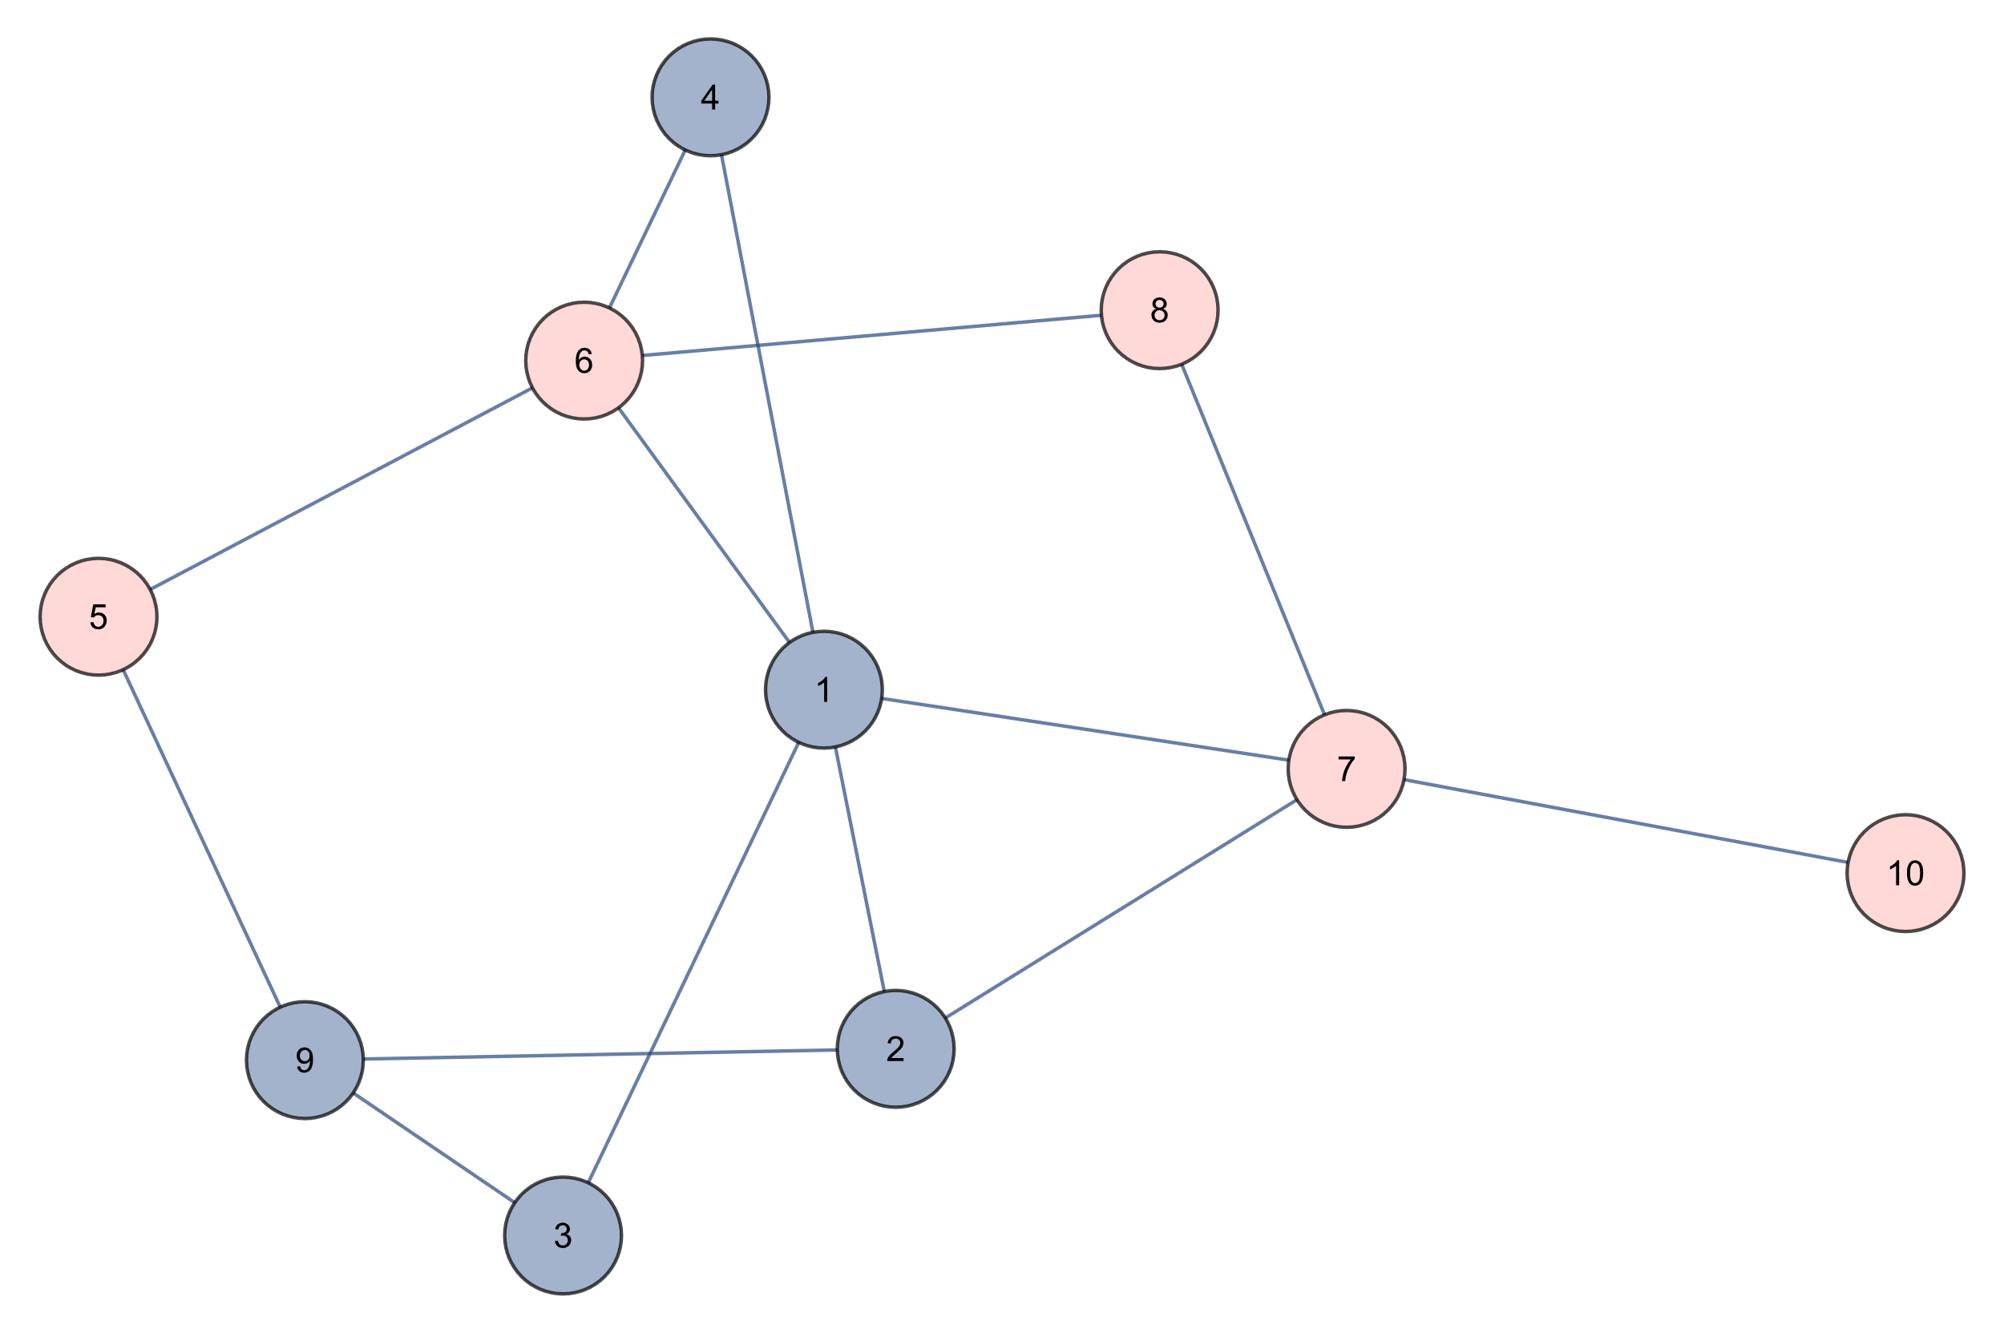
Depth First Search
5 6 8 7 10
STACK

Slide 9
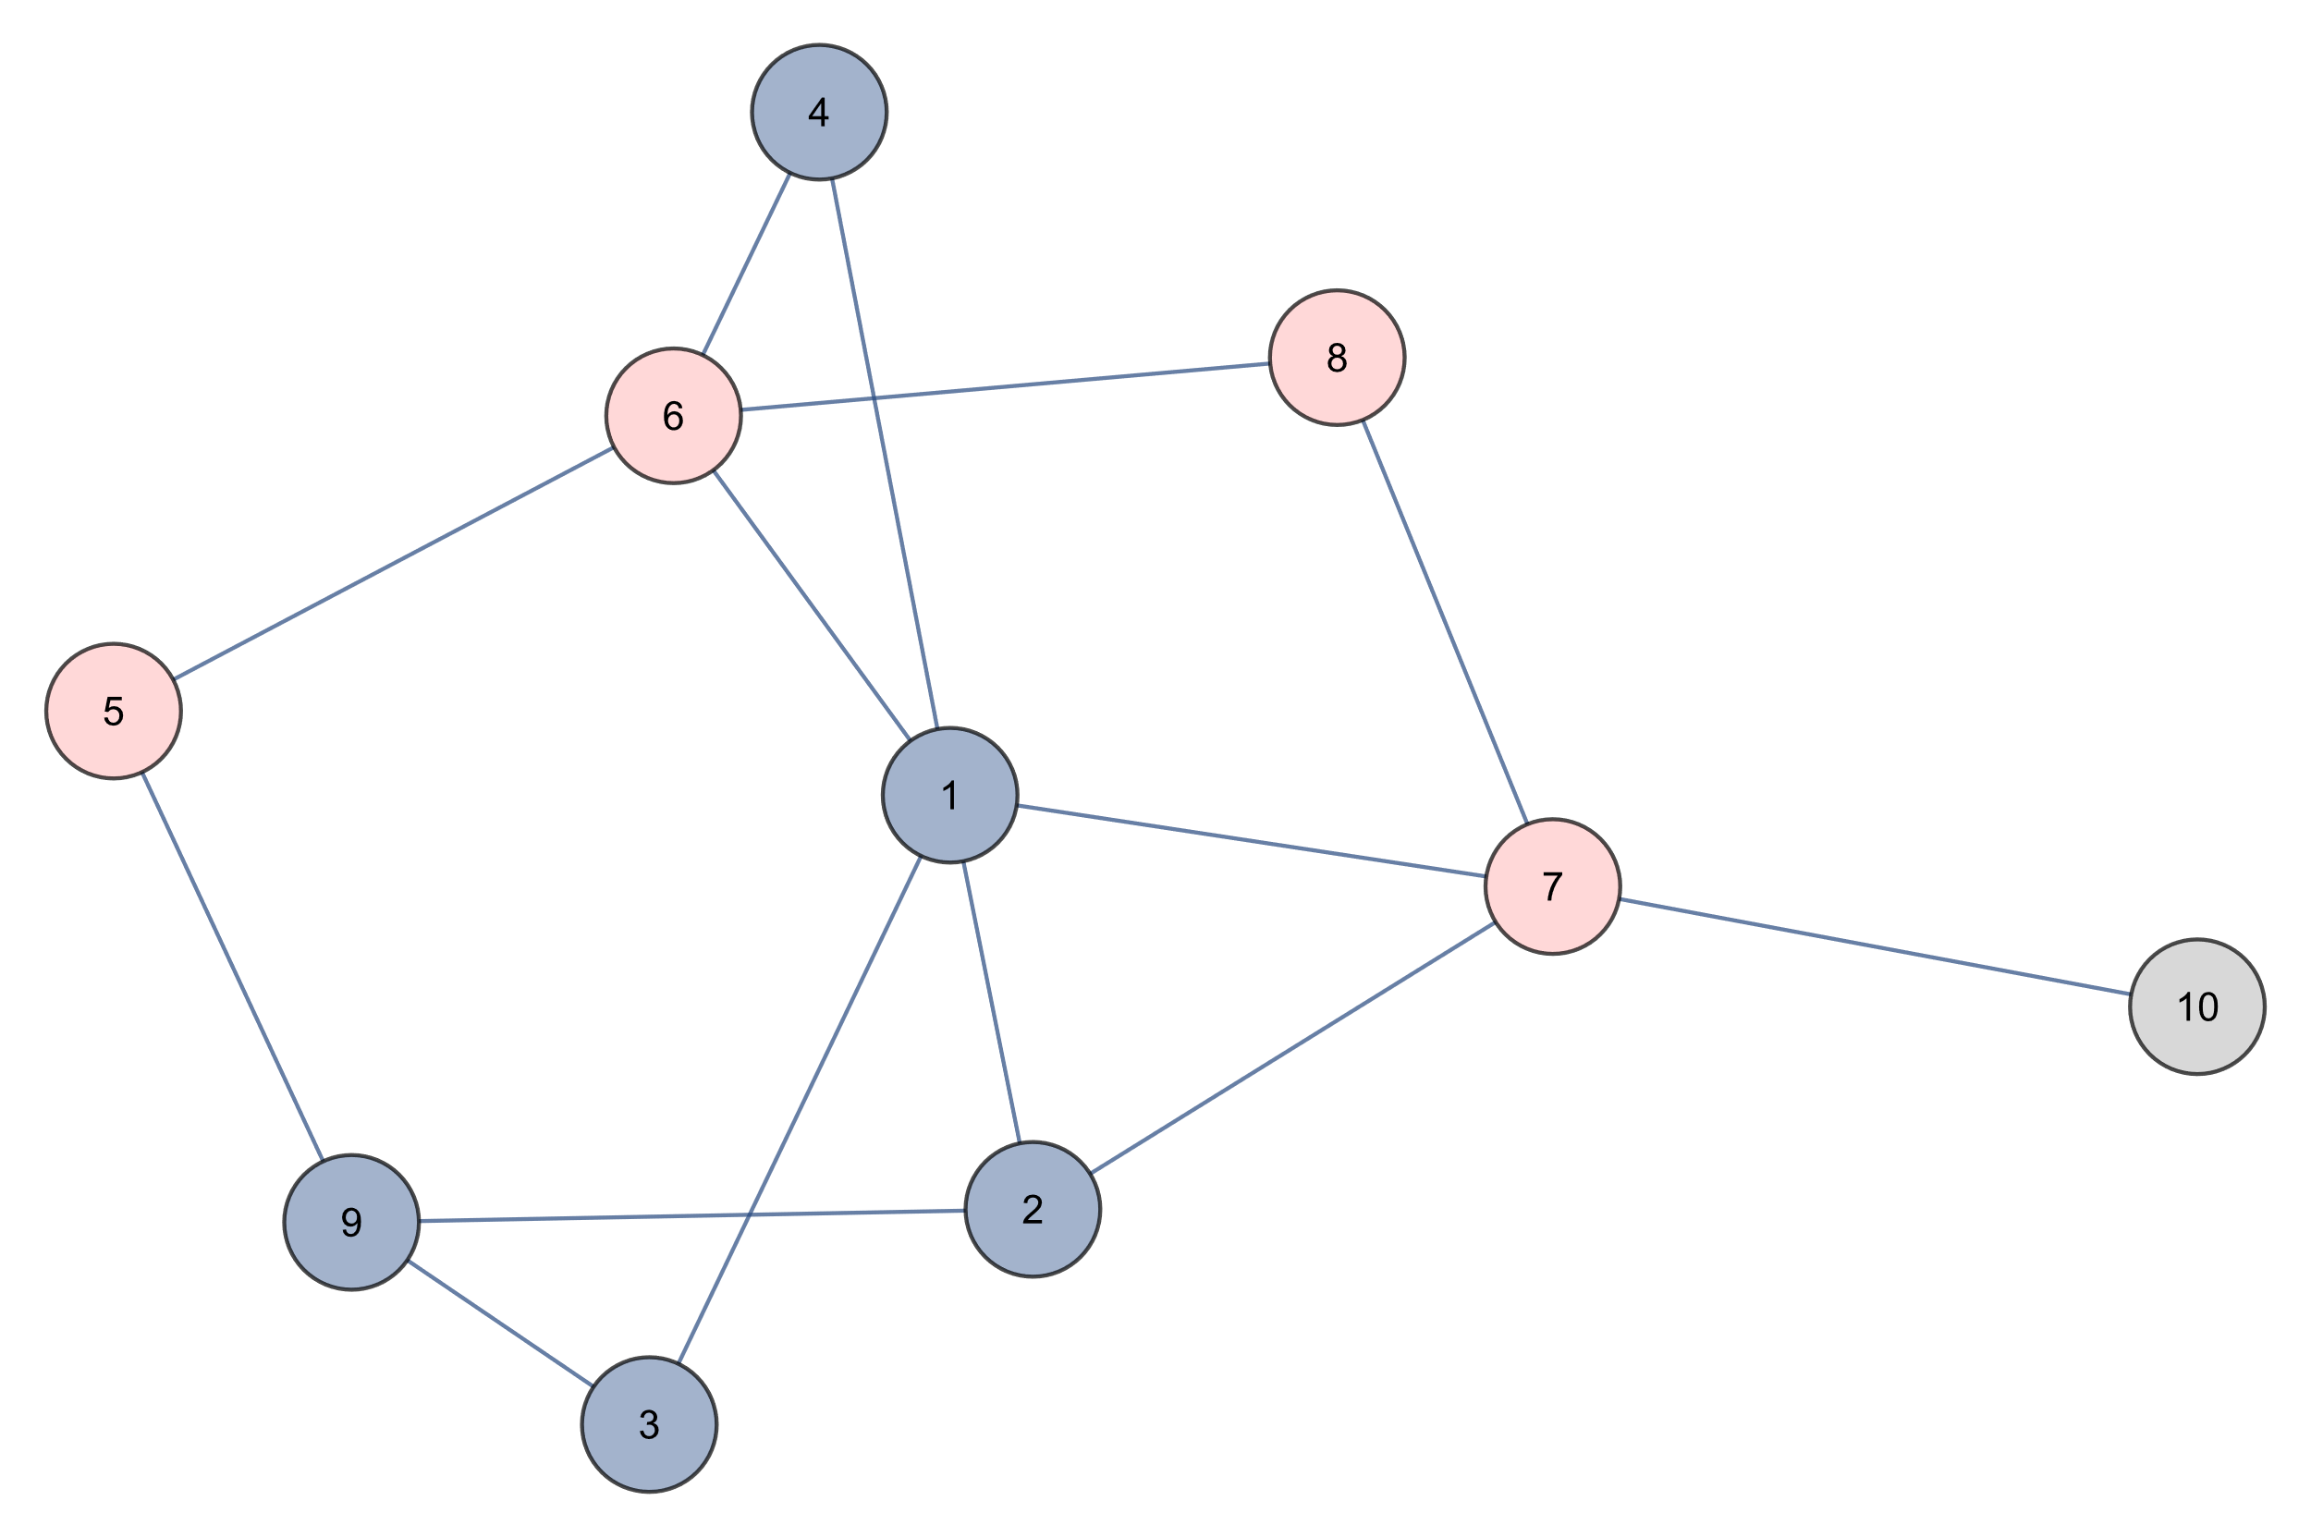
Depth First Search
5 6 8 7
STACK

Slide 10
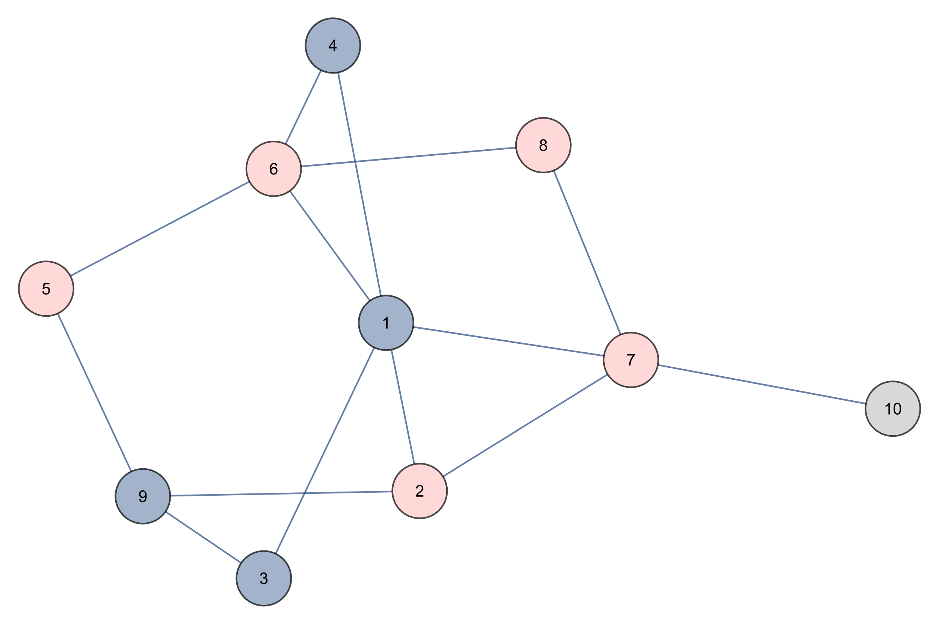
Depth First Search
5 6 8 7 2
STACK

Slide 11
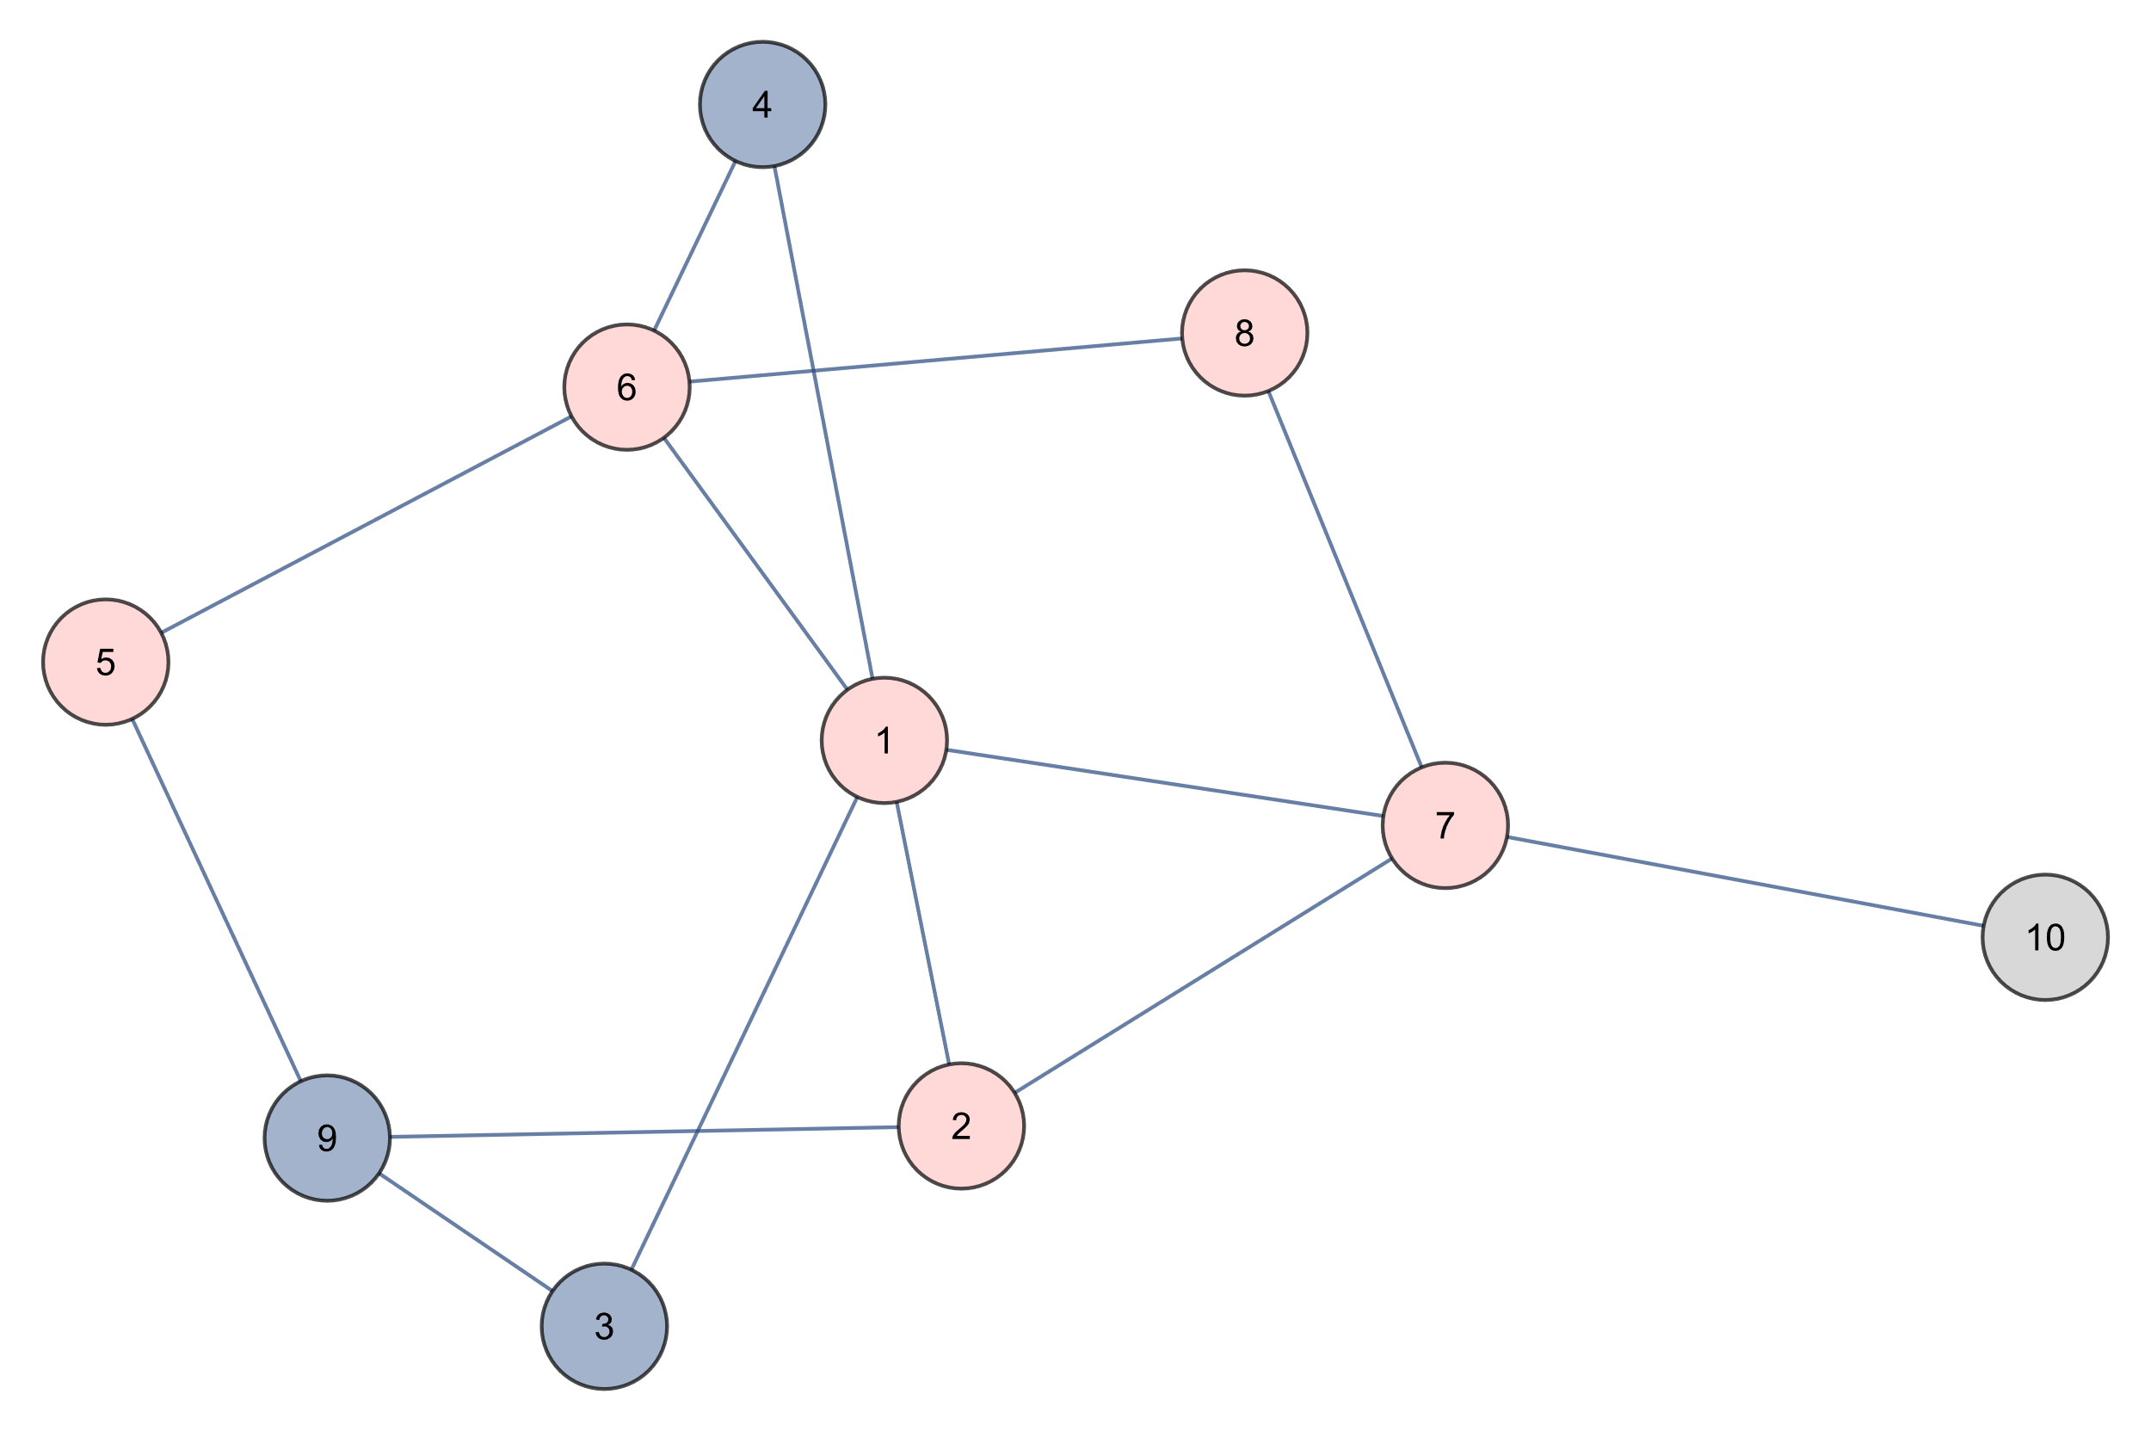
Depth First Search
5 6 8 7 2 1
STACK

Slide 12
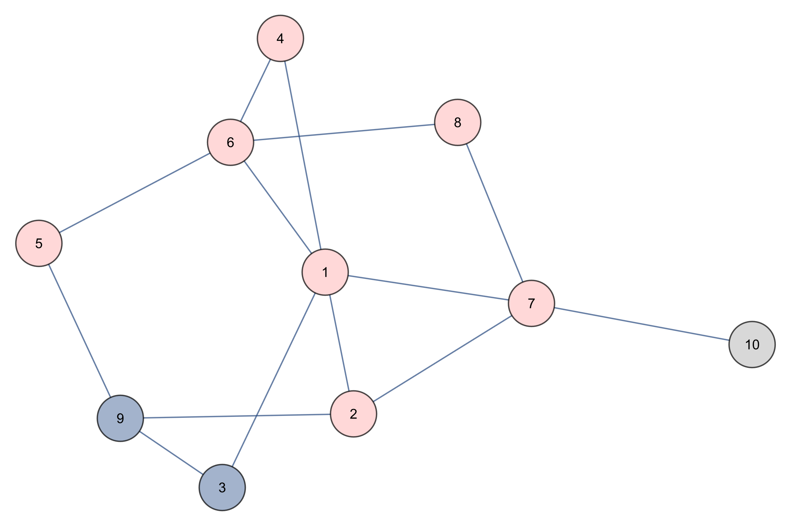
Depth First Search
5 6 8 7 2 1 4
STACK

Slide 13
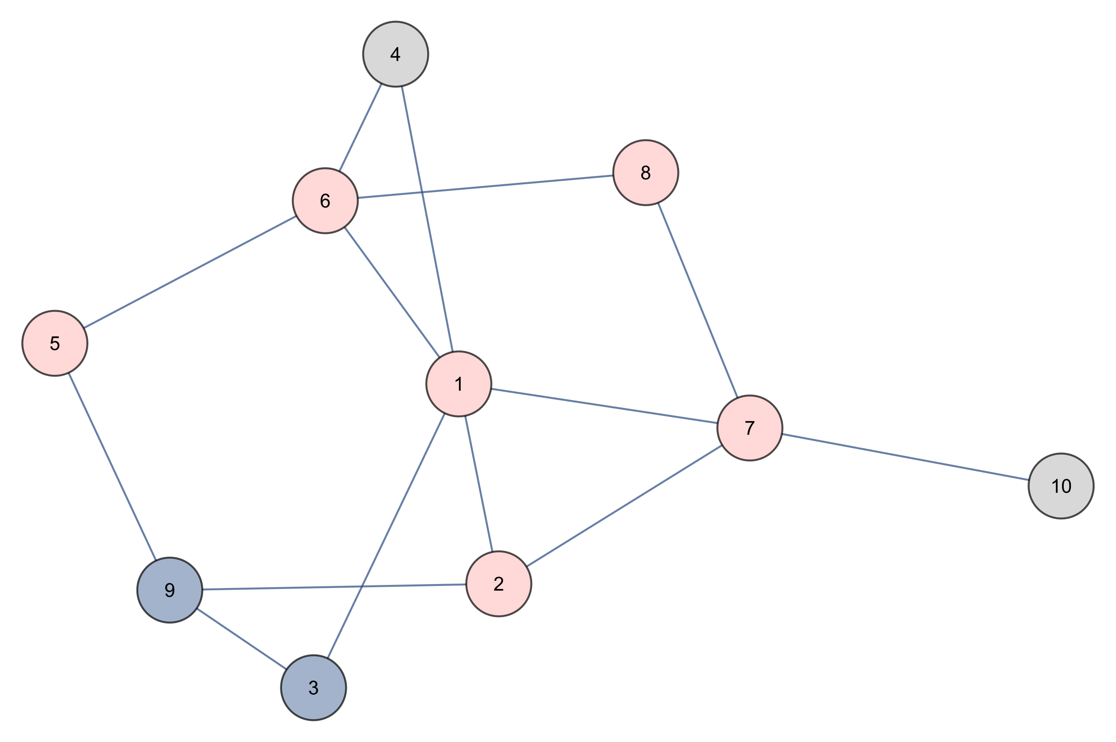
Depth First Search
5 6 8 7 2 1
STACK

Slide 14
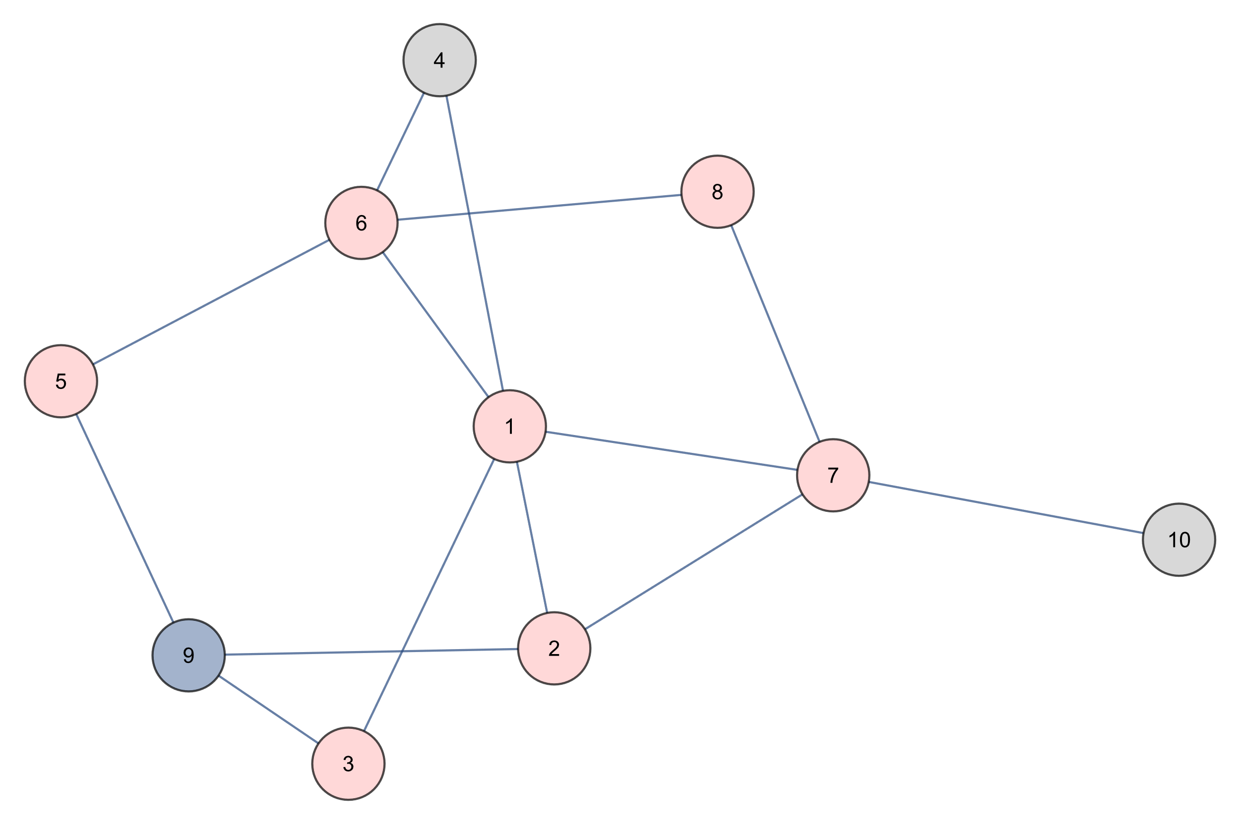
Depth First Search
5 6 8 7 2 1 3
STACK

Slide 15
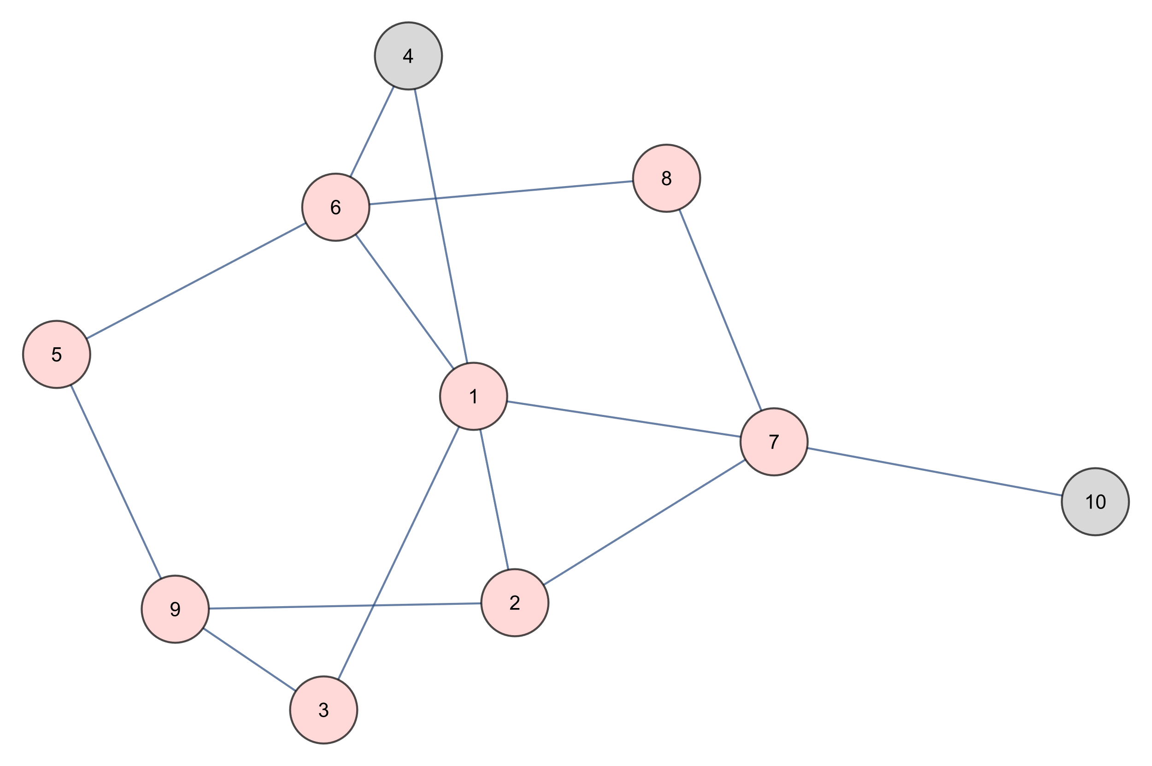
Depth First Search
5 6 8 7 2 1 3 9
STACK

Slide 16
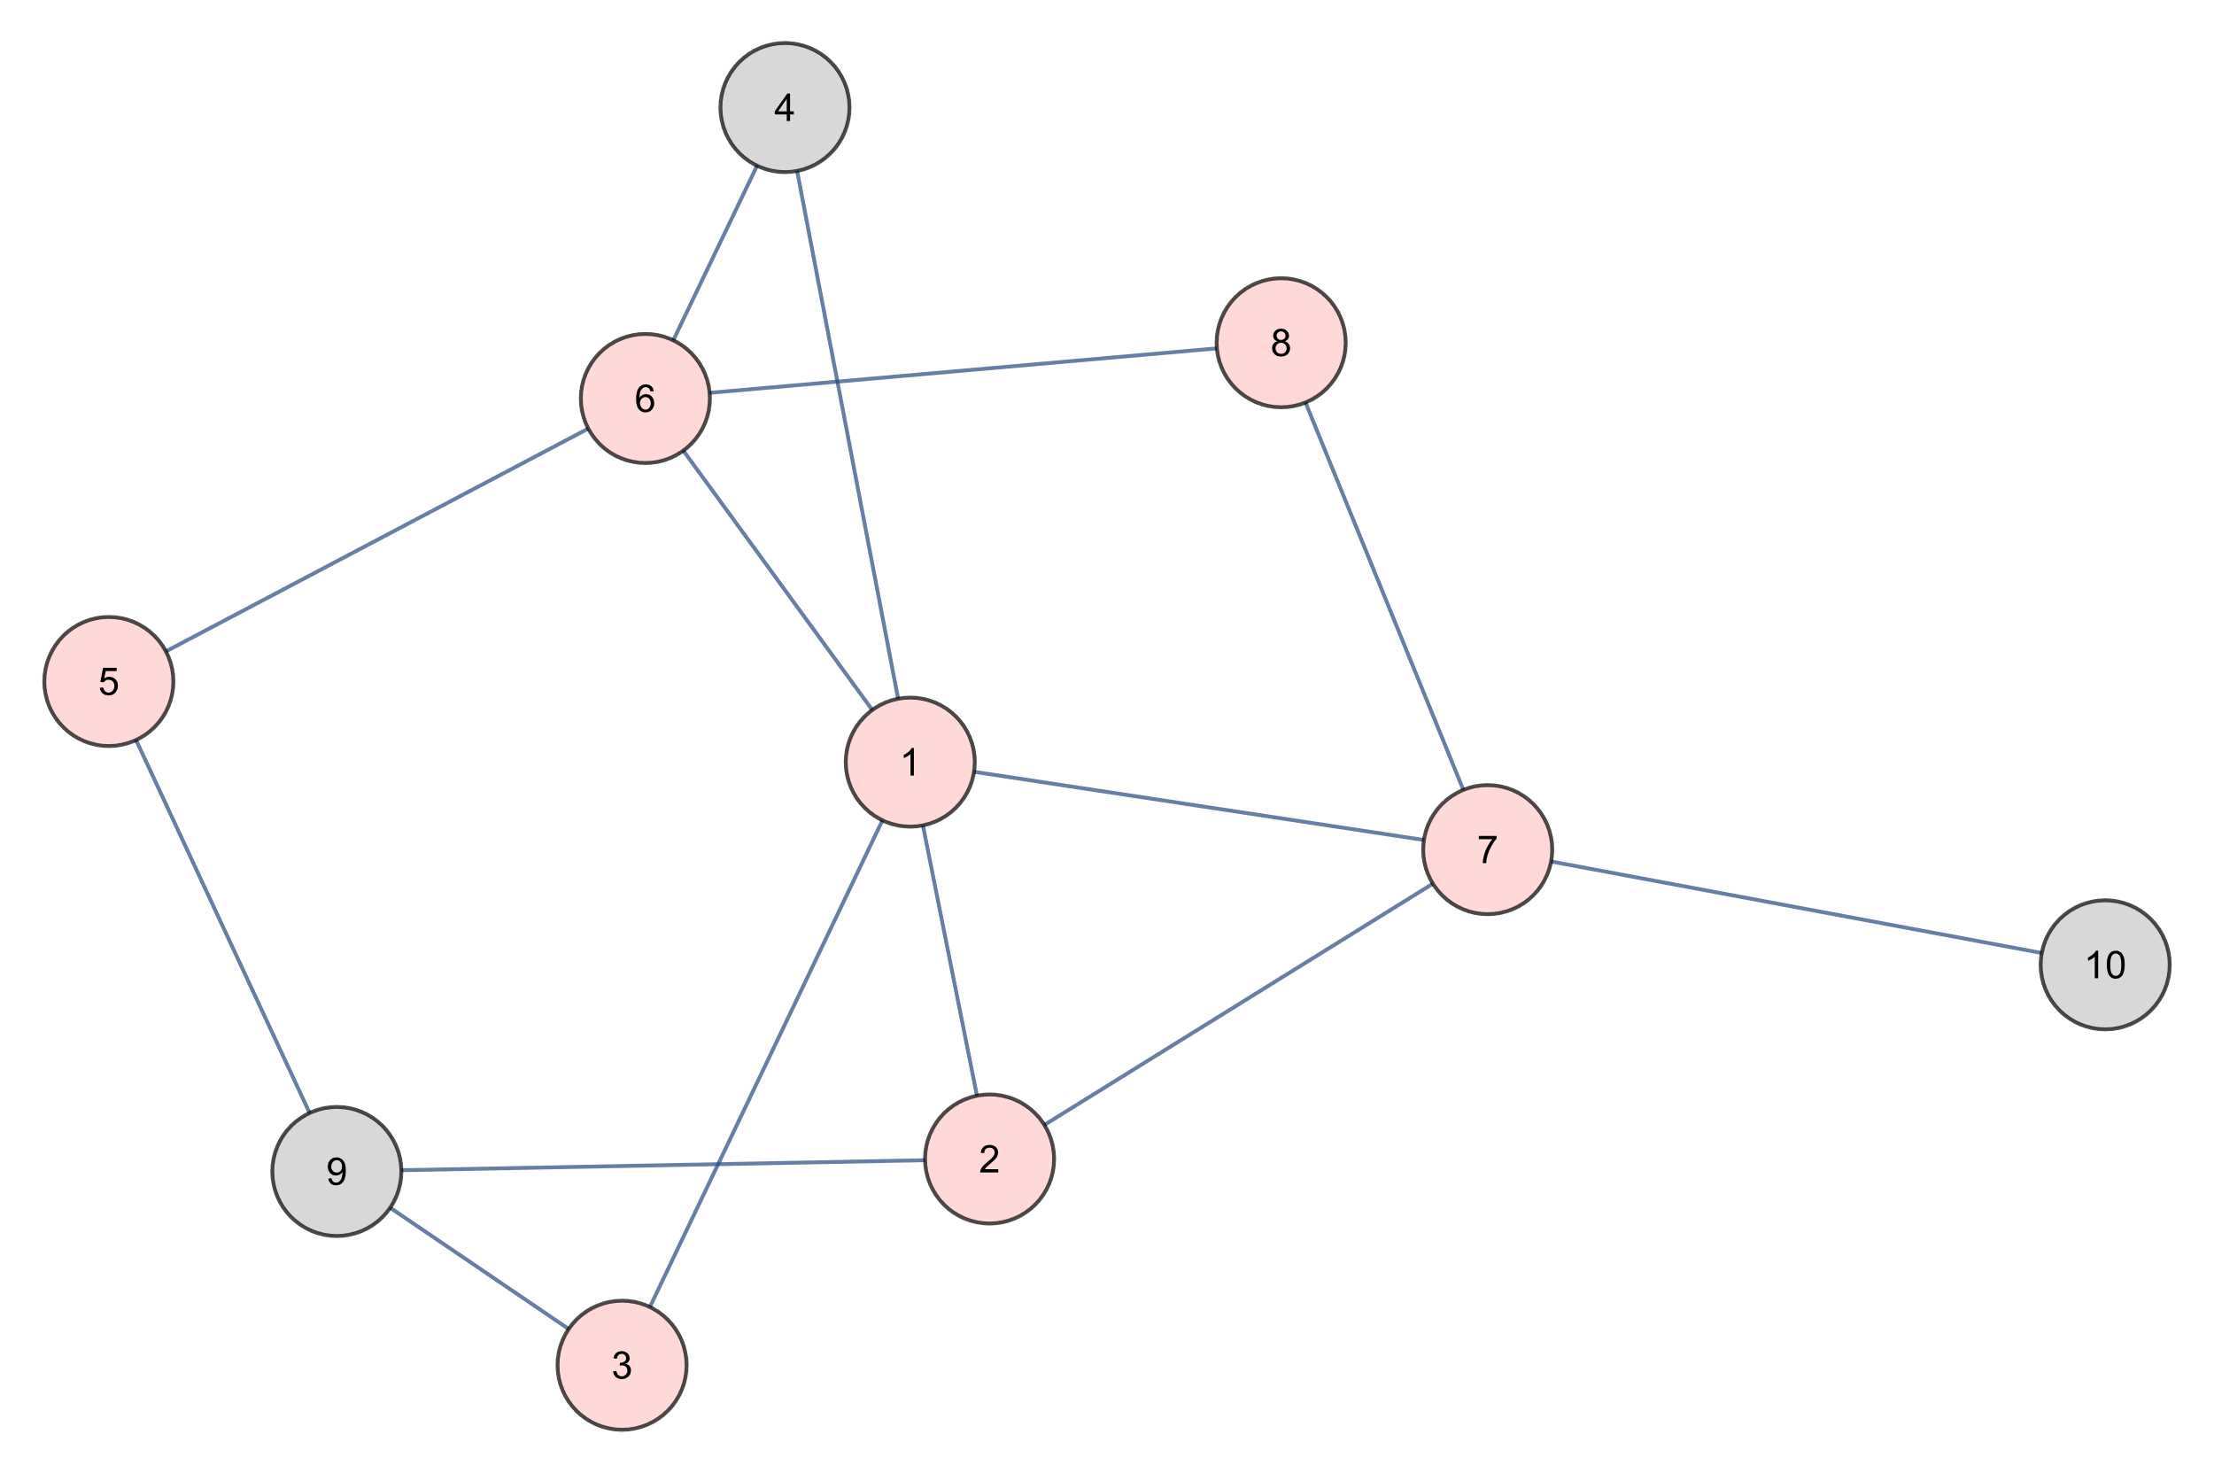
Depth First Search
5 6 8 7 2 1 3
STACK

Slide 17
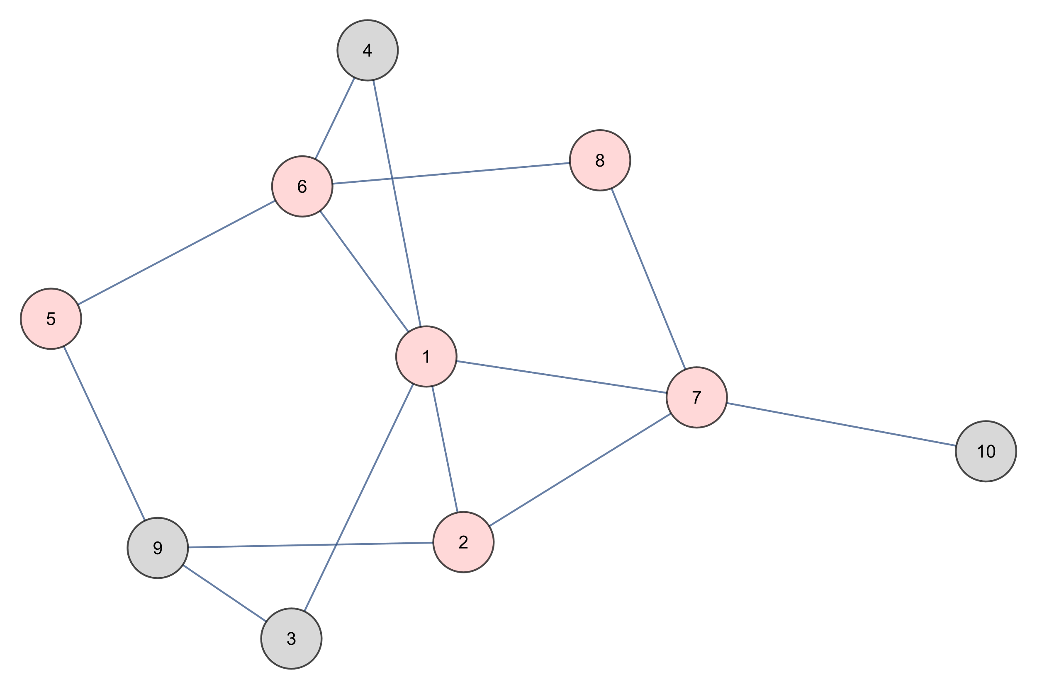
Depth First Search
5 6 8 7 2 1
STACK

Slide 18
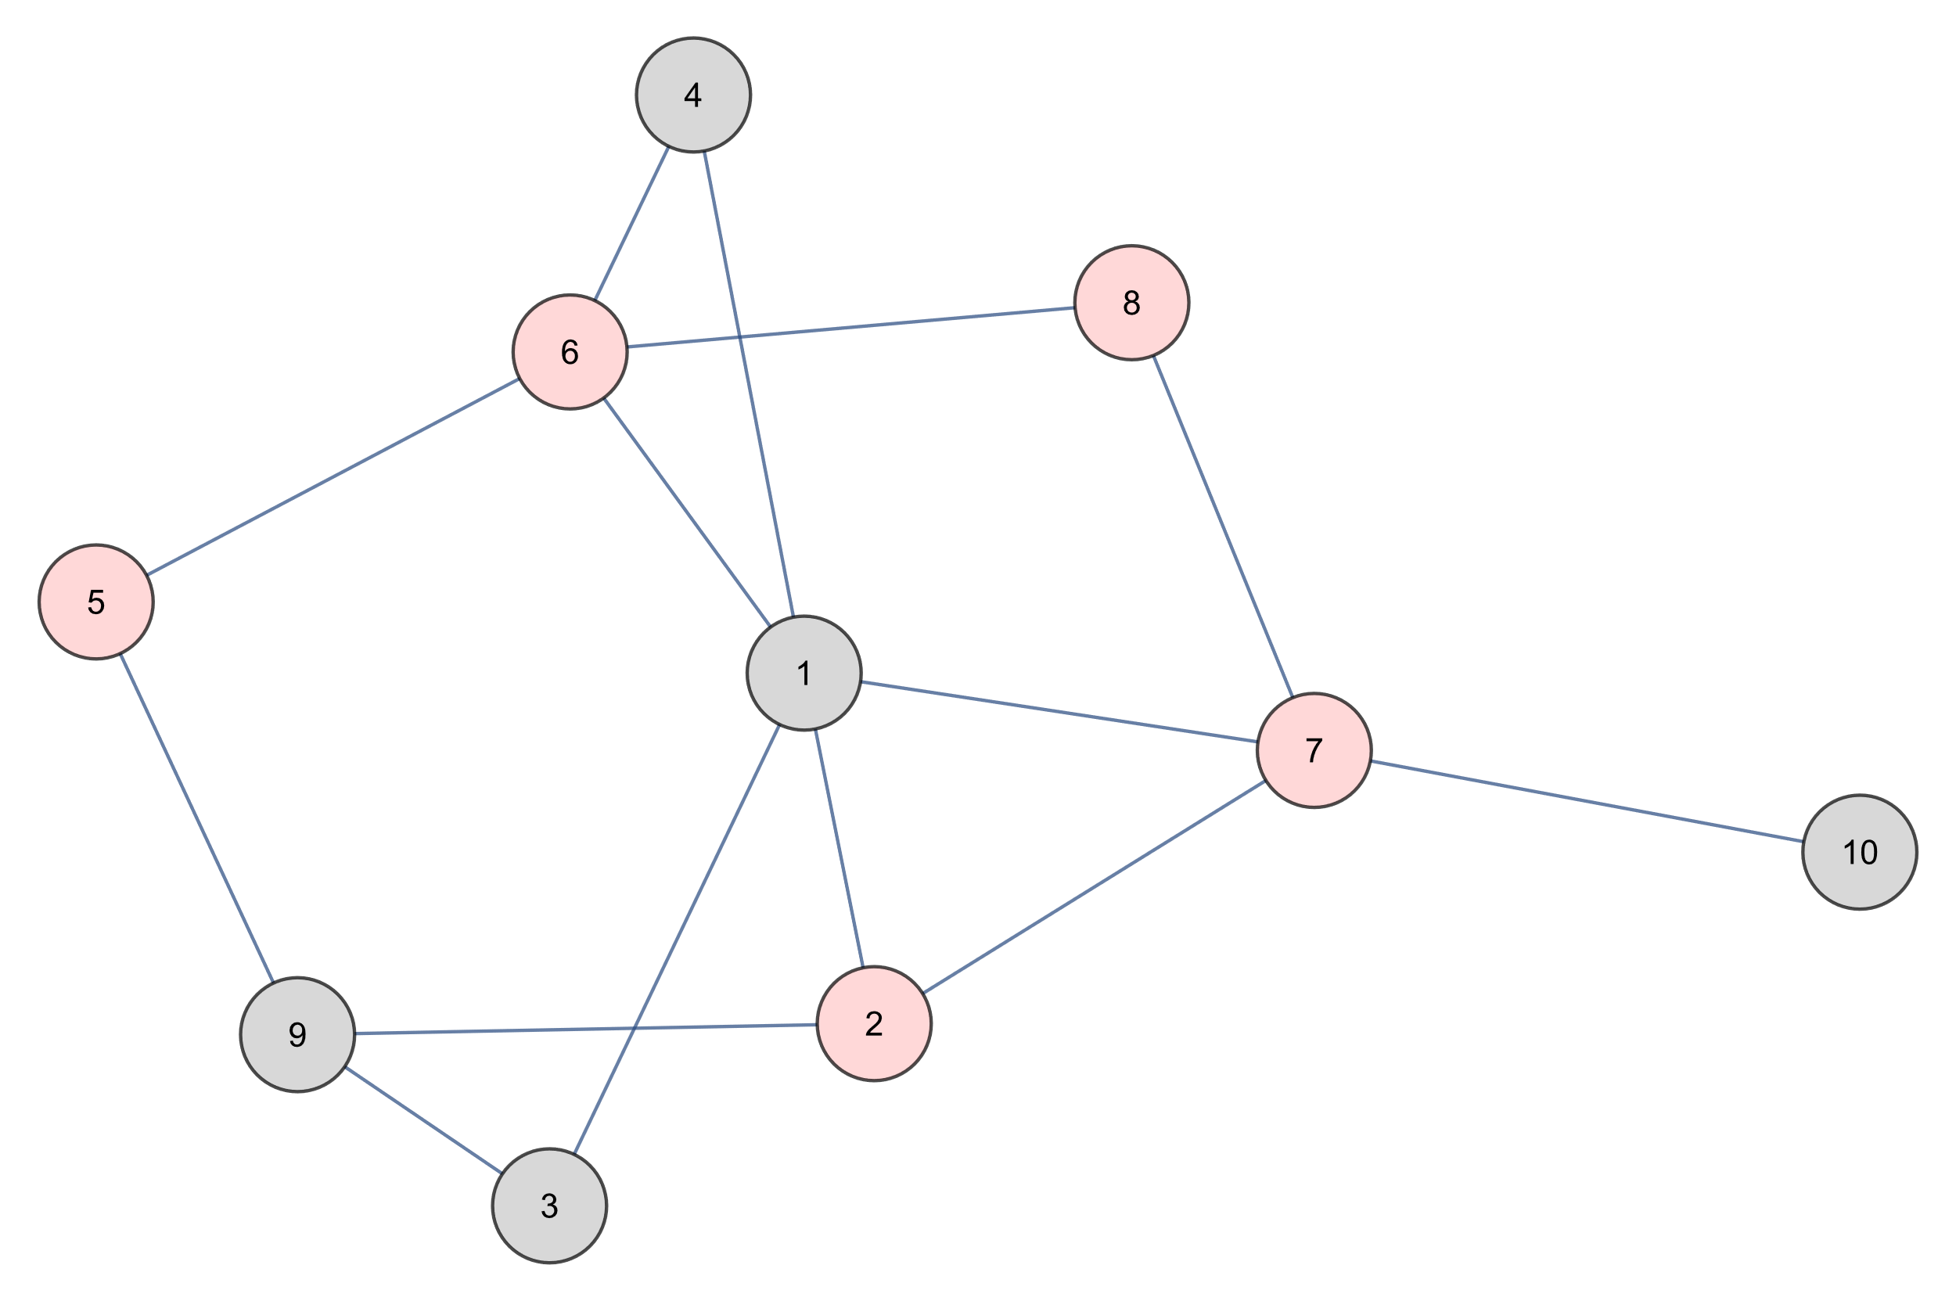
Depth First Search
5 6 8 7 2
STACK

Slide 19
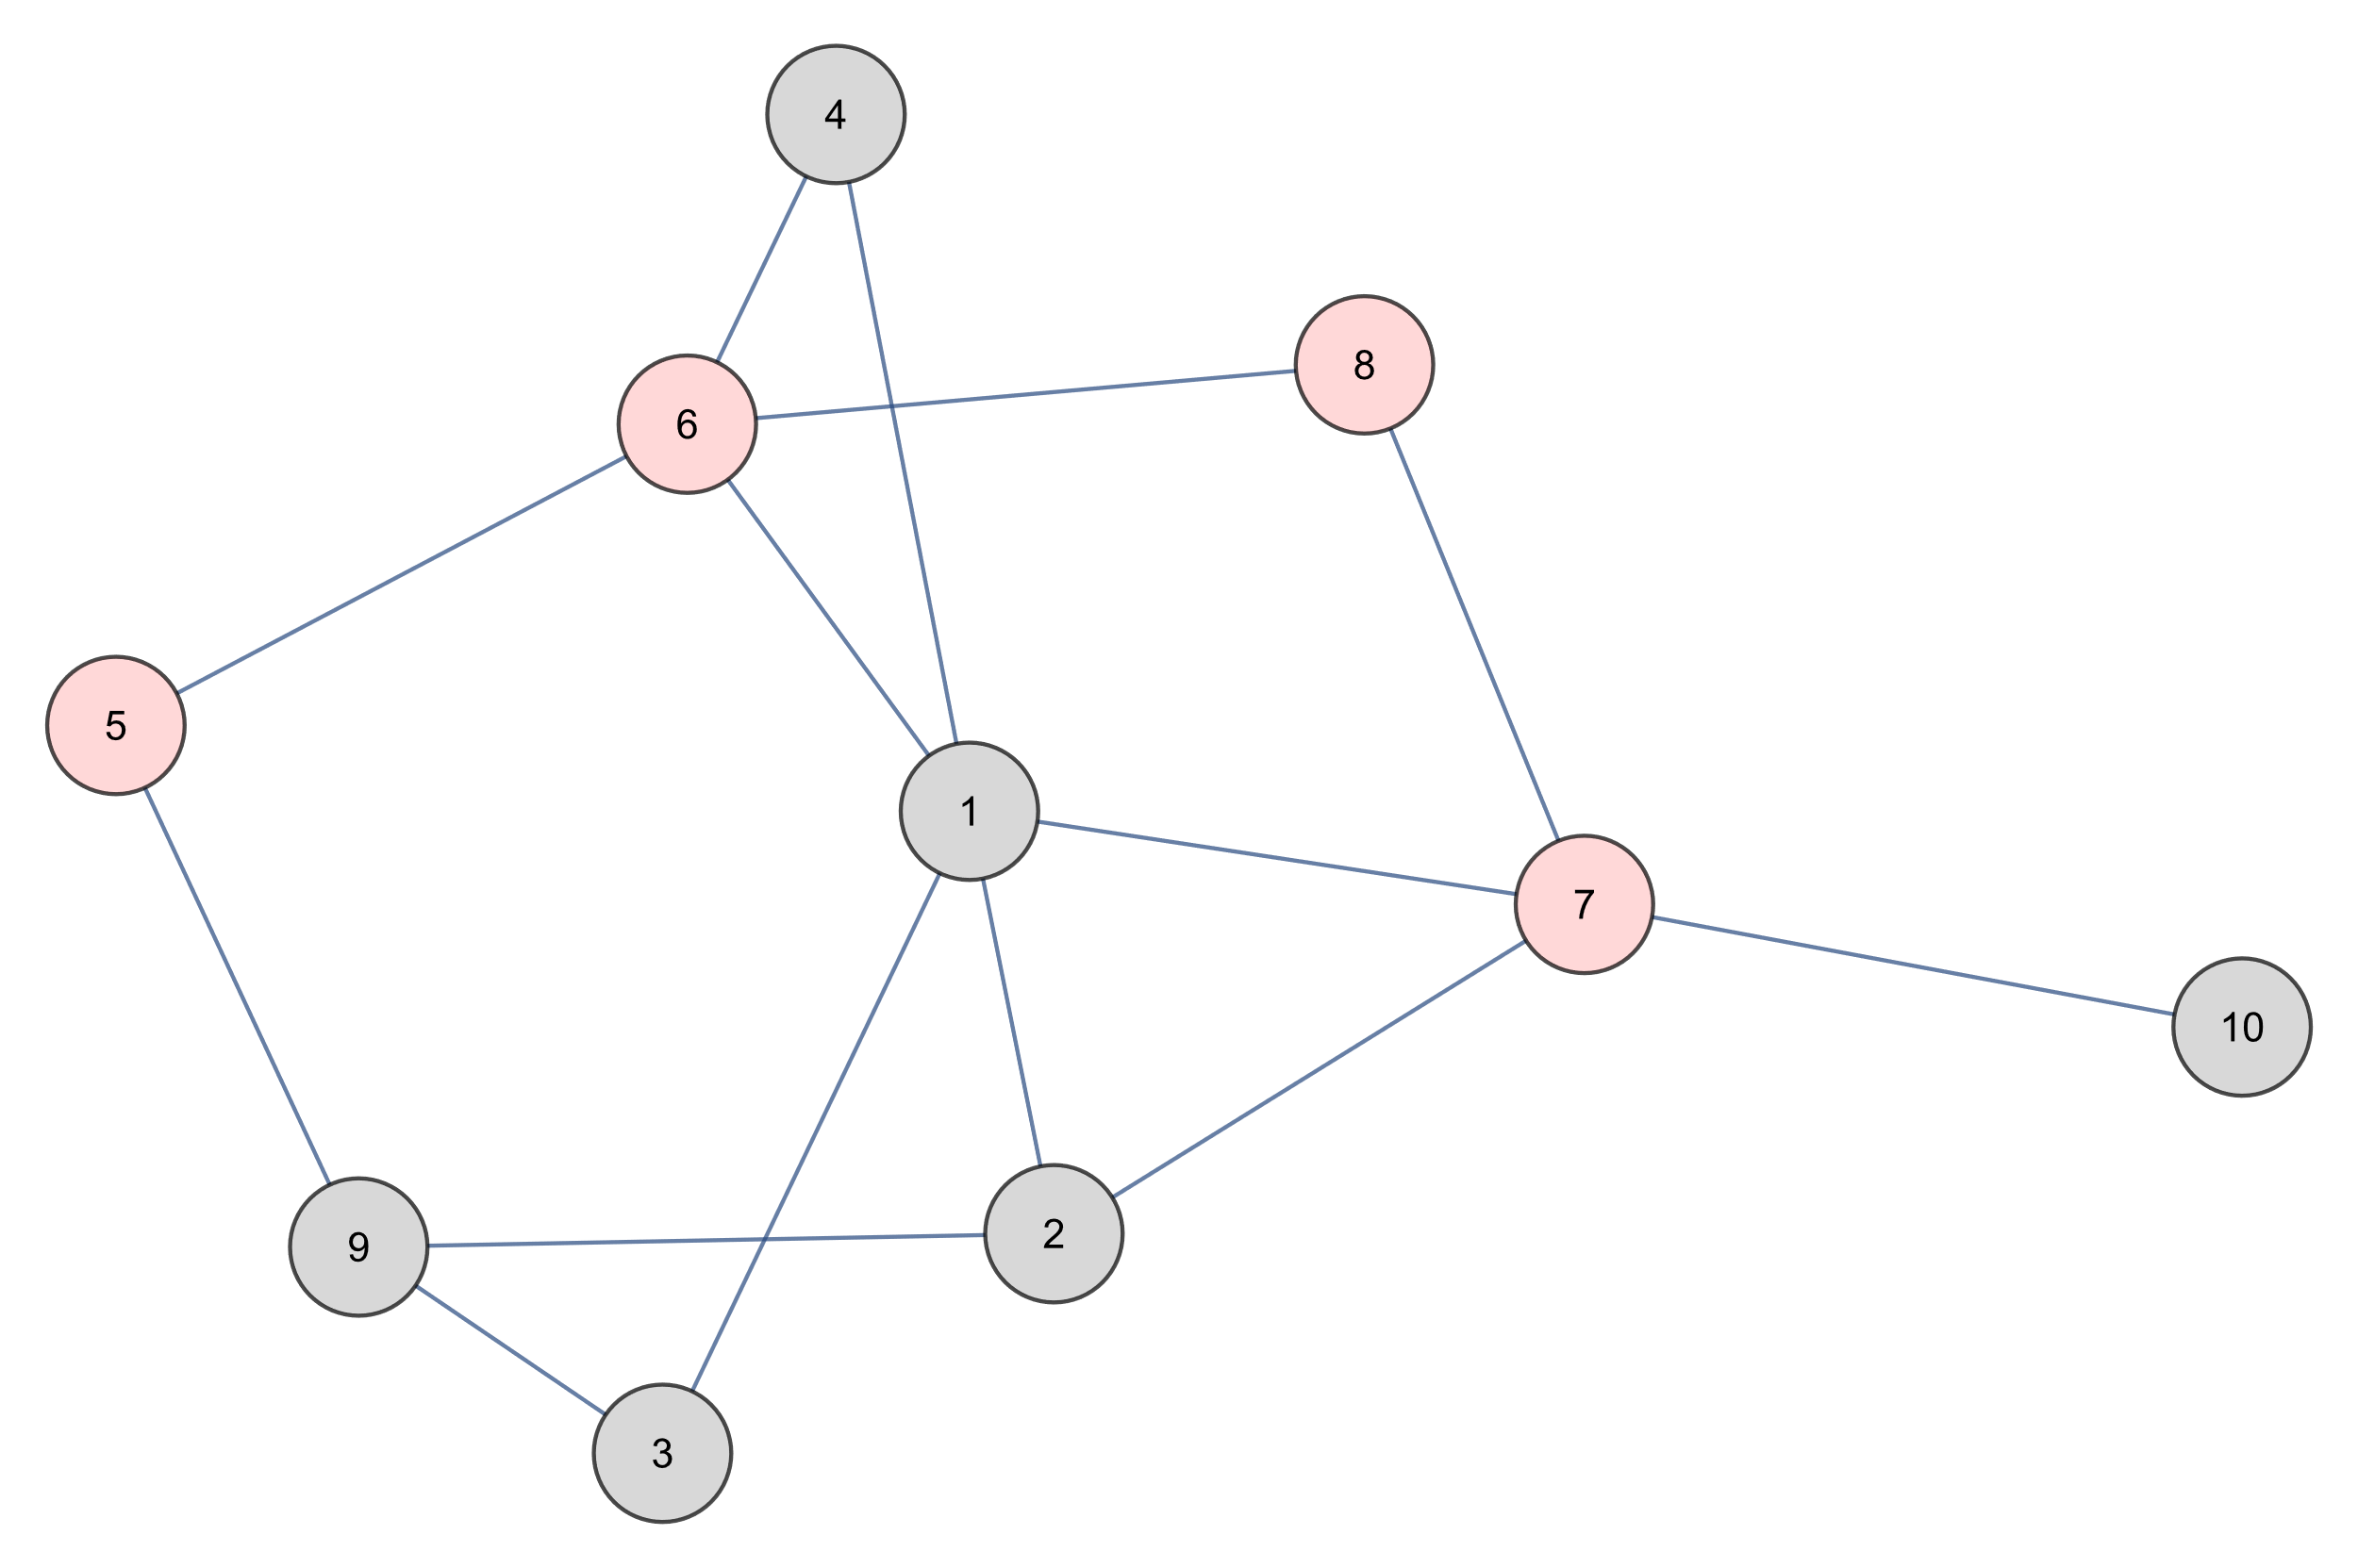
Depth First Search
5 6 8 7
STACK

Slide 20
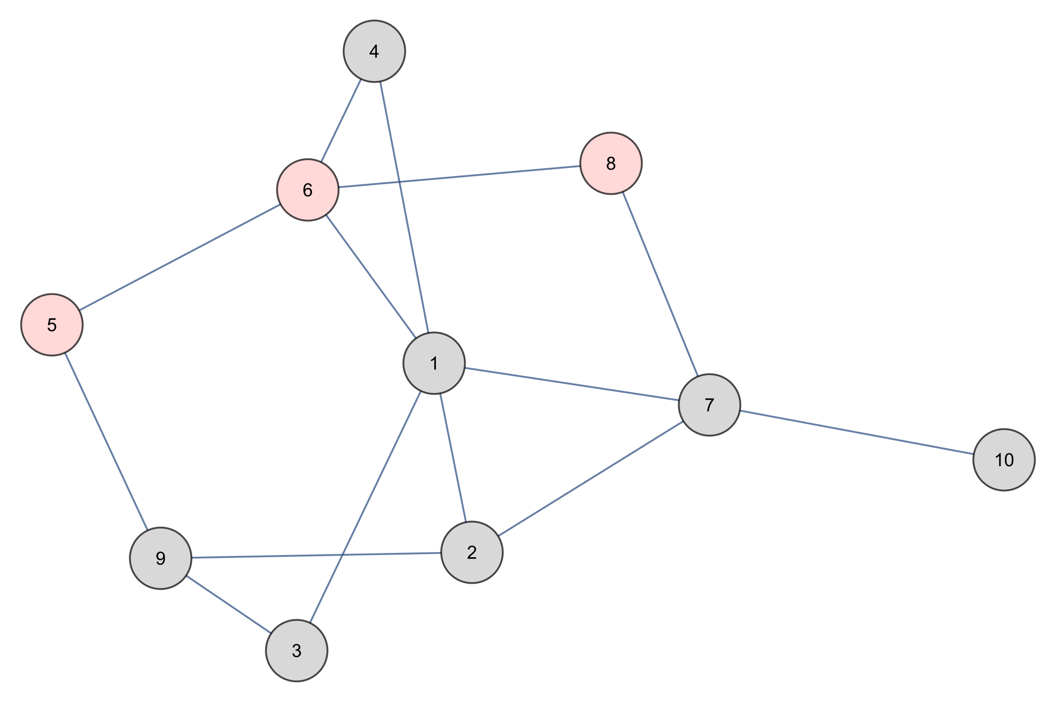
Depth First Search
5 6 8
STACK

Slide 21
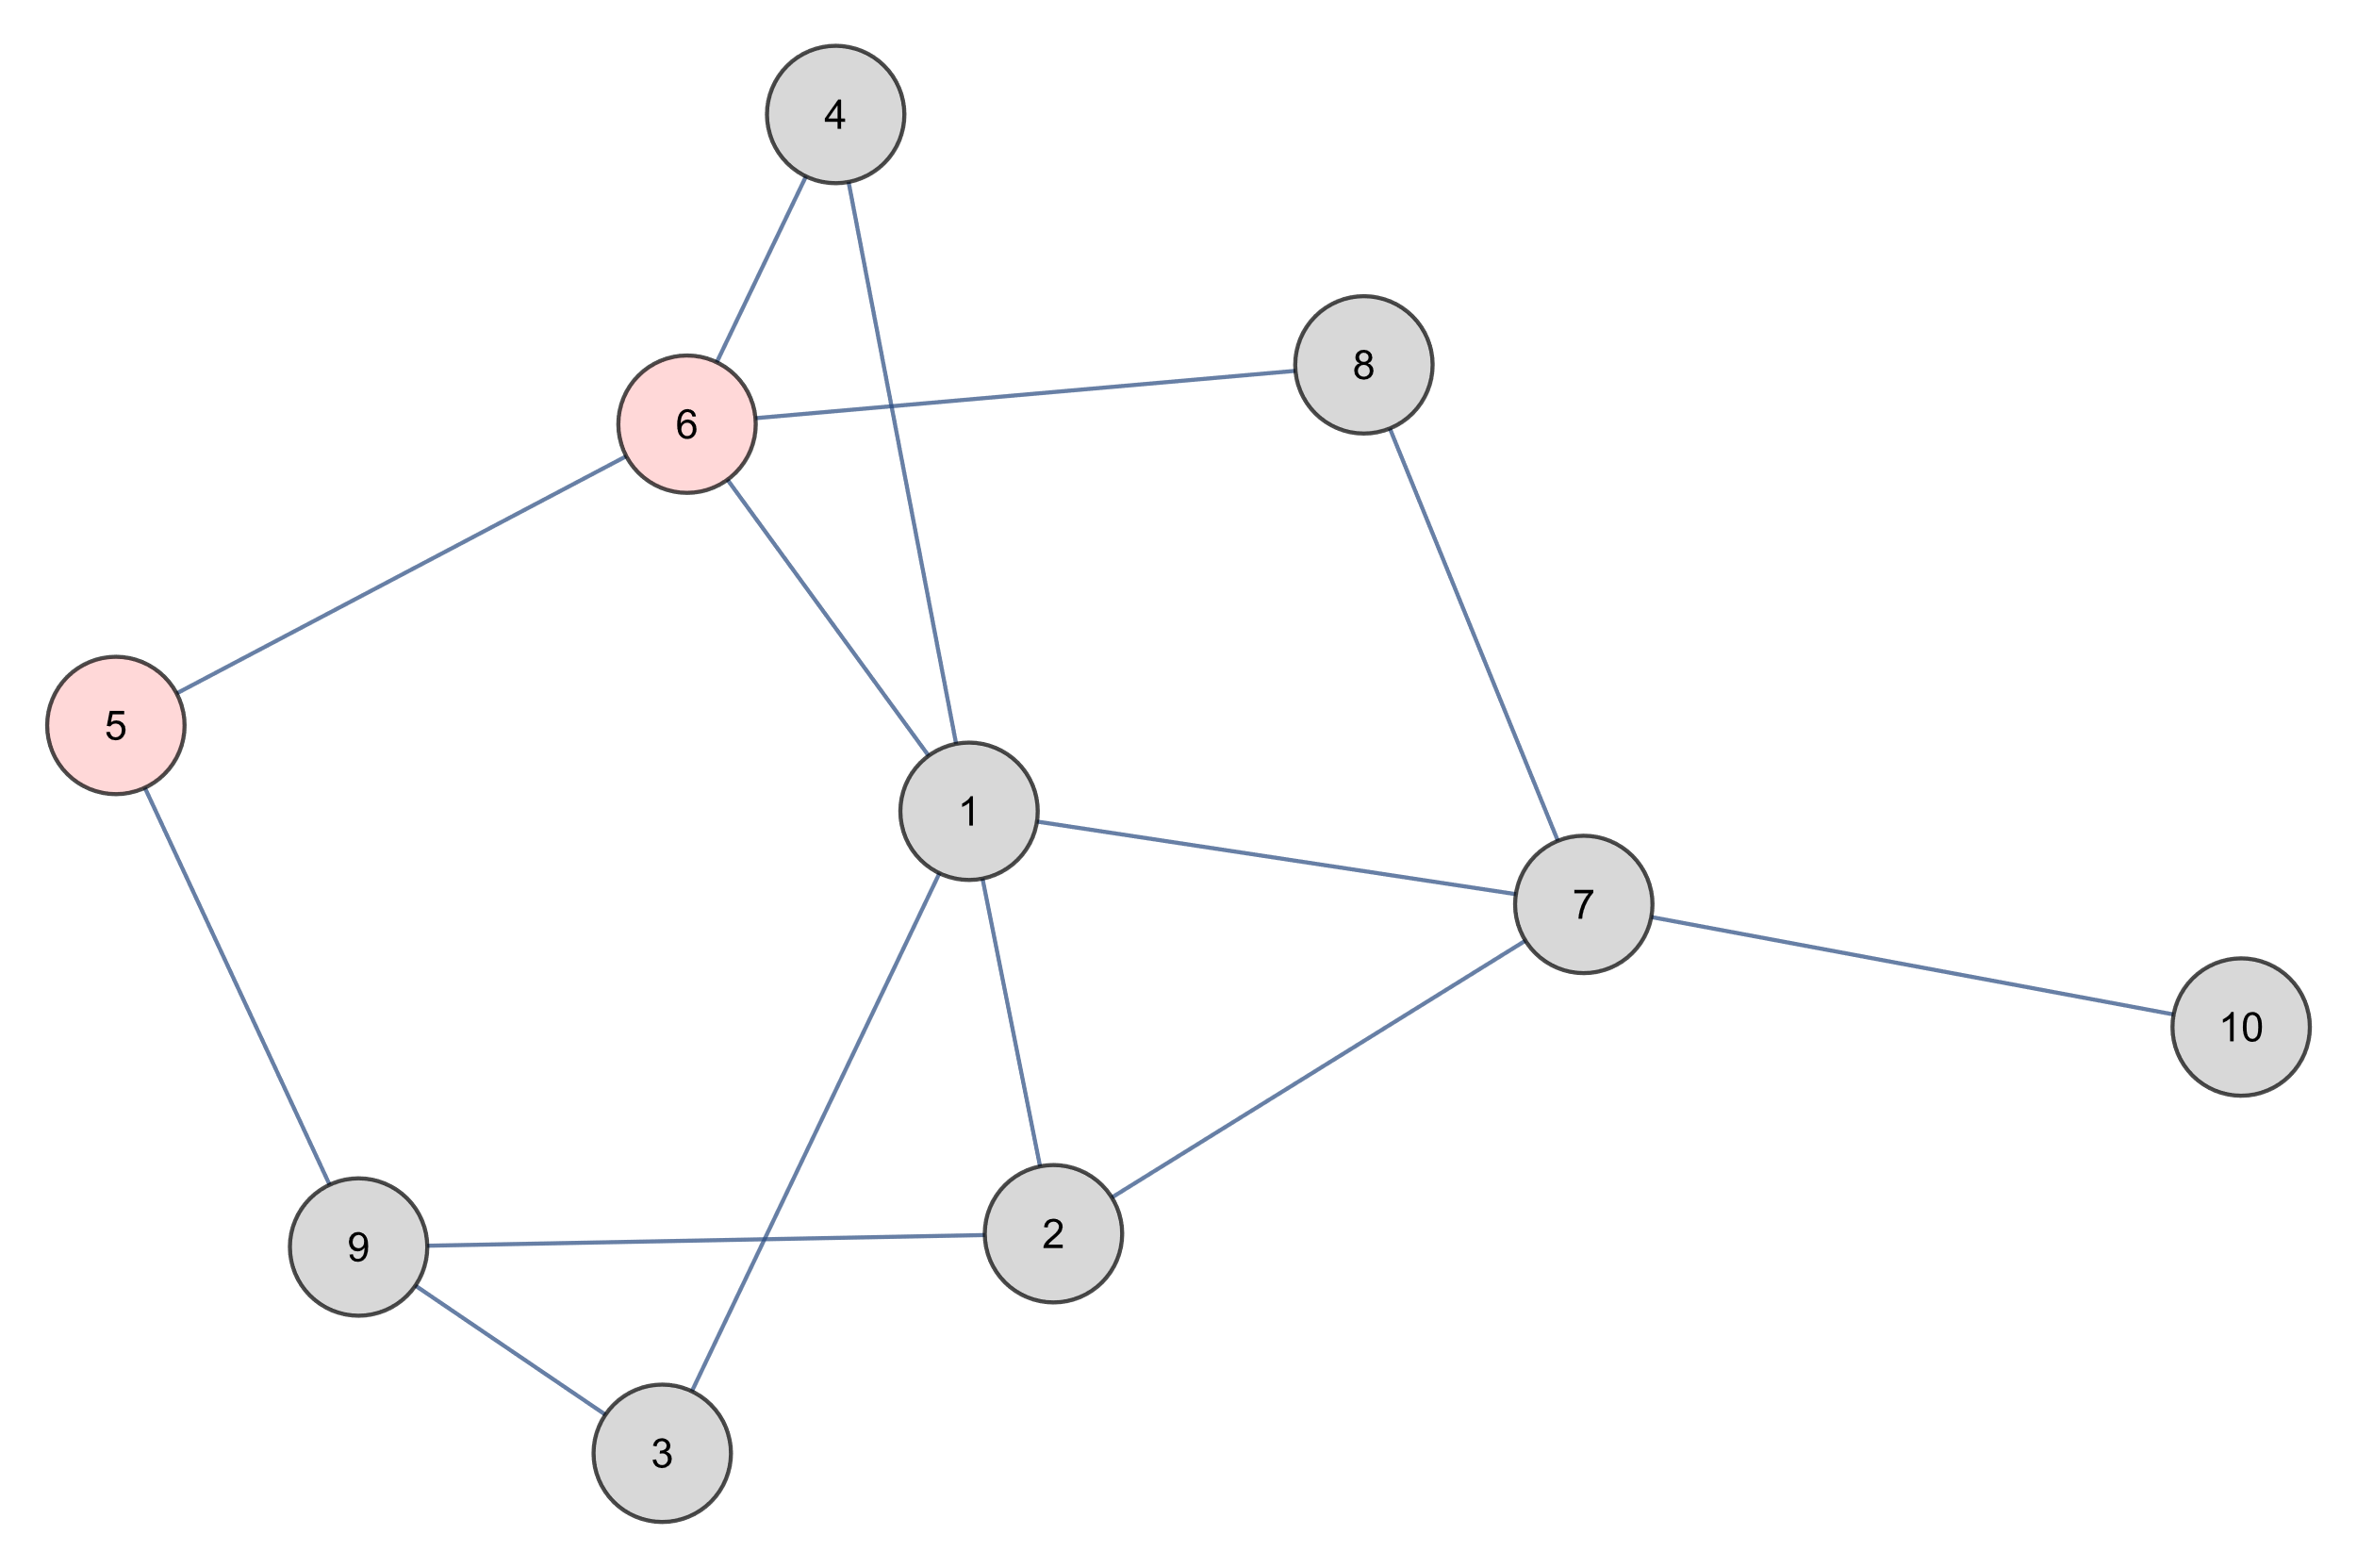
Depth First Search
5 6
STACK

Slide 22
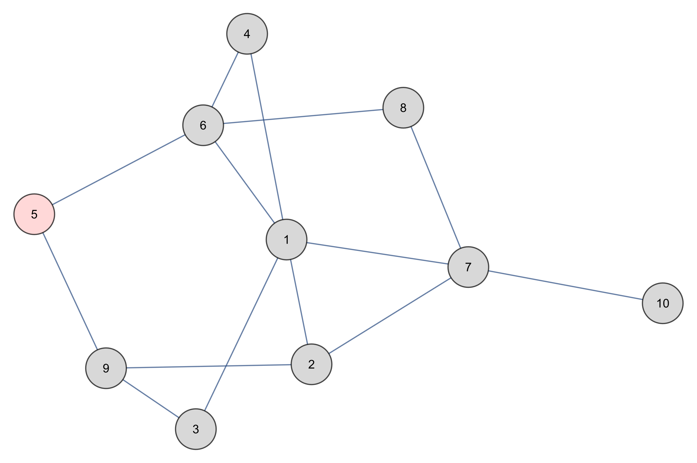
Depth First Search
5
STACK

Slide 23
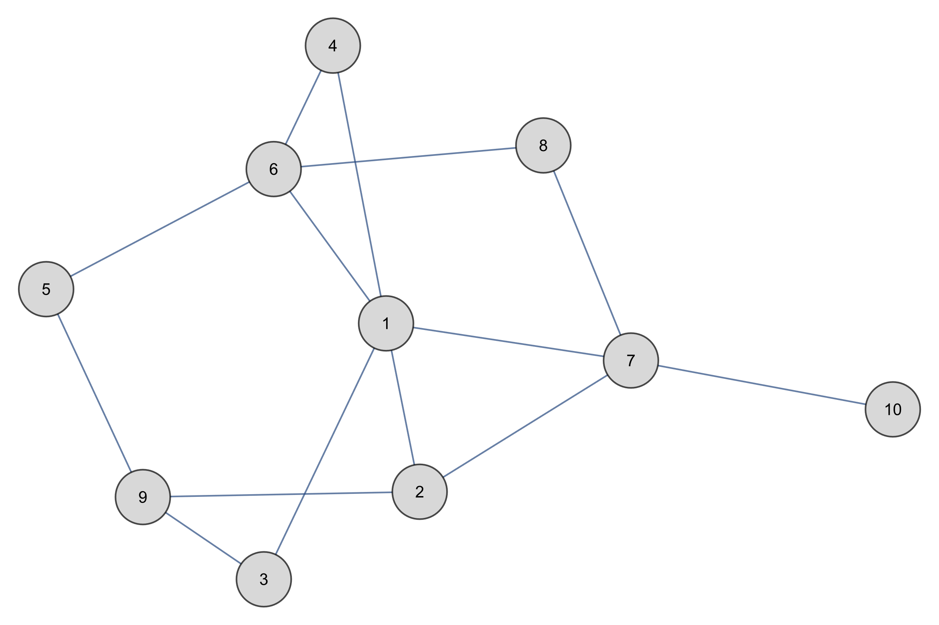
Depth First Search
STACK

Slide 24
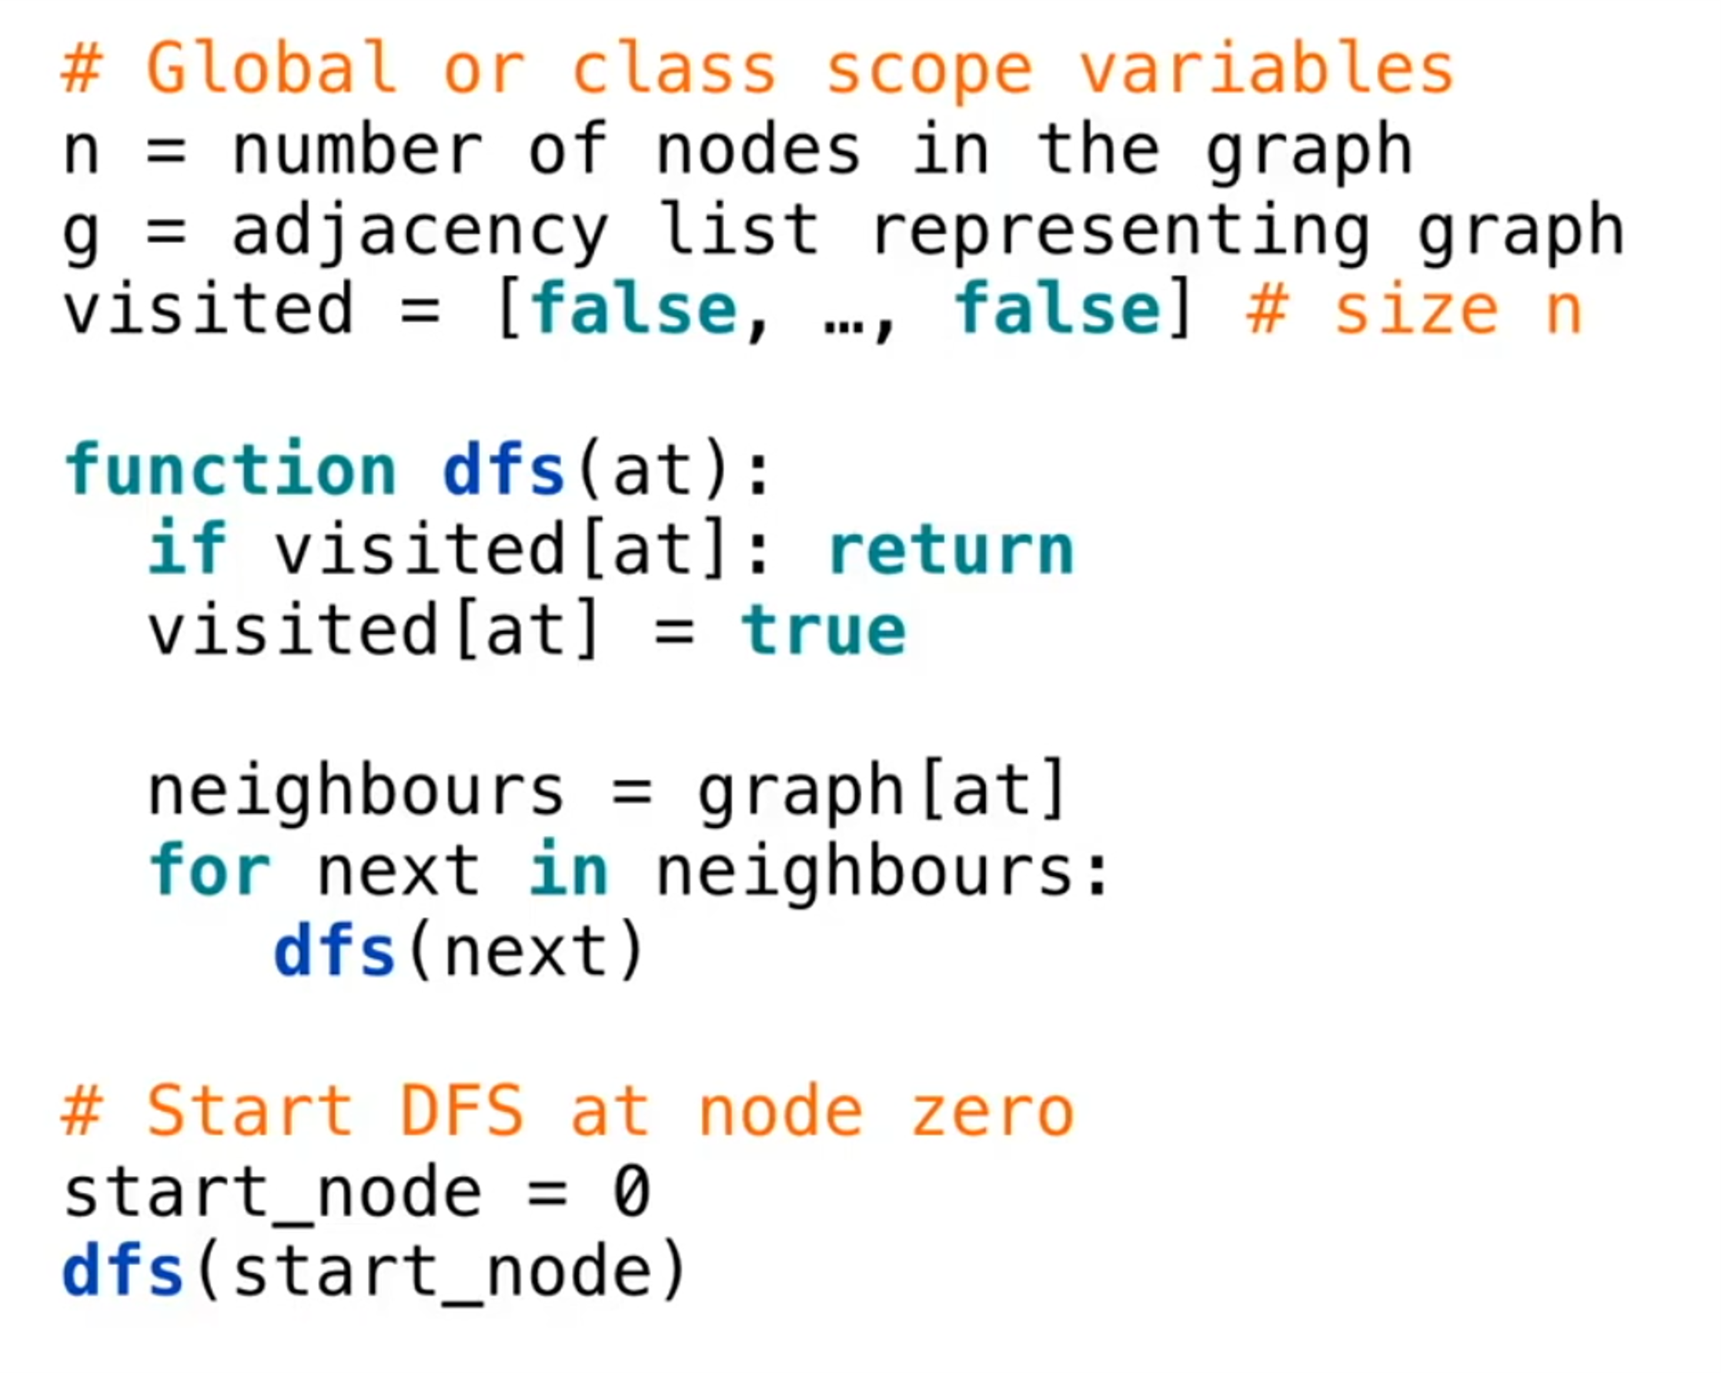
Depth First Search

Slide 25
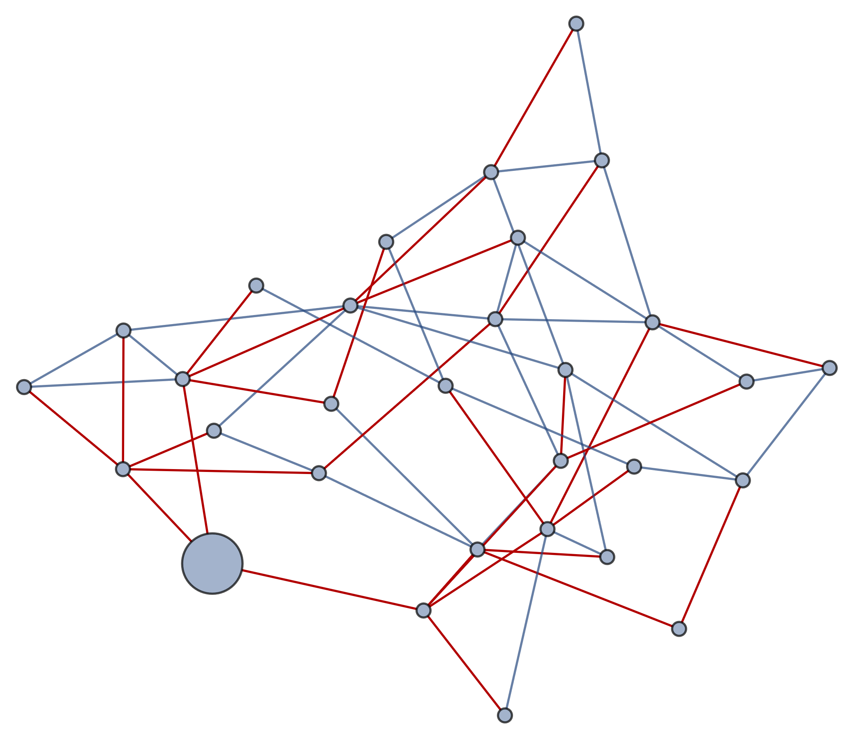
Breadth First Search
Breadth-first search (BFS) is an algorithm for traversing or searching tree or graph data structures. It starts at the tree root (or some arbitrary node of a graph, sometimes referred to as a 'search key'), and explores all of the neighbor nodes at the present depth prior to moving on to the nodes at the next depth level.

Slide 26

Breadth First Search

Slide 27
Breadth First Search
5
QUEUE

Slide 28
Breadth First Search
5 6
QUEUE

Slide 29
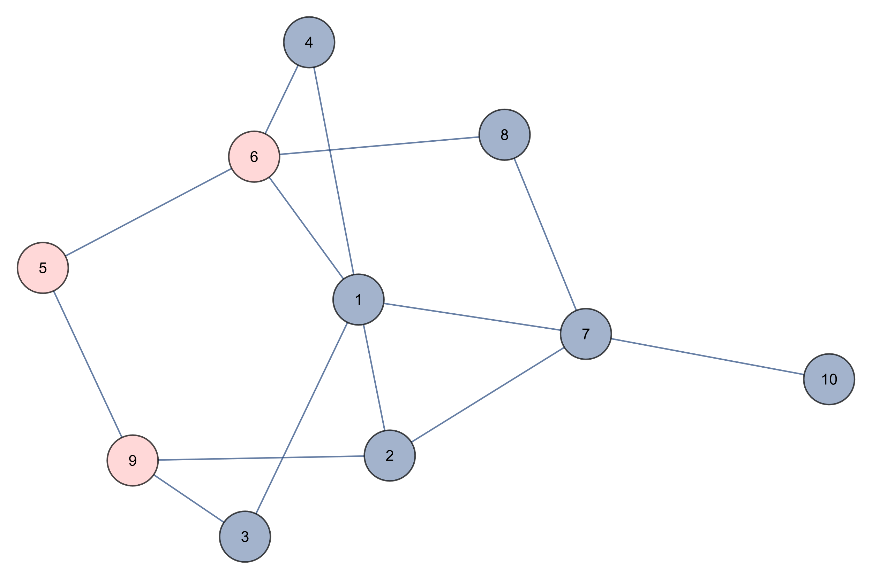
Breadth First Search
5 6 9
QUEUE

Slide 30
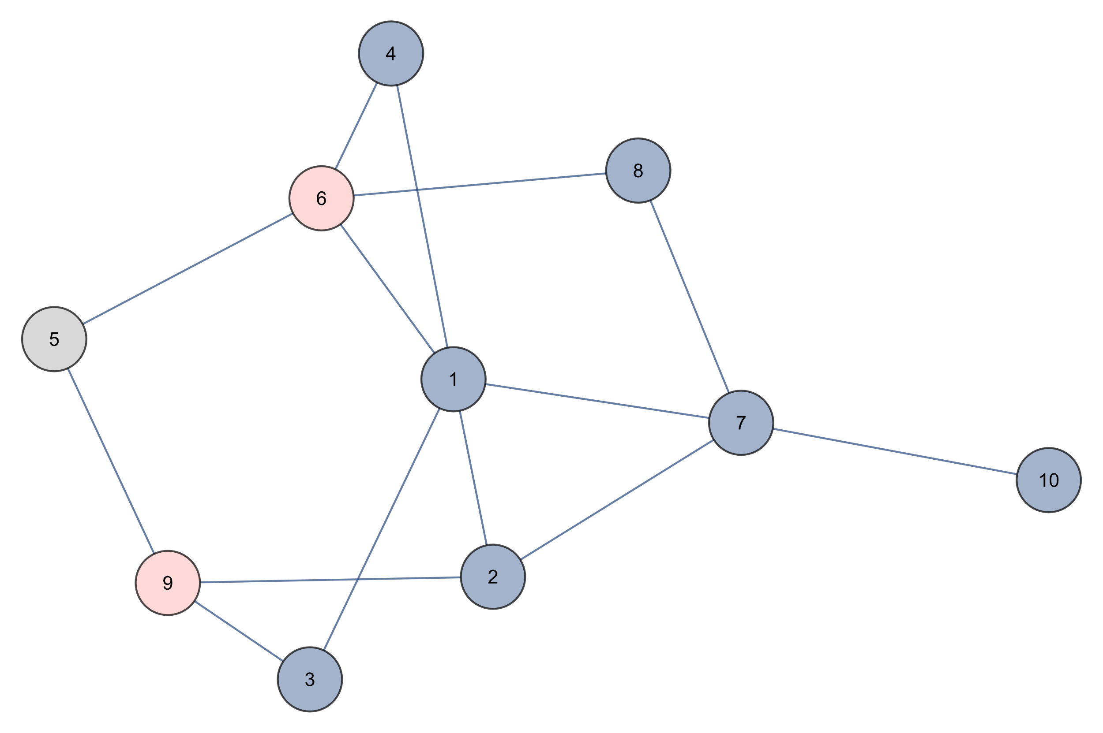
Breadth First Search
6 9
QUEUE

Slide 31
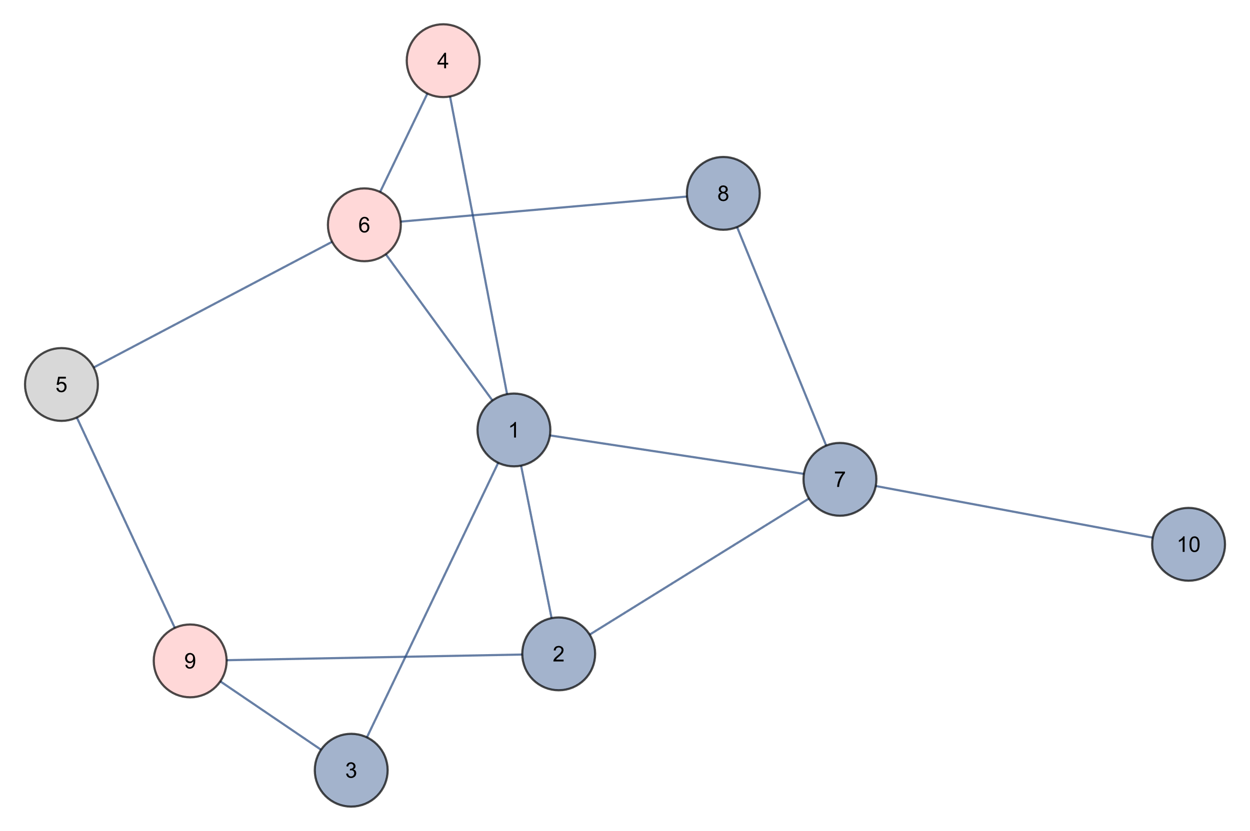
Breadth First Search
6 9 4
QUEUE

Slide 32
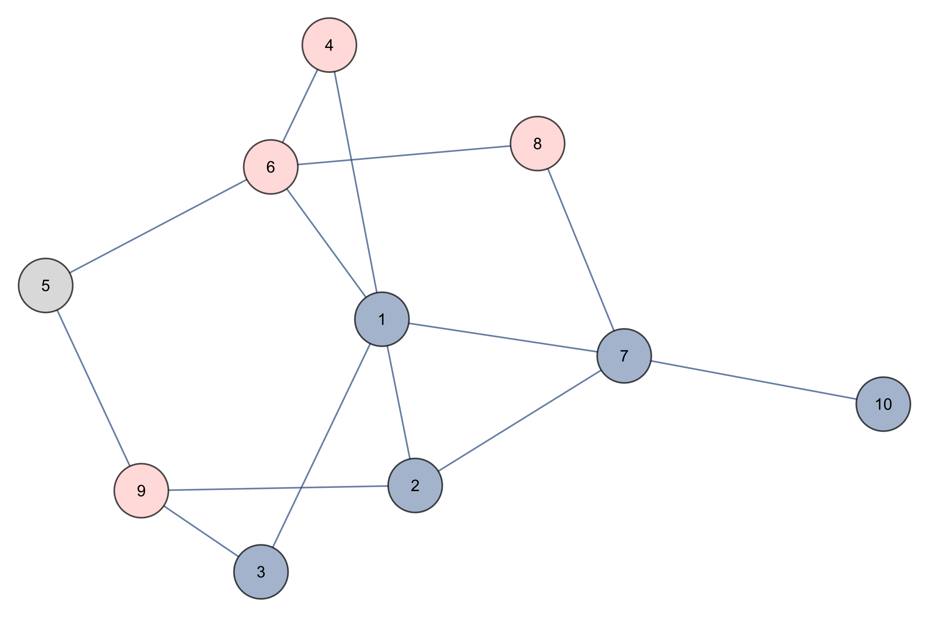
Breadth First Search
6 9 4 8
QUEUE

Slide 33
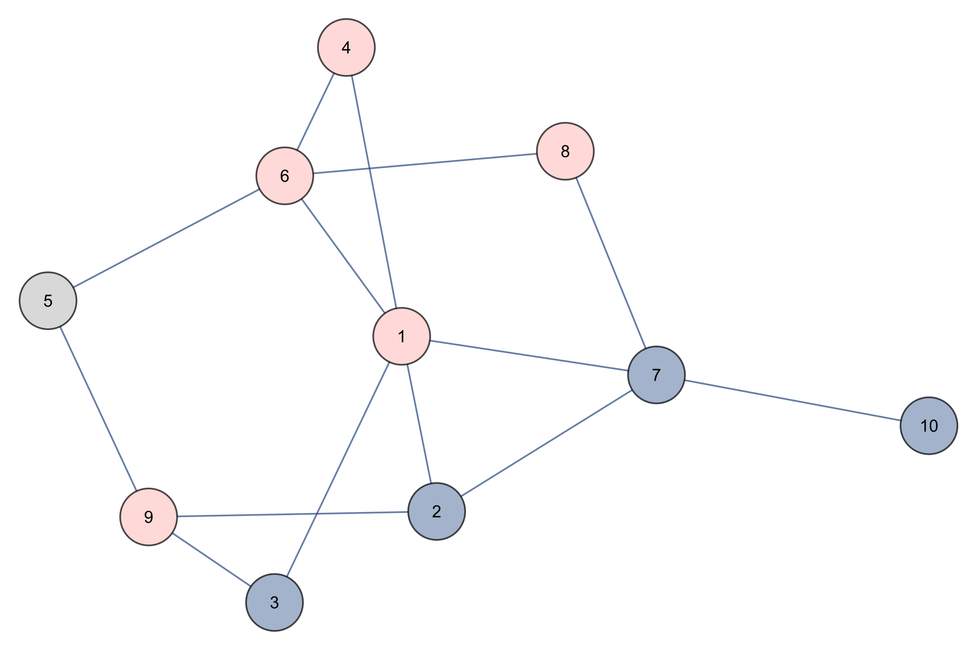
Breadth First Search
6 9 4 8 1
QUEUE

Slide 34
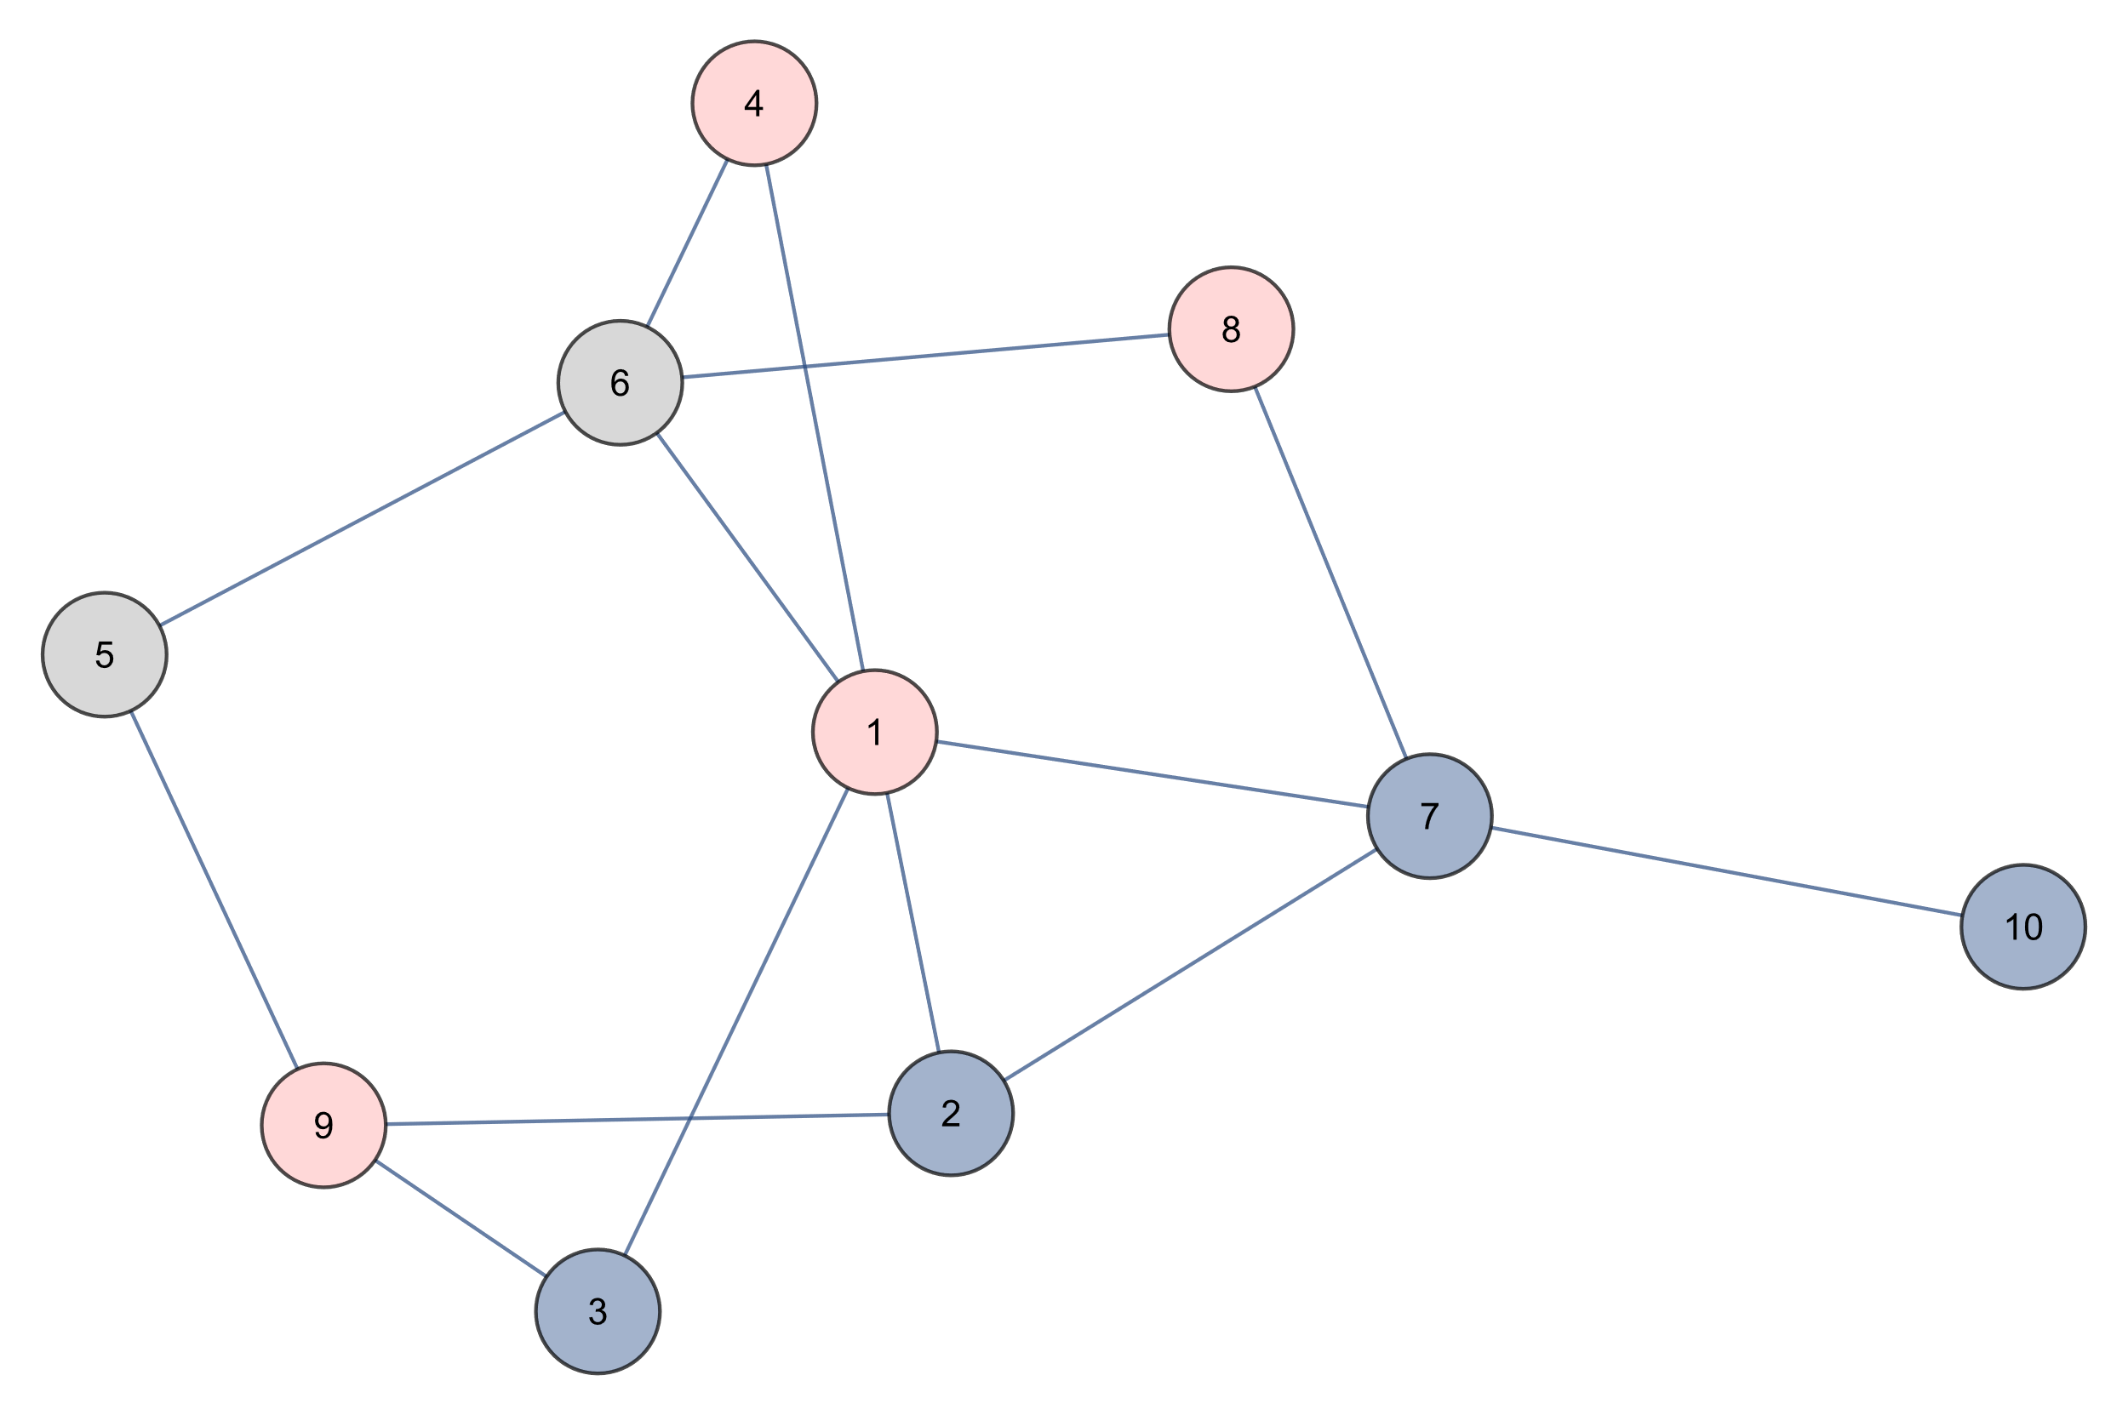
Breadth First Search
9 4 8 1
QUEUE

Slide 35
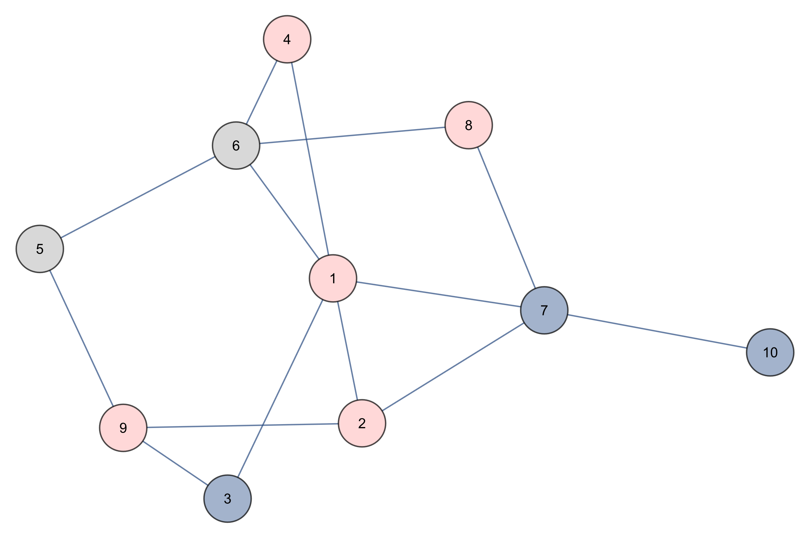
Breadth First Search
9 4 8 1 2
QUEUE

Slide 36
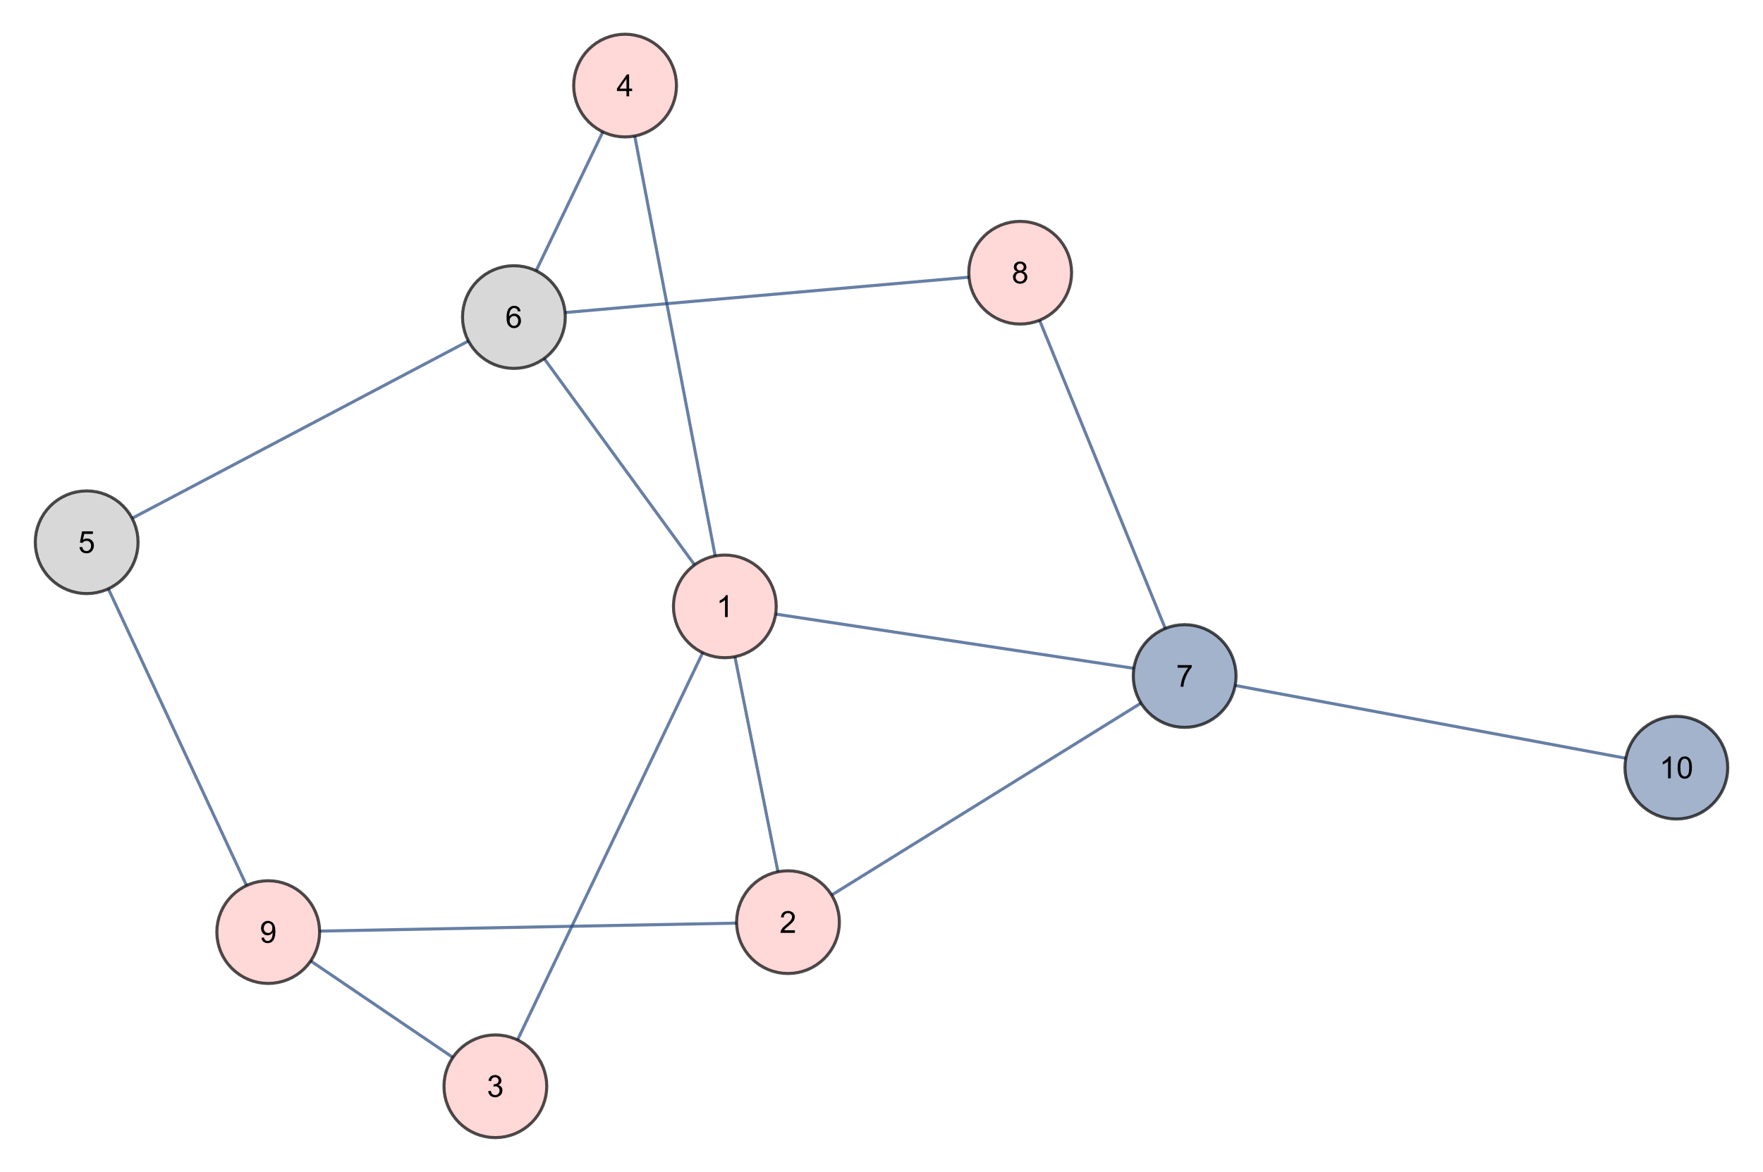
Breadth First Search
9 4 8 1 2 3
QUEUE

Slide 37
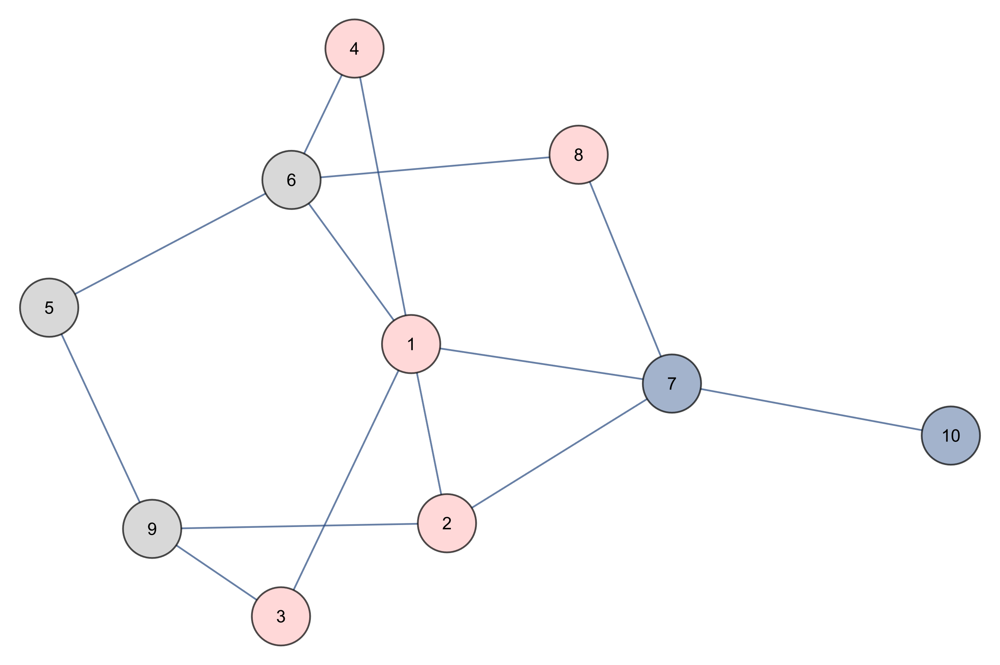
Breadth First Search
4 8 1 2 3
QUEUE

Slide 38
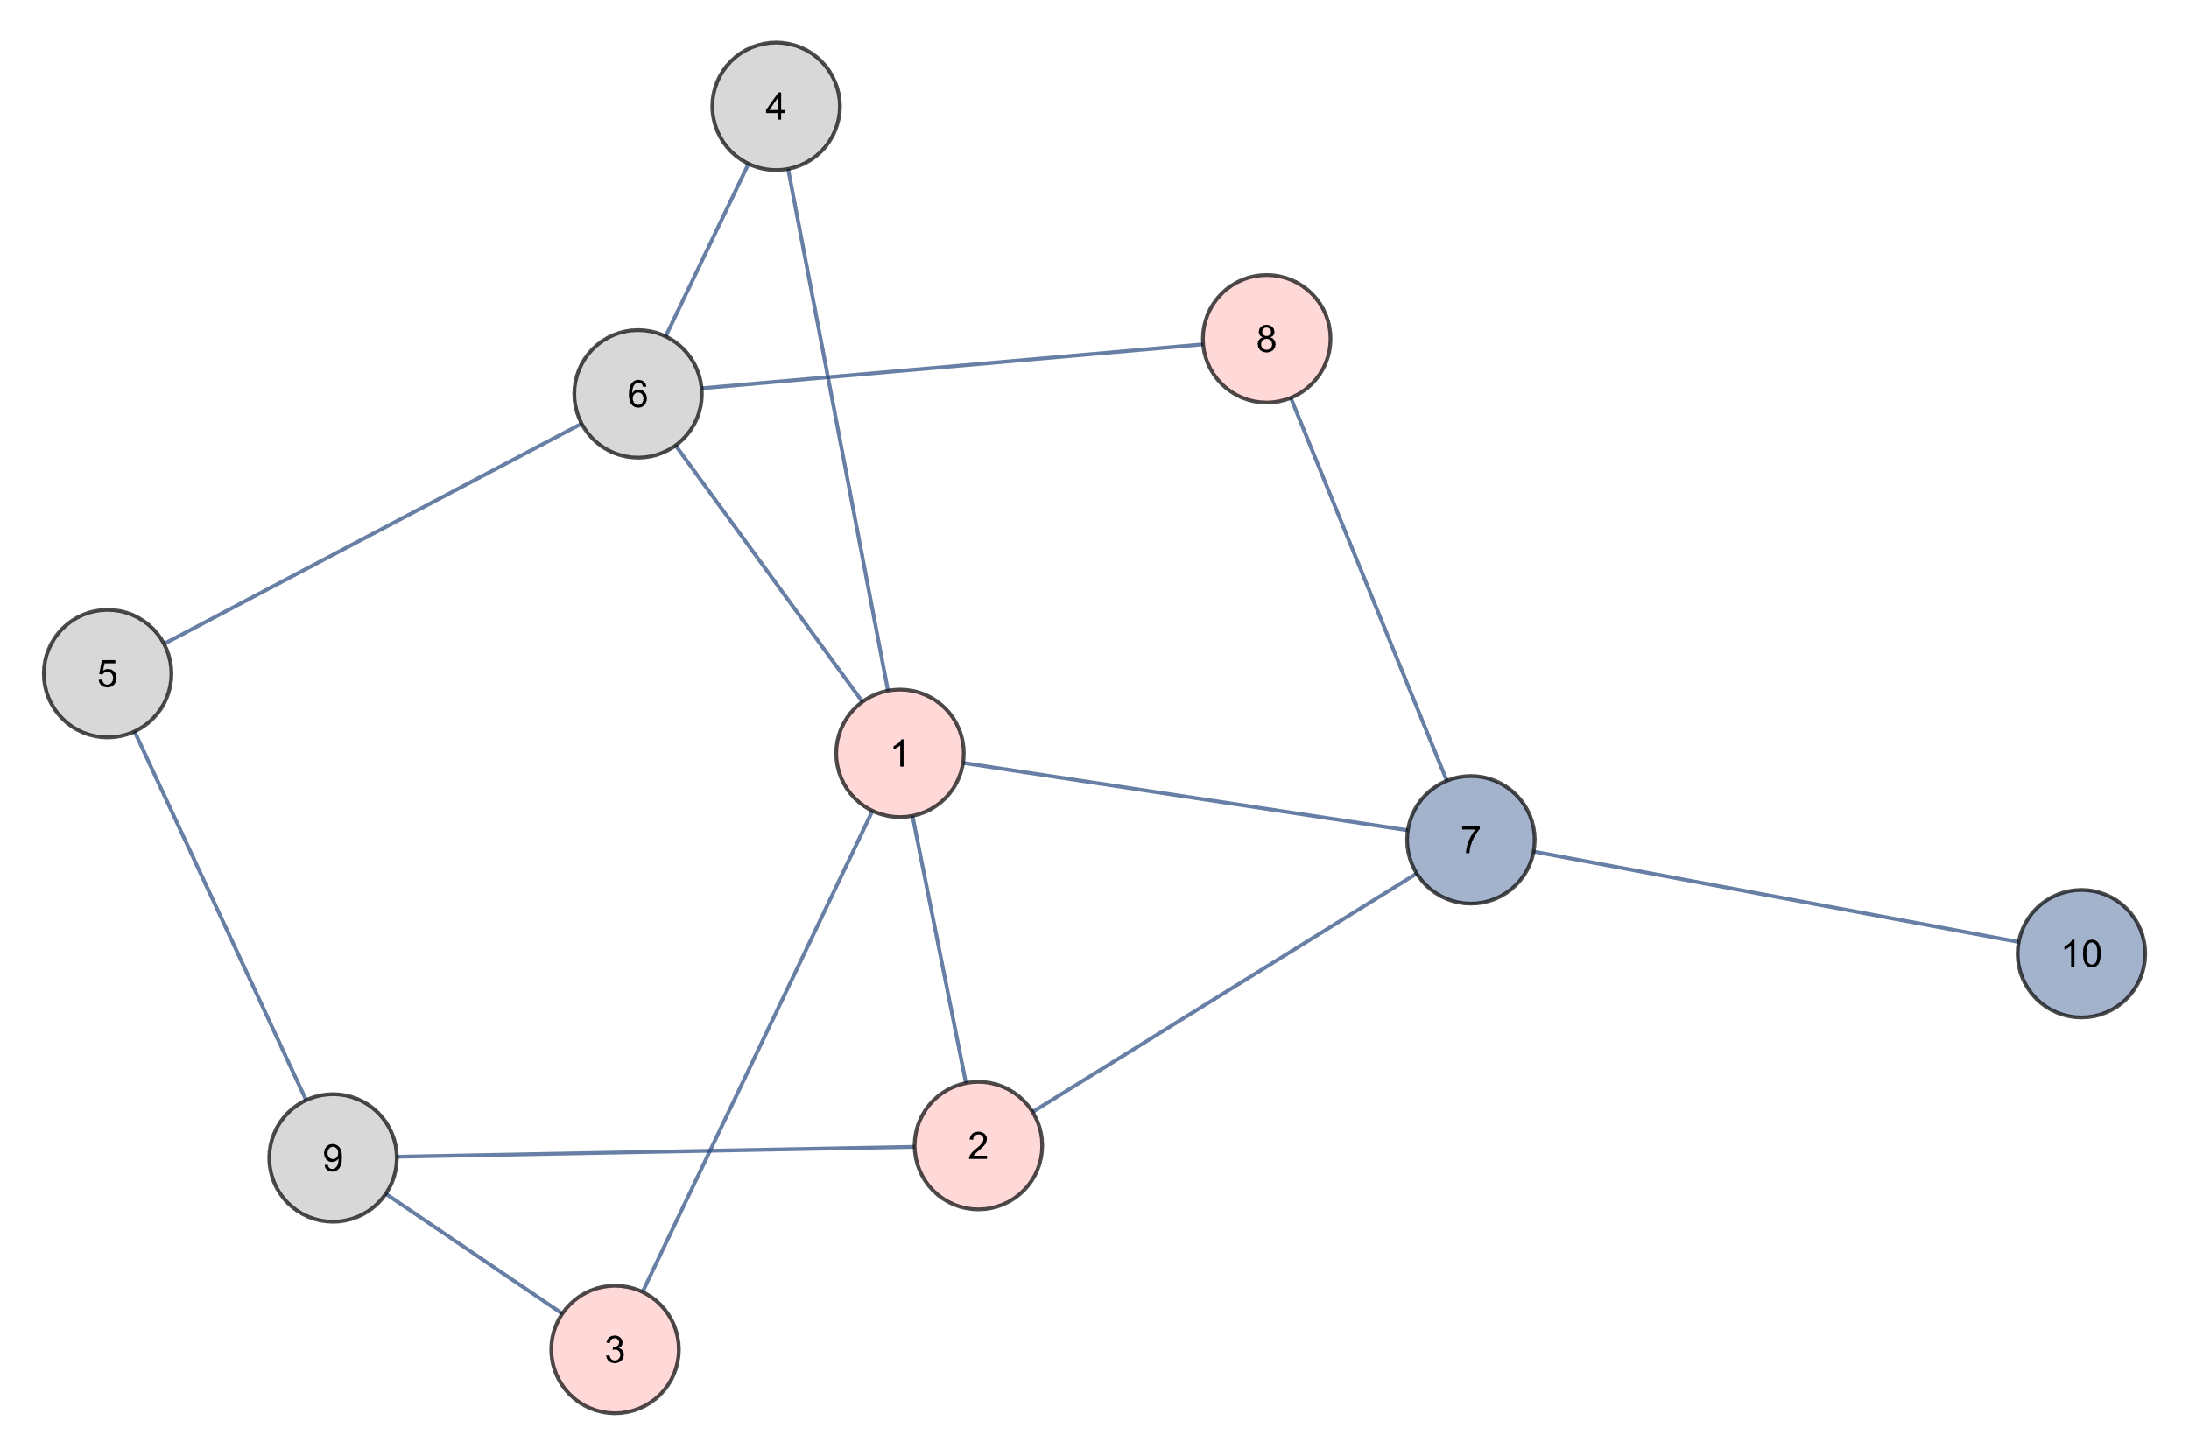
Breadth First Search
8 1 2 3
QUEUE

Slide 39
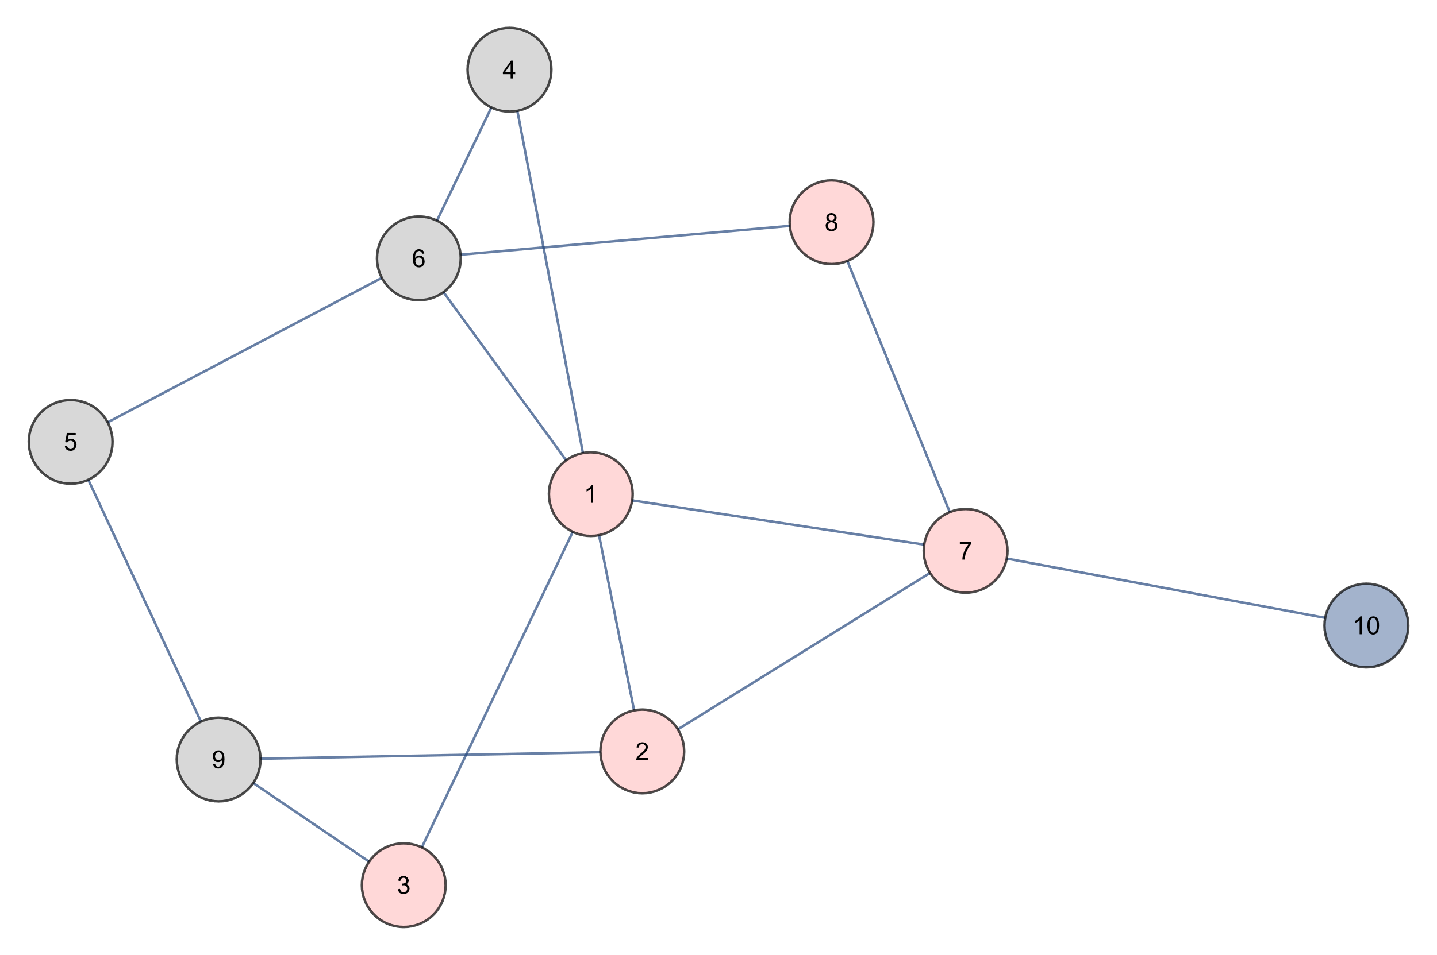
Breadth First Search
8 1 2 3 7
QUEUE

Slide 40
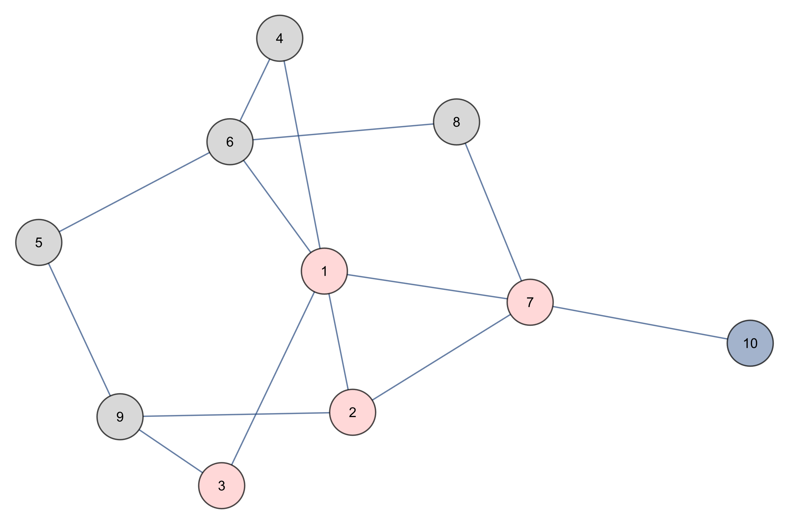
Breadth First Search
1 2 3 7
QUEUE

Slide 41
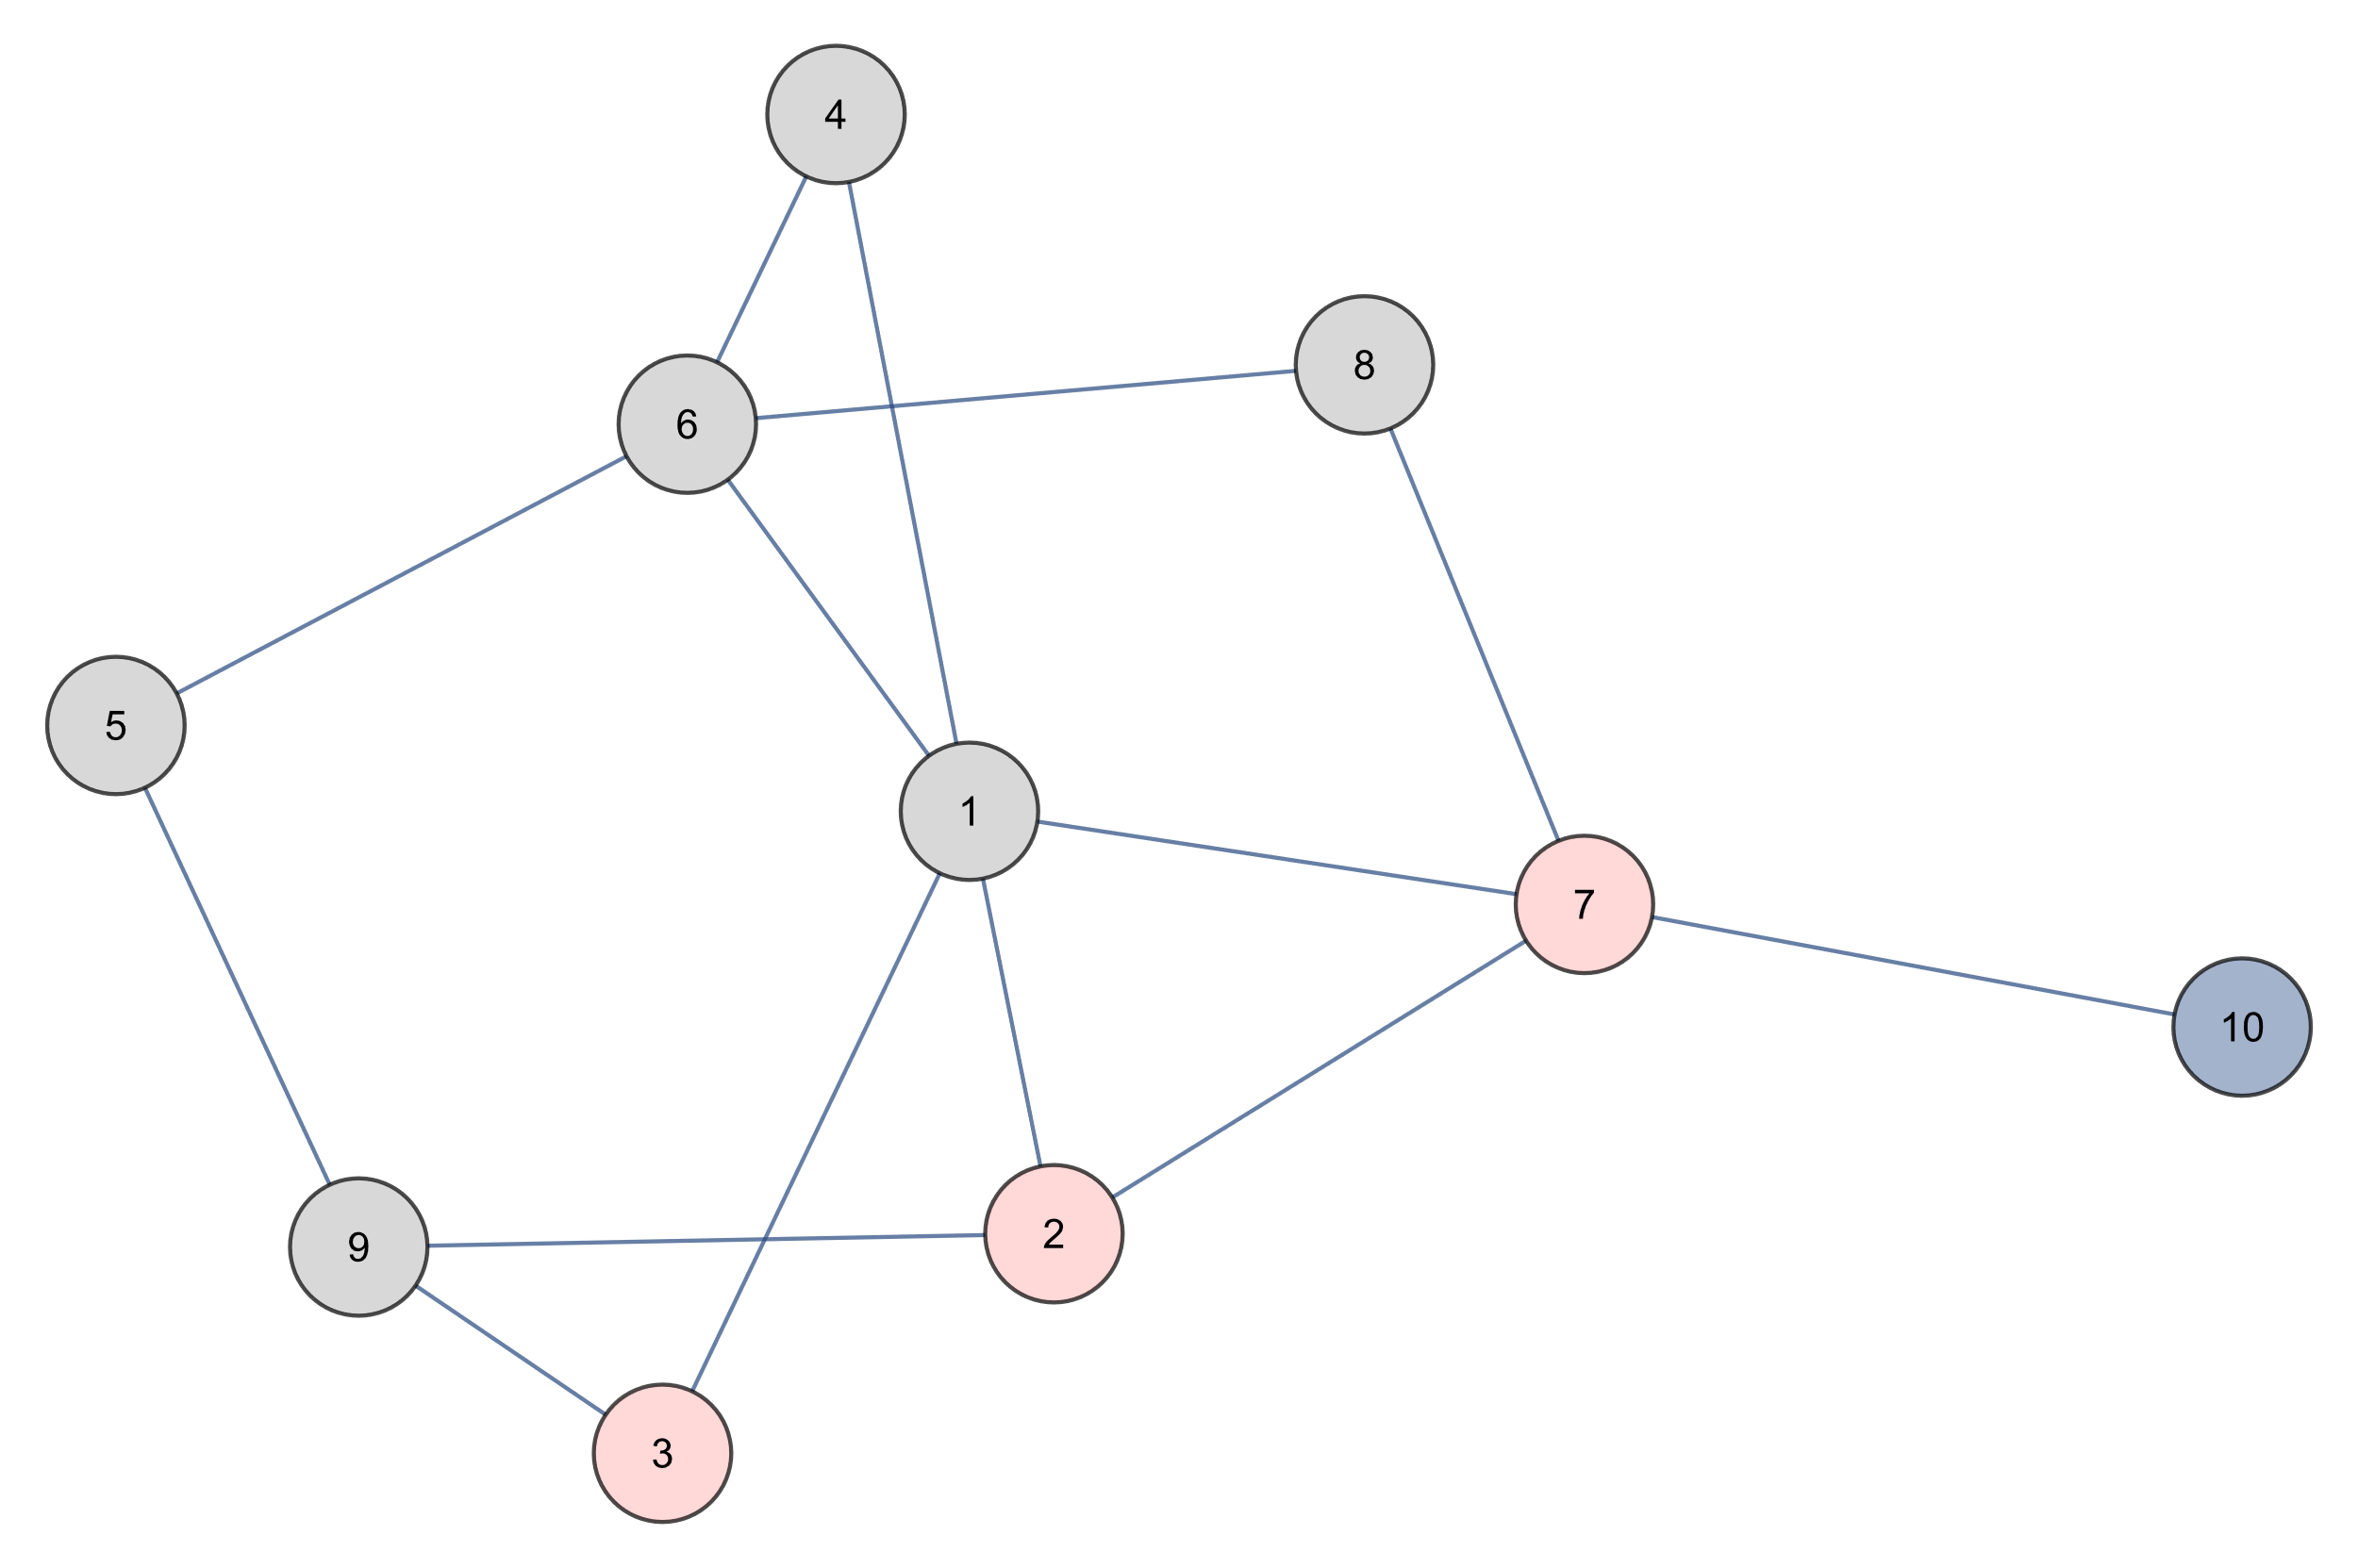
Breadth First Search
2 3 7
QUEUE

Slide 42
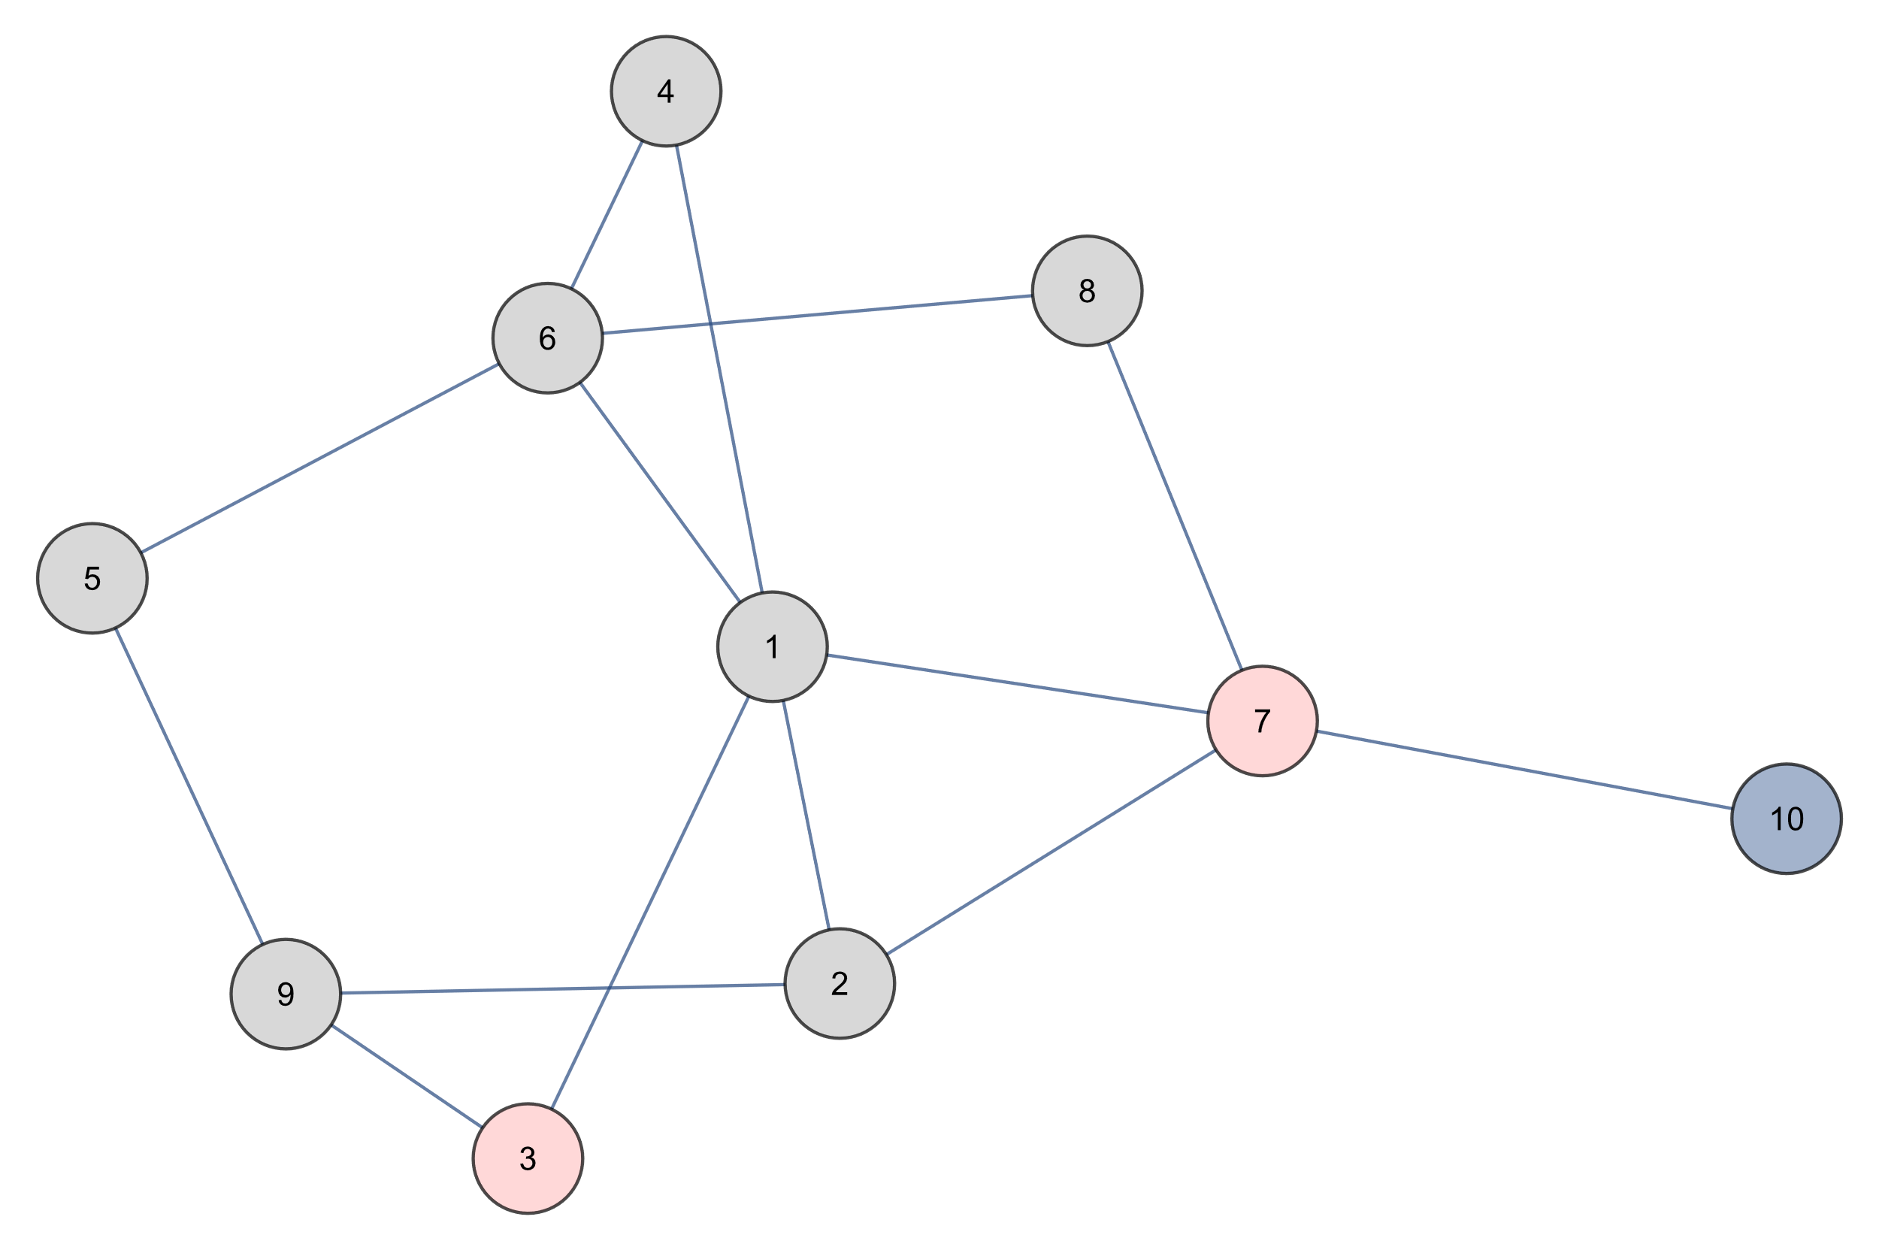
Breadth First Search
3 7
QUEUE

Slide 43
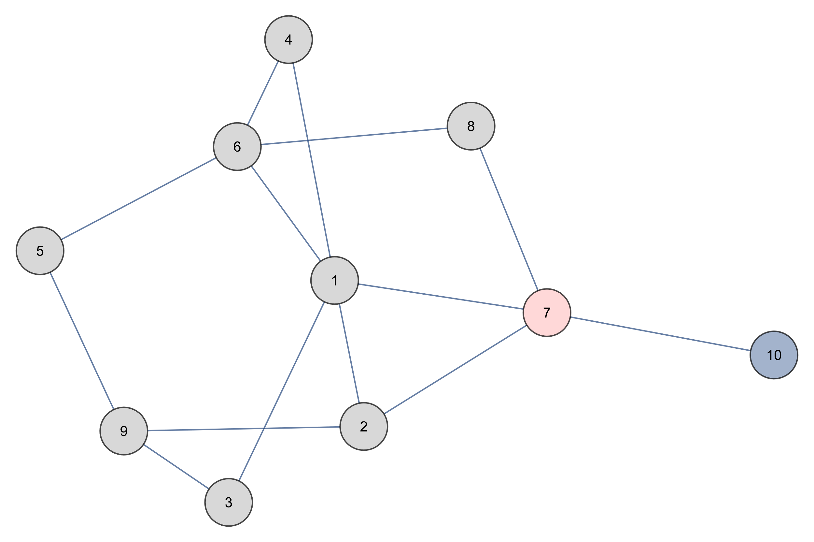
Breadth First Search
7
QUEUE

Slide 44
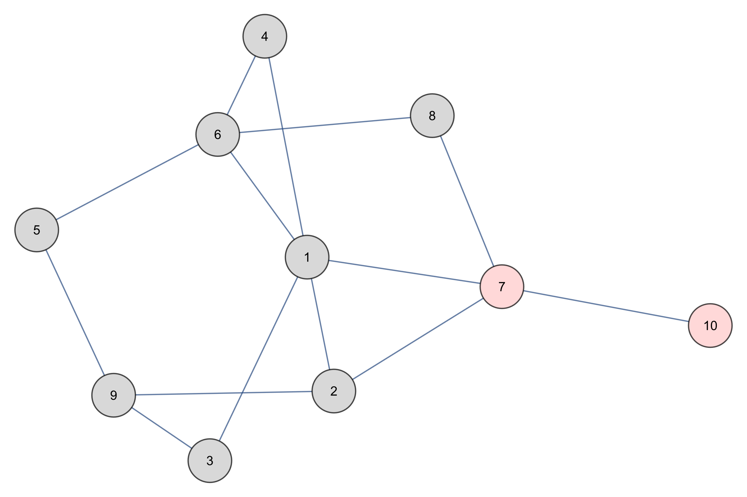
Breadth First Search
7 10
QUEUE

Slide 45
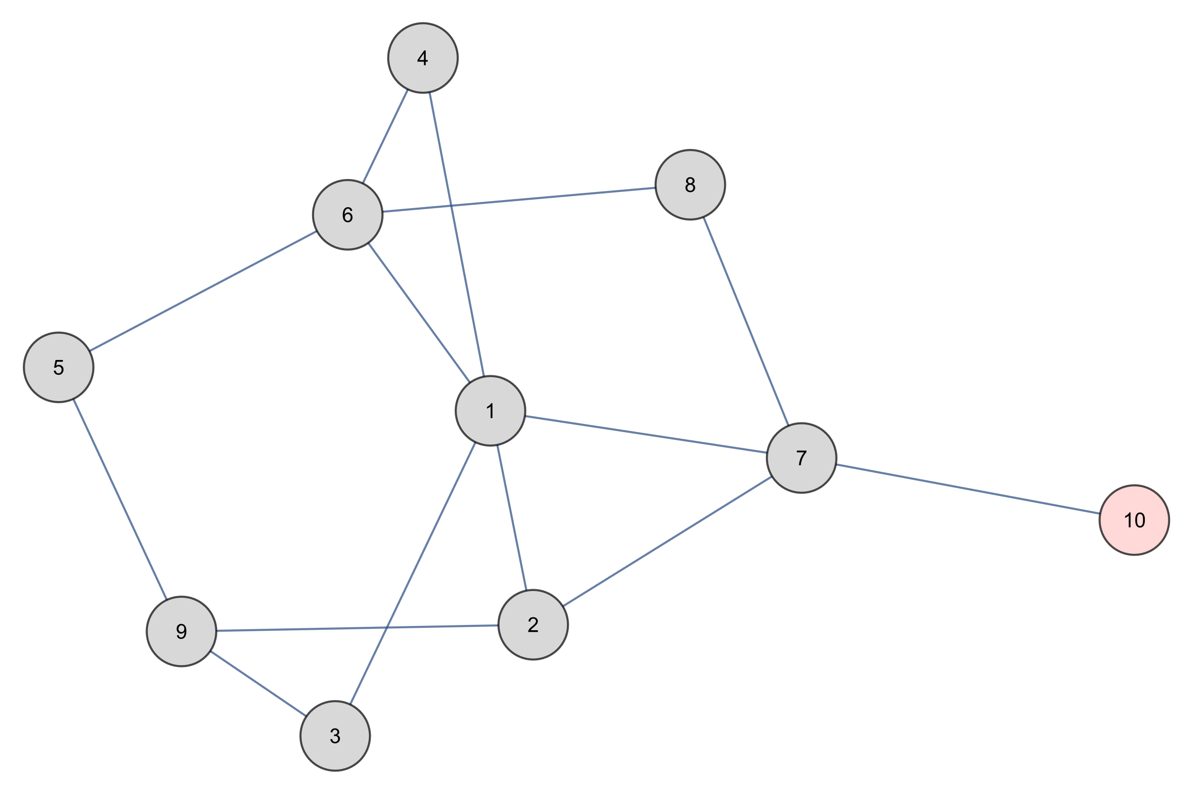
Breadth First Search
10
QUEUE

Slide 46
Breadth First Search
QUEUE

Slide 47
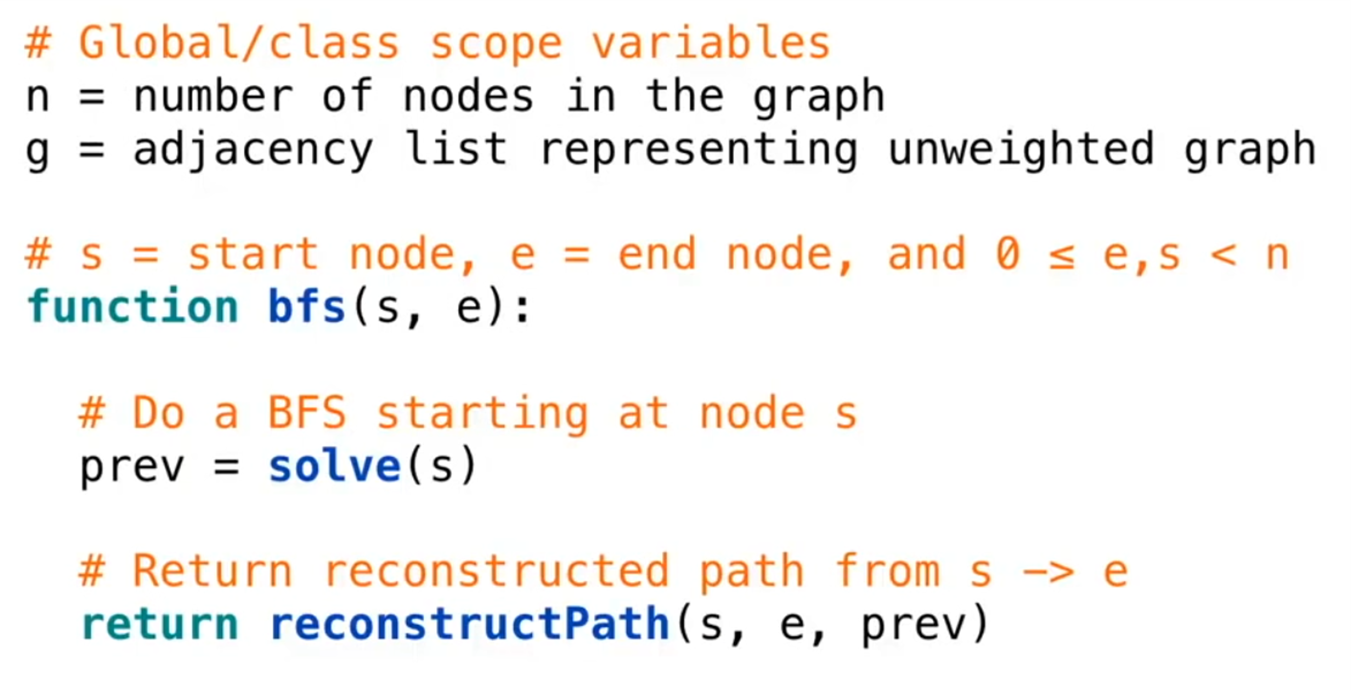
Breadth First Search

Slide 48
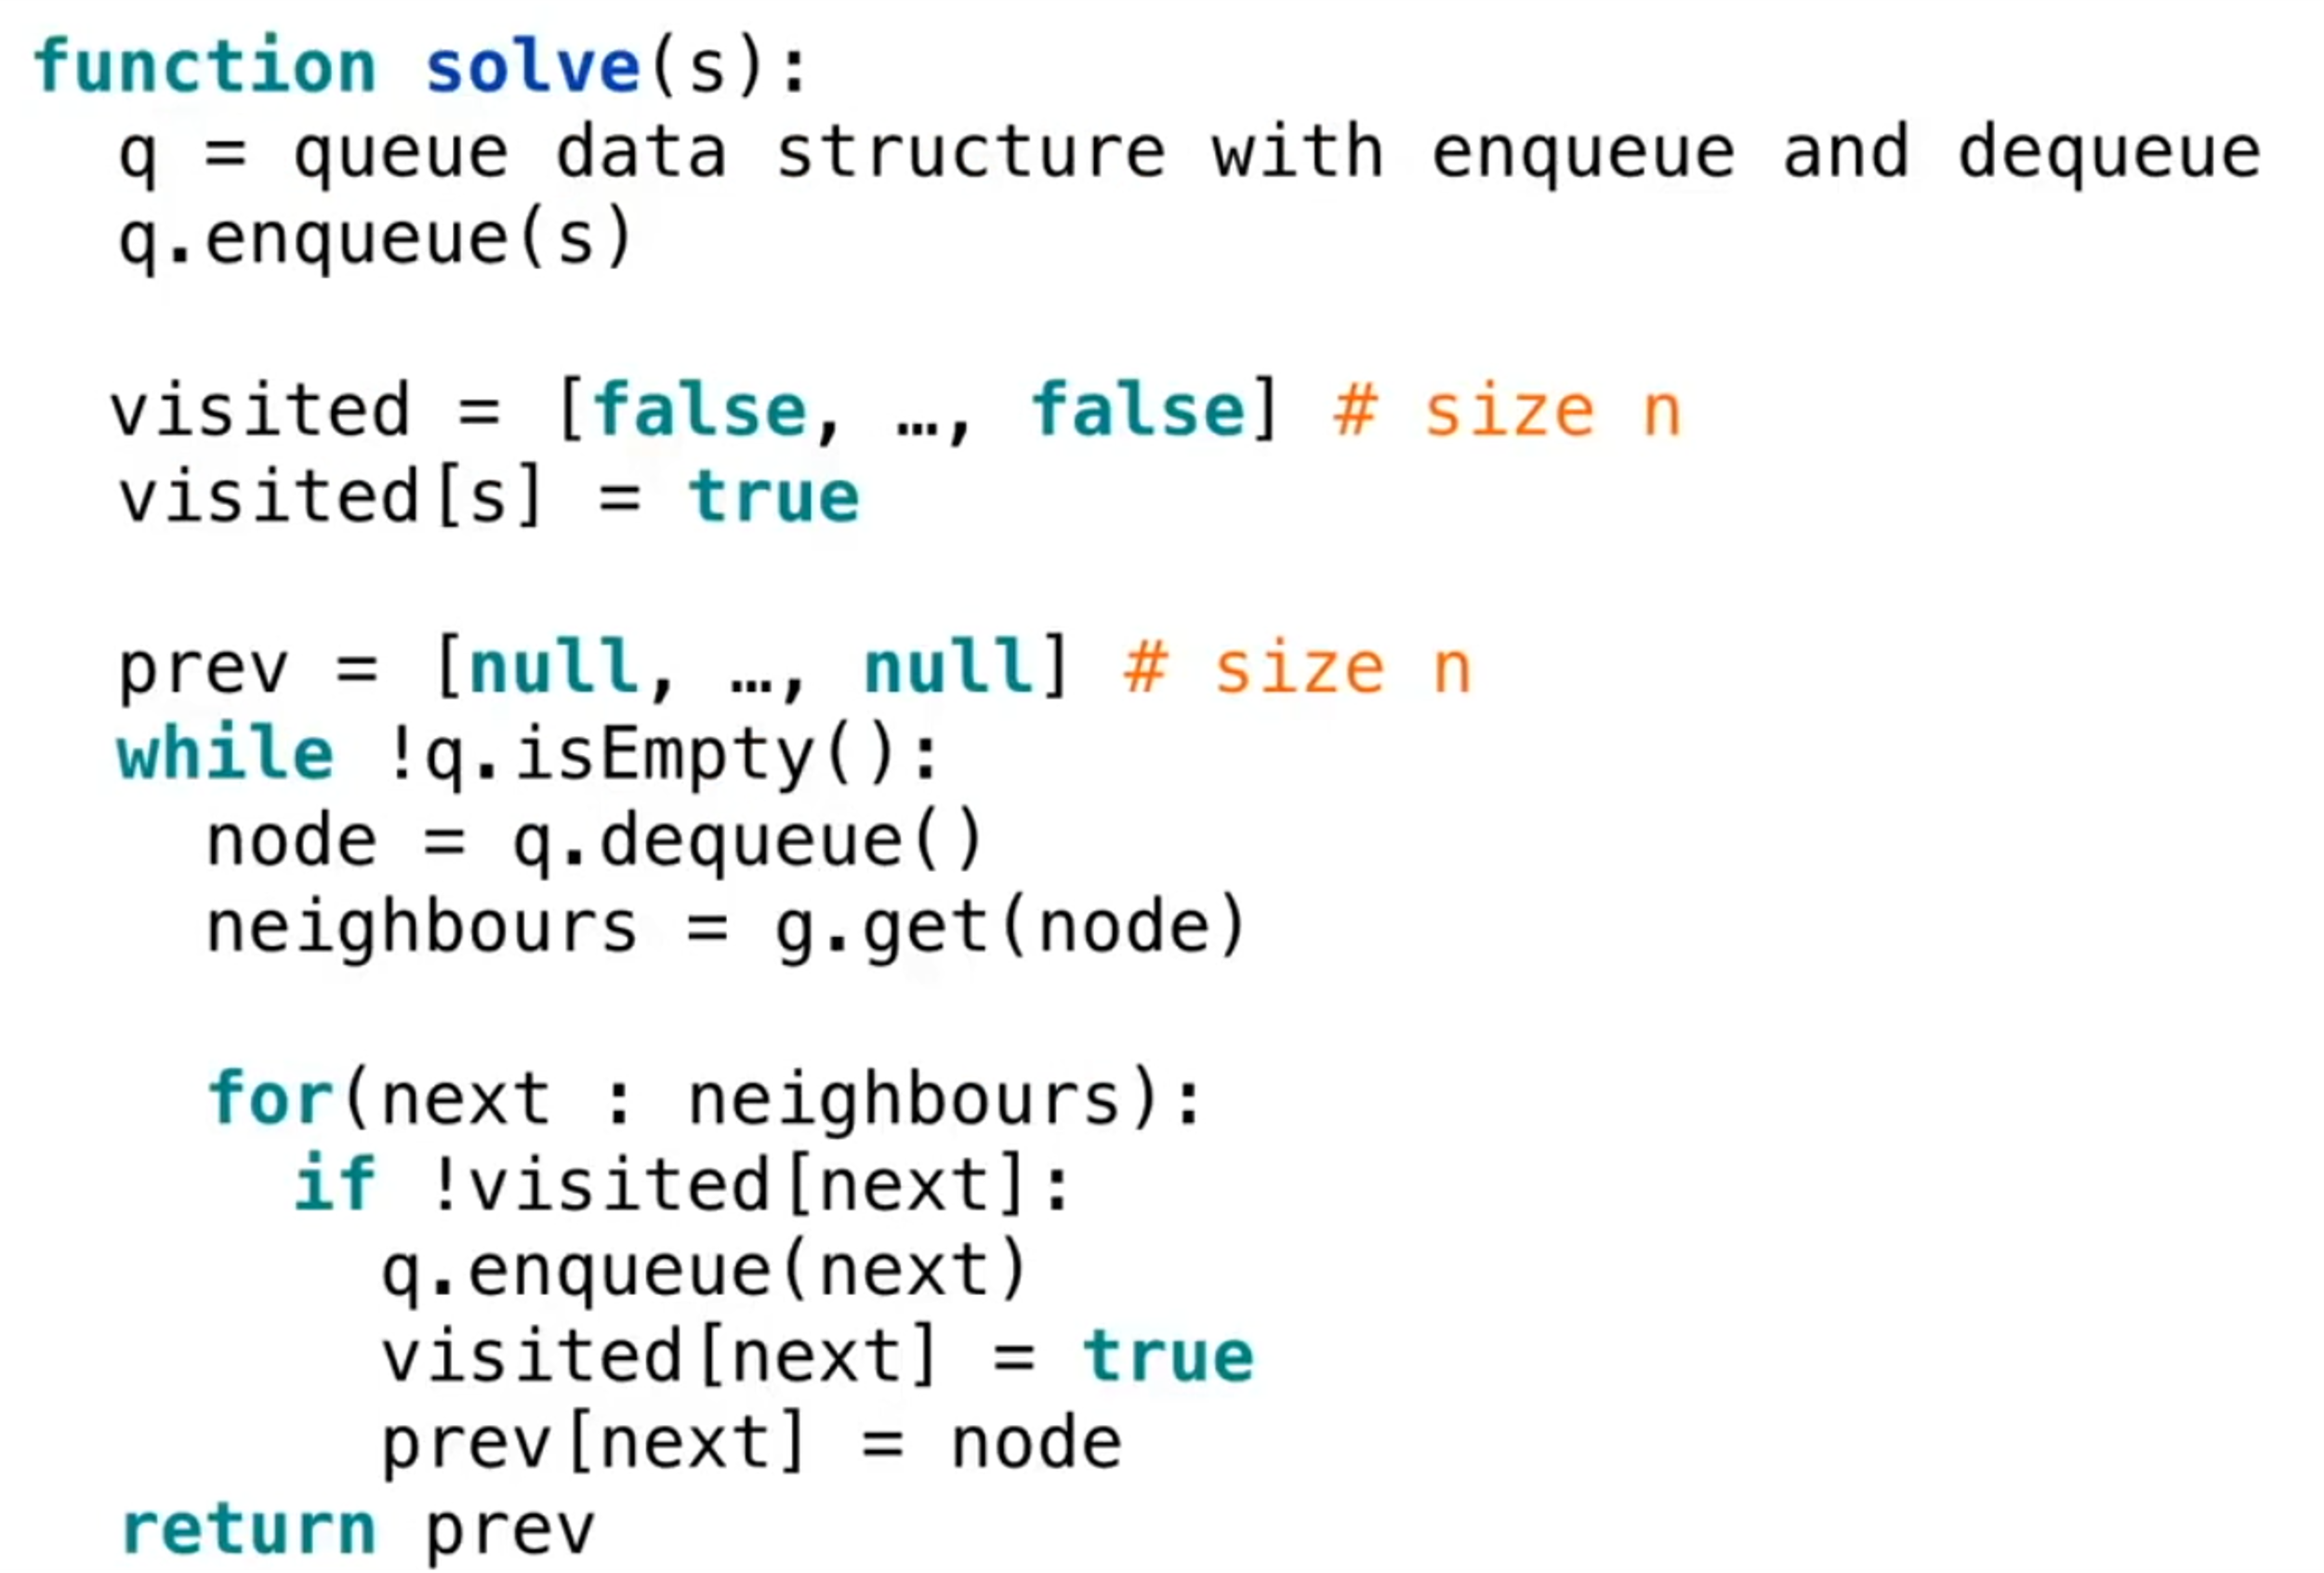
Breadth First Search

Slide 49
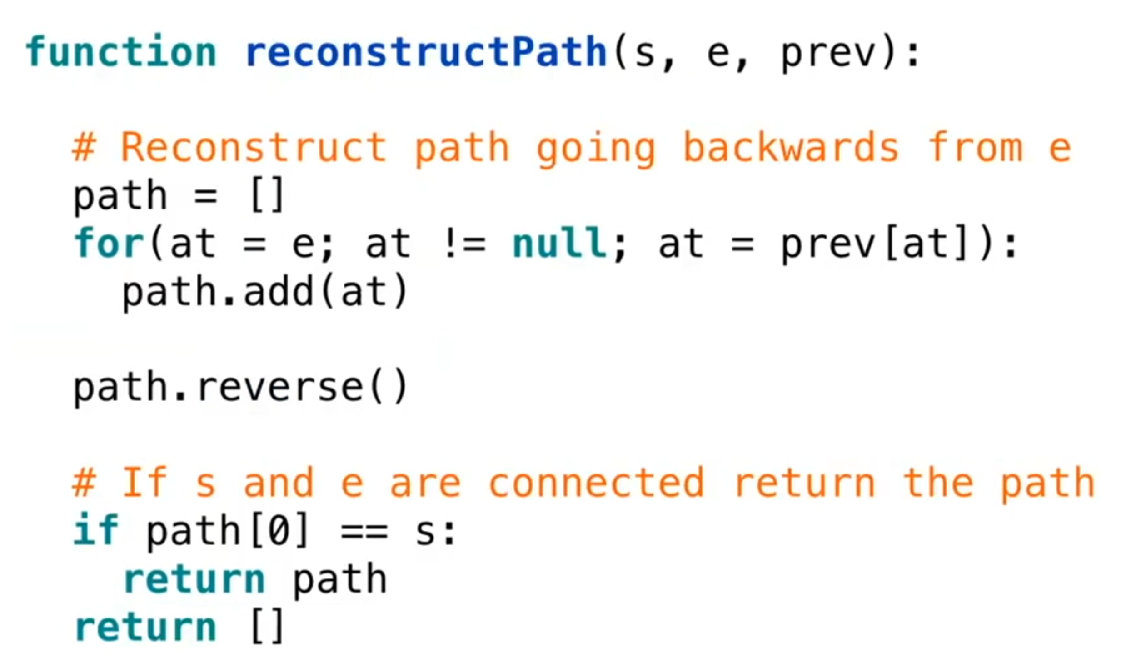
Breadth First Search

Slide 50
Shortest Path Problem

Slide 51
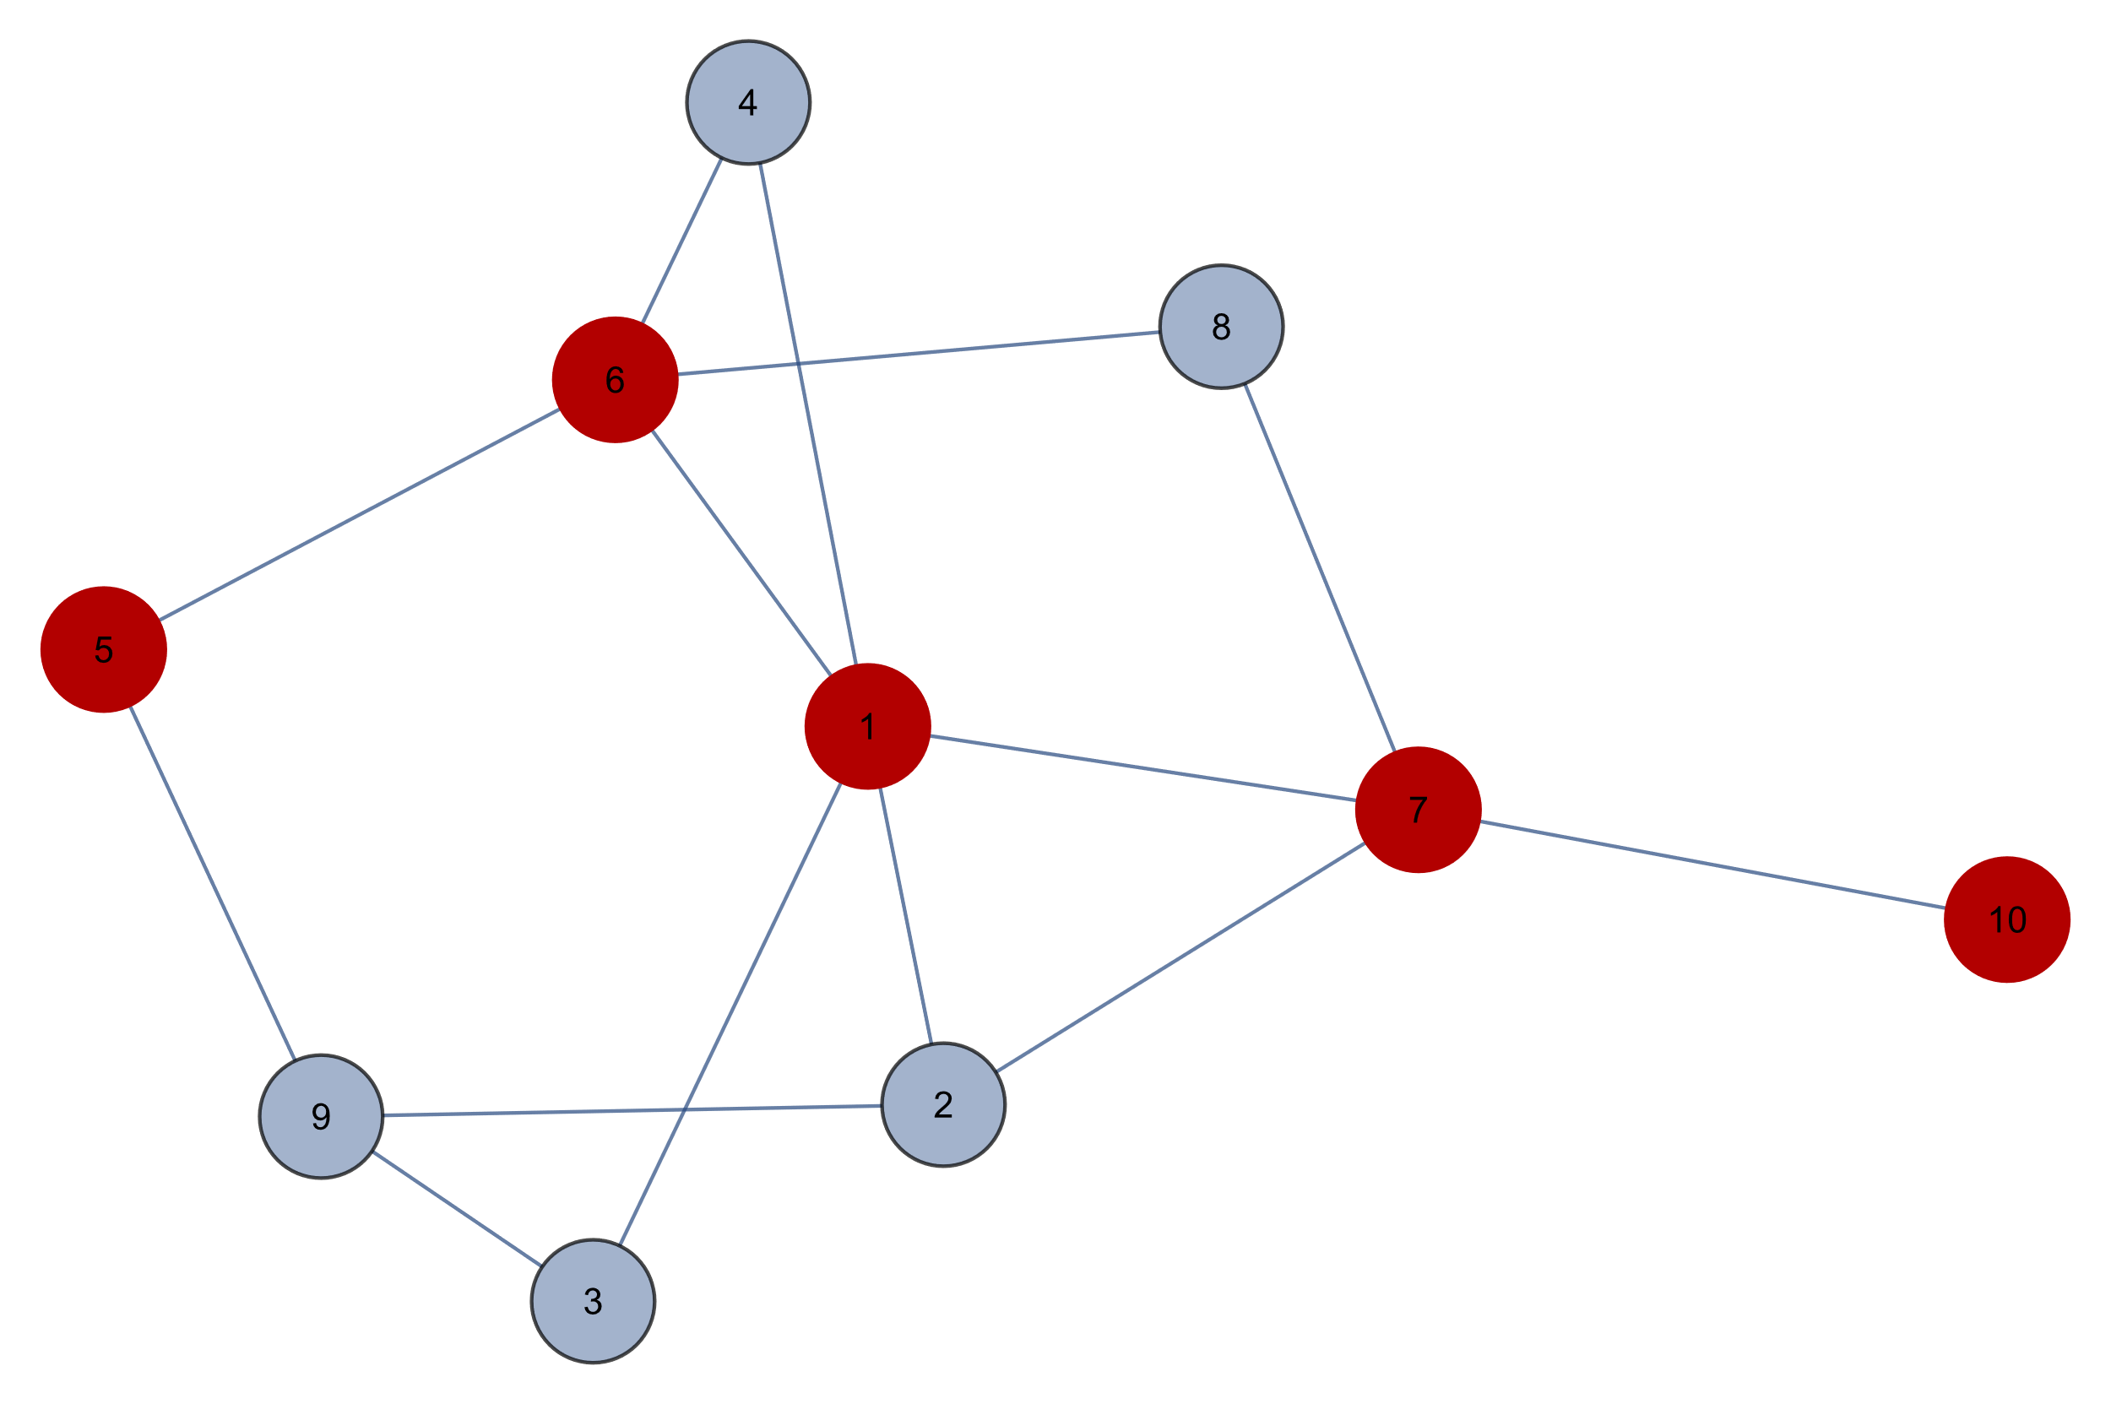
Shortest Path Problem

Slide 52
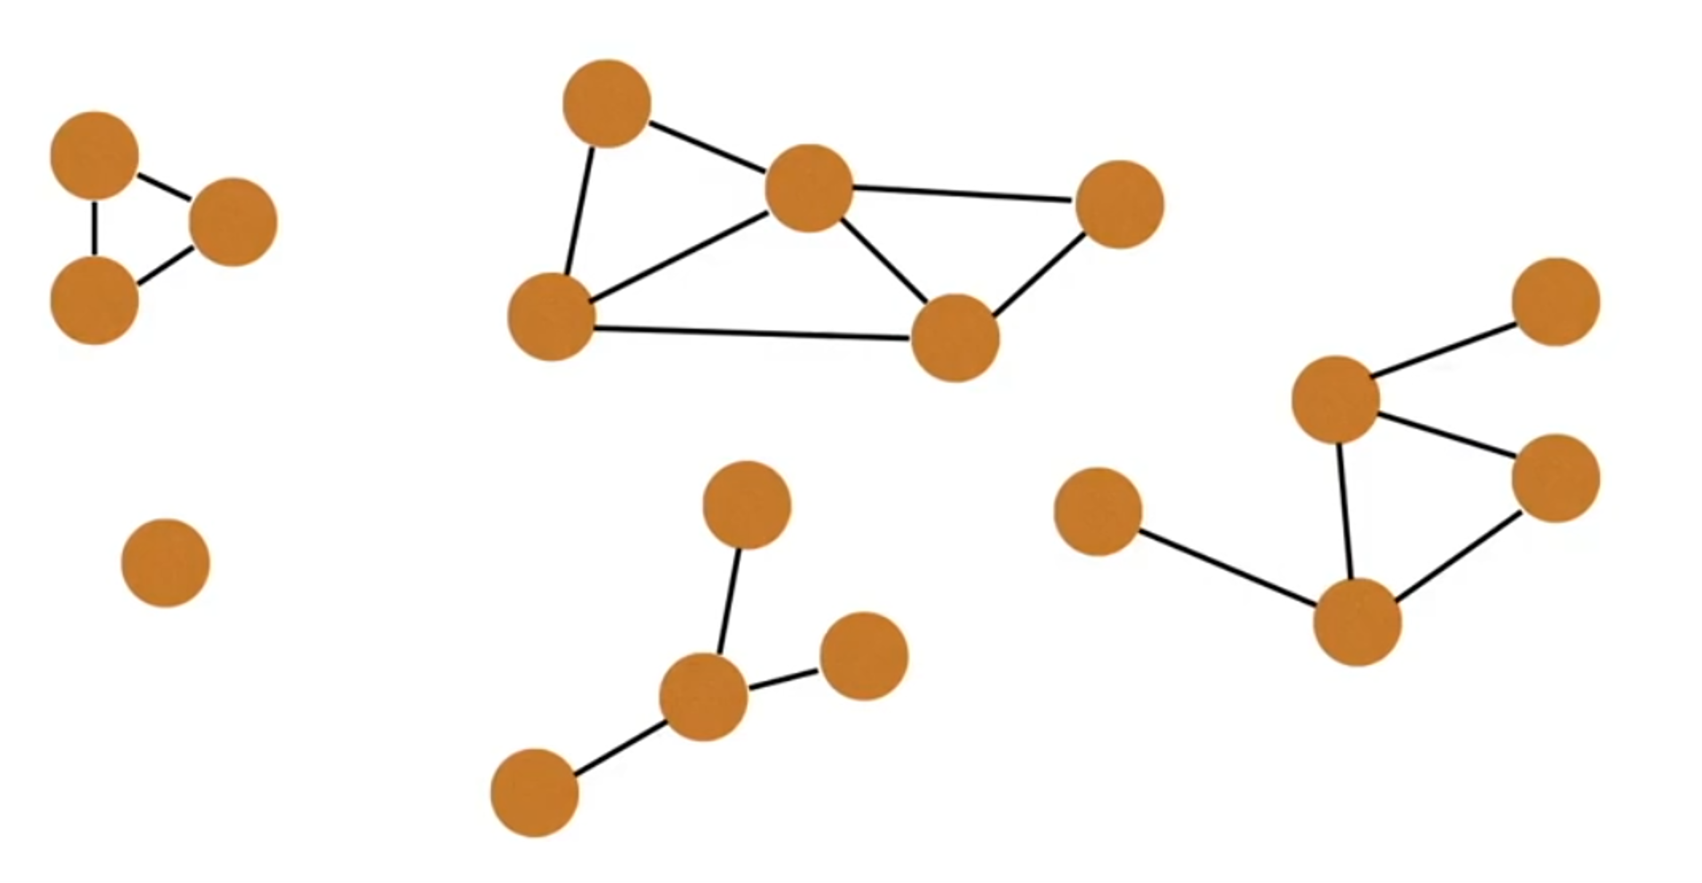
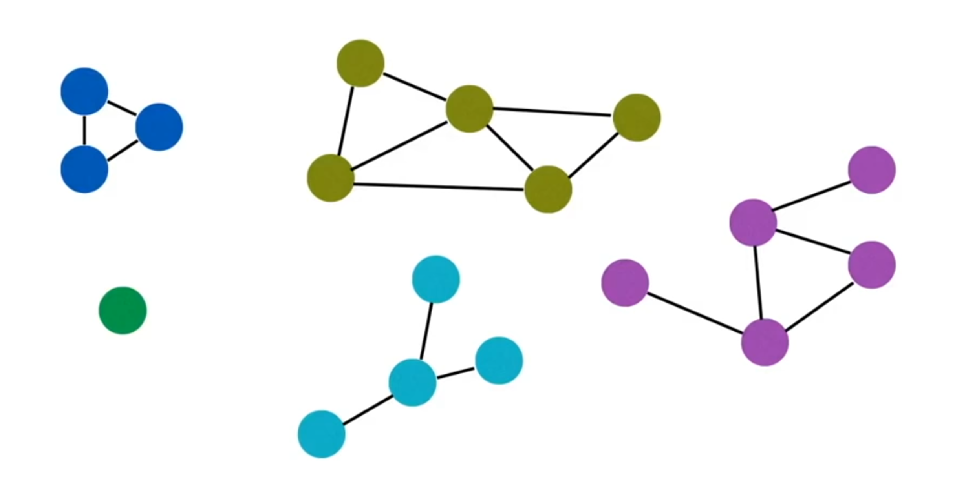
Connected Components
In graph theory, a component, sometimes called a connected component, of an undirected graph is a subgraph in which any two vertices are connected to each other by paths, and which is connected to no additional vertices in the supergraph. For example, the graph shown in the illustration has three components. A vertex with no incident edges is itself a component. A graph that is itself connected has exactly one component, consisting of the whole graph.
A graph with 5 components.

Slide 53
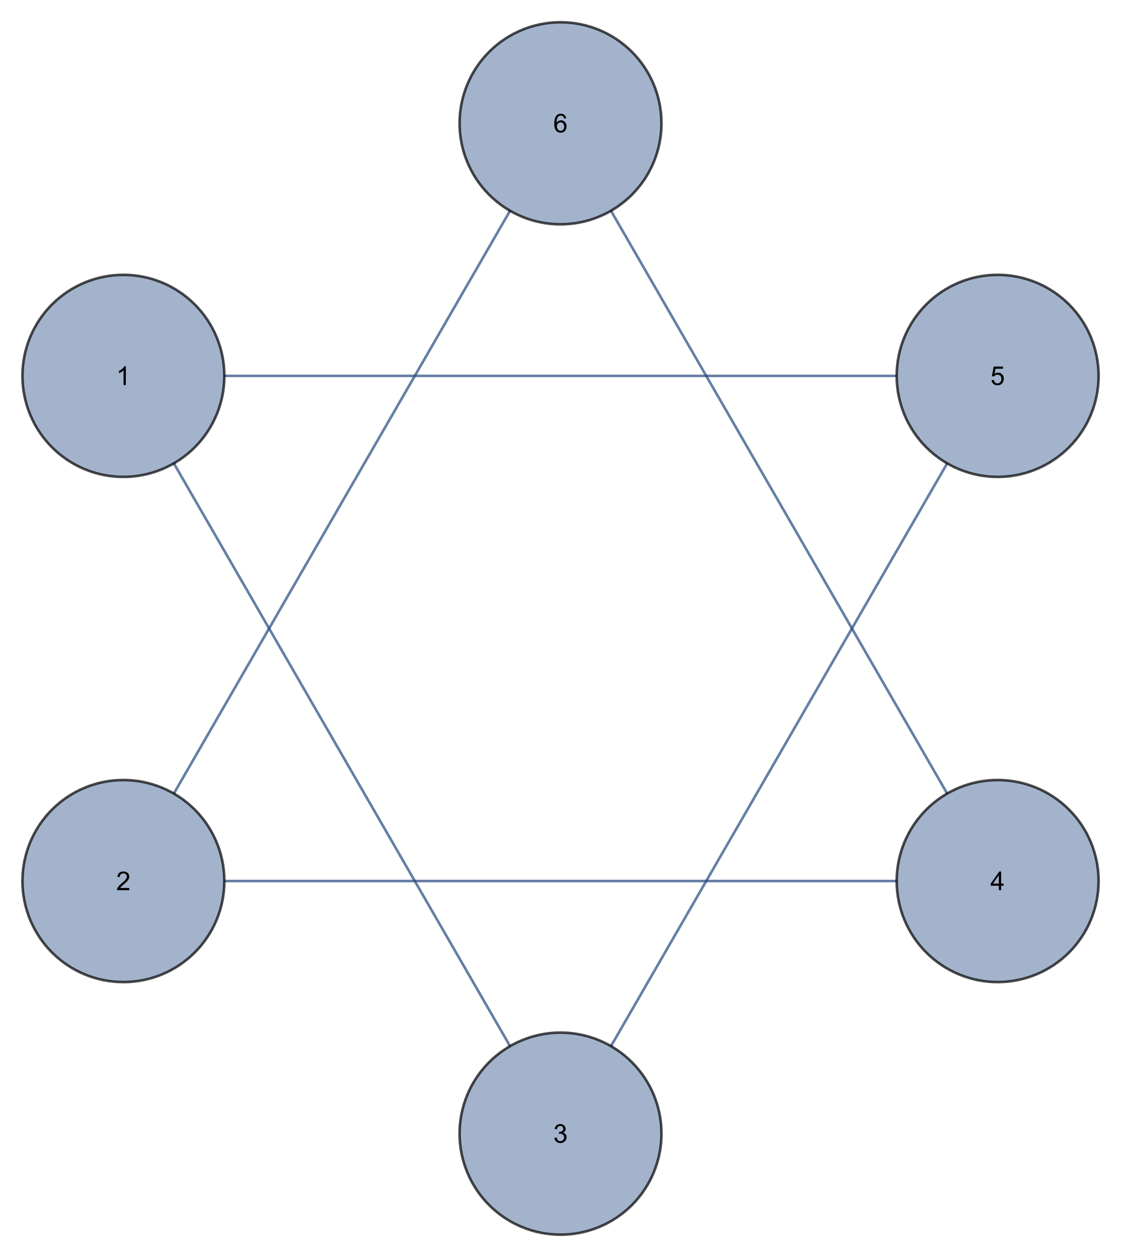
Connected Components

Slide 54
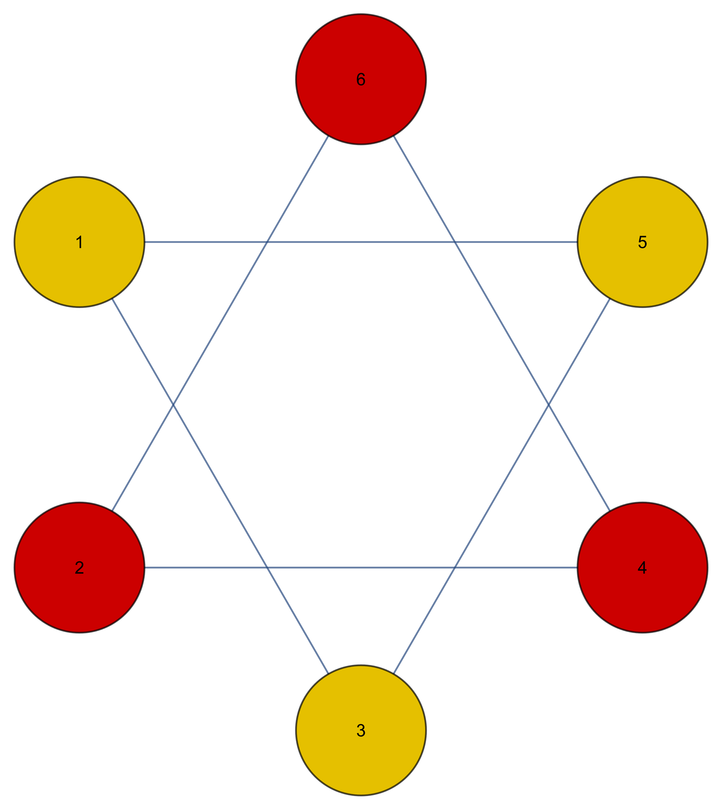
Connected Components

Slide 55


Connected Components

Slide 56

Connected Components

Slide 57

Topological Sort
In computer science, a topological sort or topological ordering of a directed graph is a linear ordering of its vertices such that for every directed edge uv from vertex u to vertex v, u comes before v in the ordering.

Slide 58

Topological Sort
In computer science, a topological sort or topological ordering of a directed graph is a linear ordering of its vertices such that for every directed edge uv from vertex u to vertex v, u comes before v in the ordering.
_ _ _ _ _ _ _ _

Slide 59

Topological Sort
In computer science, a topological sort or topological ordering of a directed graph is a linear ordering of its vertices such that for every directed edge uv from vertex u to vertex v, u comes before v in the ordering.
_ _ _ _ _ _ _ _

Slide 60

Topological Sort
In computer science, a topological sort or topological ordering of a directed graph is a linear ordering of its vertices such that for every directed edge uv from vertex u to vertex v, u comes before v in the ordering.
_ _ _ _ _ _ _ _

Slide 61

Topological Sort
In computer science, a topological sort or topological ordering of a directed graph is a linear ordering of its vertices such that for every directed edge uv from vertex u to vertex v, u comes before v in the ordering.
_ _ _ _ _ _ _ 6

Slide 62

Topological Sort
In computer science, a topological sort or topological ordering of a directed graph is a linear ordering of its vertices such that for every directed edge uv from vertex u to vertex v, u comes before v in the ordering.
_ _ _ _ _ _ 5 6

Slide 63

Topological Sort
In computer science, a topological sort or topological ordering of a directed graph is a linear ordering of its vertices such that for every directed edge uv from vertex u to vertex v, u comes before v in the ordering.
_ _ _ _ _ _ 5 6

Slide 64

Topological Sort
In computer science, a topological sort or topological ordering of a directed graph is a linear ordering of its vertices such that for every directed edge uv from vertex u to vertex v, u comes before v in the ordering.
_ _ _ _ _ 8 5 6

Slide 65

Topological Sort
In computer science, a topological sort or topological ordering of a directed graph is a linear ordering of its vertices such that for every directed edge uv from vertex u to vertex v, u comes before v in the ordering.
_ _ _ _ 4 8 5 6

Slide 66

Topological Sort
In computer science, a topological sort or topological ordering of a directed graph is a linear ordering of its vertices such that for every directed edge uv from vertex u to vertex v, u comes before v in the ordering.
_ _ _ _ 4 8 5 6

Slide 67

Topological Sort
In computer science, a topological sort or topological ordering of a directed graph is a linear ordering of its vertices such that for every directed edge uv from vertex u to vertex v, u comes before v in the ordering.
_ _ _ _ 4 8 5 6

Slide 68

Topological Sort
In computer science, a topological sort or topological ordering of a directed graph is a linear ordering of its vertices such that for every directed edge uv from vertex u to vertex v, u comes before v in the ordering.
_ _ _ 7 4 8 5 6

Slide 69

Topological Sort
In computer science, a topological sort or topological ordering of a directed graph is a linear ordering of its vertices such that for every directed edge uv from vertex u to vertex v, u comes before v in the ordering.
_ _ 3 7 4 8 5 6

Slide 70

Topological Sort
In computer science, a topological sort or topological ordering of a directed graph is a linear ordering of its vertices such that for every directed edge uv from vertex u to vertex v, u comes before v in the ordering.
_ _ 3 7 4 8 5 6

Slide 71

Topological Sort
In computer science, a topological sort or topological ordering of a directed graph is a linear ordering of its vertices such that for every directed edge uv from vertex u to vertex v, u comes before v in the ordering.
_ _ 3 7 4 8 5 6

Slide 72

Topological Sort
In computer science, a topological sort or topological ordering of a directed graph is a linear ordering of its vertices such that for every directed edge uv from vertex u to vertex v, u comes before v in the ordering.
_ 2 3 7 4 8 5 6

Slide 73

Topological Sort
In computer science, a topological sort or topological ordering of a directed graph is a linear ordering of its vertices such that for every directed edge uv from vertex u to vertex v, u comes before v in the ordering.
1 2 3 7 4 8 5 6

Slide 74

Topological Sort

Slide 75

Topological Sort

Slide 76


SSSP on DAG
single source shortest path on directed acyclic graph

Slide 77


SSSP on DAG
single source shortest path on directed acyclic graph

Slide 78


SSSP on DAG
single source shortest path on directed acyclic graph

Slide 79


SSSP on DAG
single source shortest path on directed acyclic graph

Slide 80


SSSP on DAG
single source shortest path on directed acyclic graph

Slide 81

SSSP on DAG
single source shortest path on directed acyclic graph

Slide 82


SSSP on DAG
single source shortest path on directed acyclic graph

Slide 83

SSSP on DAG
single source shortest path on directed acyclic graph

Slide 84

SSSP on DAG
single source shortest path on directed acyclic graph

Slide 85


SSSP on DAG
single source shortest path on directed acyclic graph

Slide 86

SSSP on DAG
single source shortest path on directed acyclic graph

Slide 87

SSSP on DAG
single source shortest path on directed acyclic graph

Slide 88

SSSP on DAG
single source shortest path on directed acyclic graph

Slide 89


SSSP on DAG
single source shortest path on directed acyclic graph

Slide 90


SSSP on DAG
single source shortest path on directed acyclic graph

Slide 91
SSSP on DAG
single source shortest path on directed acyclic graph

Slide 92

SSSP on DAG
single source shortest path on directed acyclic graph

Slide 93
SSSP on DAG
single source shortest path on directed acyclic graph

Slide 94

SSSP on DAG
single source shortest path on directed acyclic graph

Slide 95

SSSP on DAG
single source shortest path on directed acyclic graph

Slide 96

SSSP on DAG
single source shortest path on directed acyclic graph

Slide 97
SSLP on DAG
single source longest path on directed acyclic graph

Slide 98

Negative Cycles

Slide 99

Negative Cycles

Slide 100

Negative Cycles

Slide 101

Negative Cycles

Slide 102

Negative Cycles

Slide 103

Negative Cycles

Slide 104

Negative Cycles

Slide 105

Negative Cycles

Slide 106

Negative Cycles

Slide 107

Negative Cycles

Slide 108

Negative Cycles

Slide 109

Negative Cycles

Slide 110

Negative Cycles

Slide 111

Negative Cycles

Slide 112

Negative Cycles

Slide 113

Negative Cycles

Slide 114

Negative Cycles

Slide 115

Negative Cycles

Slide 116

Negative Cycles

Slide 117

Negative Cycles

Slide 118

Negative Cycles

Slide 119

Negative Cycles

Slide 120

Negative Cycles

Slide 121

Negative Cycles

Slide 122

Negative Cycles

Slide 123

Negative Cycles

Slide 124

Negative Cycles

Slide 125

Negative Cycles

Slide 126

Negative Cycles

Slide 127

Negative Cycles

Slide 128

Negative Cycles

Slide 129
Dijkstra algorithm Bellman-Ford Algorithm Floyd-Warshall algorithm …
The basic DFS and BFS algorithm is the building block of some more complicated algorithms.

Slide 130
References
https://github.com/williamfiset/Algorithms/tree/master/src/main/java/com/williamfiset/algorithms/graphtheory

